Slide 1

Building Small Business Cybersecurity Teams: From In-House to Outsourcing
DATE: June 3, 2026
TIME: 1:30 p.m. – 2:15 p.m.
SPEAKER: Daniel Eliot, Applied Cybersecurity Division, NIST

Slide 2
Certain commercial entities may be identified in this presentation or linked websites. Such identification is not intended to imply recommendation or endorsement by NIST, nor is it intended to imply that the entities, materials, or equipment are necessarily the best available for the purpose.

Slide 3

Goals of today
Overview of NIST SMB Program
SMB Cybersecurity Landscape
Building SMB Cybersecurity Teams
NIST SMB Cybersecurity Resources
Aligning Cybersecurity, ERM, and Workforce
Discussion

Slide 4
Is there anything specific you’d like to get out of this session?

Slide 5

Coordinating across NIST, across government, and across the SMB ecosystem to create opportunities for small organizations to better engage with NIST guidance, resources, and subject matter experts.
Coordinating across NIST, government, and the SMB ecosystem to create opportunities for small organizations to better engage with NIST guidelines, resources, and subject matter experts.
Notes:
My role is to coordinate across NIST, government, and the SMB ecosystem to create opportunities for small, underresourced organizations to better engage with NIST guidance, resources, and subject matter expertise.

Slide 6

Cybersecurity Enhancement Act of 2014
Public Law No: 113-274
Disseminate cybersecurity technical standards and best practices that small business may use voluntarily to help identify, assess, manage, and reduce their cybersecurity risks.
NIST Small Business Cybersecurity Act
Public Law No: 115-236
Notes:
Cybersecurity Enhancement Act
“to coordinate a national cybersecurity awareness and education program, that includes activities such as:
(1) the widespread dissemination of cybersecurity technical standards and best practices identified by the Director;
(2) efforts to make cybersecurity best practices usable by individuals, small to medium-sized businesses, educational institutions, and State, local, and tribal governments;
(3) increasing public awareness of cybersecurity, cyber safety, and cyber ethics;”
NIST Small Business Cybersecurity Act
“NIST must disseminate, and publish on its website, standard and method resources that small business may use voluntarily to help identify, assess, manage, and reduce their cybersecurity risks. The resources must be:
technology-neutral,
based on international standards to the extent possible,
able to vary with the nature and size of the implementing small business and the sensitivity of the data collected or stored on the information systems, and
consistent with the national cybersecurity awareness and education program under the Cybersecurity Enhancement Act of 2014.
Additionally, the resources must include case studies of practical application.”

Slide 7

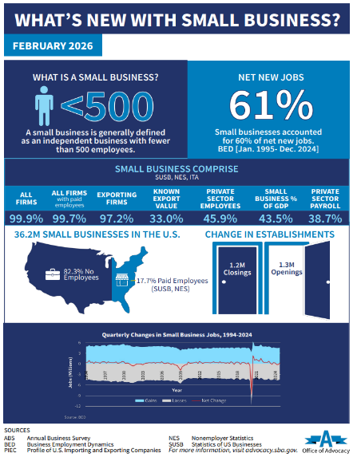
NIST SMB Cybersecurity Engagement
Small Business Communities of Interest
99.9% of U.S. businesses are small
Small Business Cybersecurity Corner
A large population that is largely
under-resourced when it comes to cybersecurity.
NIST’s small business program aims to:
Convene the SMB community
  Through in-person and virtual outreach via multiple channels
  Introduce and educate the community on NIST’s mission, research, resources, and subject matter expertise.
  Deliver cybersecurity education
  Hear the population’s cybersecurity needs and challenges.
Create small business cybersecurity content
  Derivative of NIST technical content
  Consumable and actionable by non-technical audiences
  Best practices for supporting the SMB community
Small Business Cybersecurity Events
Small Business Cybersecurity Communications
https://advocacy.sba.gov/wp-content/uploads/2026/02/FINAL_FAQsAboutSmallBusiness_2026_012826.pdf
Notes:
We often get the question: What do you mean by small business? So I like to use data to inform my work. And many of you are already probably aware that SBA defines small business as independent firms with fewer than 500 employees. We can start there. But as you dig into the data you see that of the 33 million small businesses in the country, over 81% of them are run by a single owner and have no employees. That’s a big difference from 500.
The U.S. Small Business Administration’s Office of Advocacy generally defines a small business as an independent business having fewer than 500 employees.
Of 36.2 million small businesses, around 28.5 million (82%) are run by a single owner and have no employees.
And for those with employees, small firms averaged 11.7. And new firms, those less than 2 years old, averaged 6 employees.
So with all of that in mind. When I talk about small business, I’m really talking about the micro business, with around 10 or fewer employees. Which, according to the SBA data, is really the majority of the small business community.

Slide 8
This session is a continuation of discussion
Feb 2025 NIST SMB Webinar: How Higher Ed Cybersecurity Clinics are Supporting Workforce Development and SMB
Nov 2025 Publish “Building Your SMB Cybersecurity Team” on SBCC
May 5 NIST Building Your SMB Cybersecurity Team Webinar
2024
2025
2026
2027
2024 NICE Conference & Expo
2025 NICE Conference & Expo
2026 NICE Conference & Expo
Pre-Conference Workshop: Building a Sustainable Cybersecurity Clinic in Higher Education
June 2025: Pre-Conference Workshop: Supporting Small Business Cybersecurity ​
Through Learner-Centered Services and Experiences​
July 2025: NIST Small Business Community of Interest Content Review of “Building Your SMB Cybersecurity Team”
You Are Here
Notes:
We started out high level talking about cybersecurity clinics, then got into how clinics specifically are supporting SMB. Then branched into other models of how universities aer supporting SMB beyond just clinics (SOC, professional services, etc.) then extracted insights and content into what the many options are for building out your team, beyond just higher education.
With input from our higher education partners, marrying that with input from our SMB COI, what we ended up with was a resource that covers a lot of ground, which we’ll cover here today. And I hope this leaves room to continue the discussion.
Expanding the discussion.
Opportunities to support local/regional small business communities.
Continuing capacity building/knowledge sharing.
Any thoughts on what should be next?

Slide 9
What cybersecurity challenges are SMBs facing?
Notes:
how can small businesses begin addressing cybersecurity risks? What are challenges unique to SMB?
3) Ask and Address: What are various approaches/models for SMB's to build out cybersecurity teams (We'll specifically discuss
upskilling existing staff, hiring considerations, outsourcing, leveraging local resources like colleges or universities, etc.) and will include
how the NICE Framework can assist with these efforts.
4) Discuss: What additional resources do SMBs need to support their workforce efforts? What are additional effective models we have
not yet addressed?

Slide 10
Research Insights
“Top challenges…include lack of funds, shortage of in-house cybersecurity skills, and the increasing prevalence of cybersecurity requirements in contracts with larger organizations” [1].
“A literature review suggests deficiencies that could prevent SMEs from implementing security controls and precautions fall into three categories:
(1) not understanding the importance of cybersecurity to their business continuity,
(2) lack of cyber situational awareness, and
(3) lack of resources needed to implement cybersecurity precautions and controls [4].”
“Larger SMBs typically have more structured IT arrangements, while smaller ones…often rely on DIY approaches or informal IT support” [1].
SMB's often don't know which assets to protect and underestimate risks [2].
Reaching out for technical support often reactive, not proactive [3].
Belief that securing the organization or improving cybersecurity posture is costly [3].
Low levels of cybersecurity knowledge among SMB; comprehension, capability and attitudes adversely affect SMB's ability and willingness to act [3].
Lack of tangible benefits from efforts and investment in cybersecurity possibly results in disengagement [3].
“…significant disparities between SMEs self-reported cybersecurity practices and evidence from expert assessments [5].
[1] Chidukwani, A., Zander, S., and Koutsakis, P “Cybersecurity preparedness of small-to-medium businesses: A Western Australia study with broader implications” Computers & Security Volume 145, October 2024, 104026. https://doi.org/10.1016/j.cose.2024.104026
[2] Bada, M., Nurse, J.R., 2019. Developing cybersecurity education and awareness programmes for small-and medium-sized enterprises (SME)
DOI https://doi.org/10.11.1108/ICS-07-2018-0080
[3] Khan, N., Furnell, S., Bada, M., Rand, M., Nurse, J., 2024. Investigating the experiences of providing cyber security support to small-and medium-sized businesses. DOI https://doi.org/10.1016/j.cose.2025.104448
[4] Renaud, K., Ophoff, J. (2021) A cyber situational awareness model to predict the implementation of cyber security controls and precautions by SMEs: https://www.emerald.com/insight/content/doi/10.1108/OCJ-03-2021-0004/full/html
[5] Chidukwani, A., Zander, S., and Koutsakis, P “Beyond self-reporting: Uncovering the operational realities of SME cybersecurity through expert assessment” Computers & Security, Volume 164, May 2026, 104839.
https://doi.org/10.1016/j.cose.2026.104839
Notes:
Must of this probably won’t be surprising to you.
Challenges with putting cybersecurity into practice in balance with running a business.
Clear that SMBs need help. Not only in implementation, but also in understanding the benefits of implementing cybersecurity. Understanding what resources are out there.
So I have set out of the last few years to begin identifying various ways the SMB community can close the skills gap (CLICK). To raise awareness of options and resources so they don’t feel like they are in this alone.

Slide 11
2025 Verizon Data Breach Investigation Report
Top patterns for SMB (<1,000 employees): system intrusion, social engineering, and basic web application attacks represent 96% of breaches.
  Pattern of stolen credentials account for 32% (SMB) and 33% (large orgs (33%)
  Social attacks, primarily phishing, accounts for 18% (SMB) and 13% (large organizations).
  Ransomware comprises 39% breaches for large orgs, 88% for SMB
  Primary actors are financially motivated (99%) external actors of the organized crime variety.
  Error or misuse very rare in SMB.
  Nation-state actors rarely targeting SMB
https://www.verizon.com/business/resources/reports/dbir/
Similar % for both, however security budgets and resources are vastly different
Notes:
Clear indication ransomware groups are not only targeting large orgs—targeting anyone and adjusting ransomware demands accordingly. SBMs less likely to have up-to-date and readily available backups than a large organization.
BEC is a scam targeting businesses or individuals working with suppliers and/or businesses regularly performing wire transfer payments. These sophisticated scams are carried out by fraudsters by compromising email accounts and other forms of communication such as phone numbers and virtual meeting applications, through social engineering or computer intrusion techniques to conduct unauthorized transfer of funds. In 2023, the IC3 saw a growth in BEC reporting where funds were sent directly to a financial institution housing custodial accounts held by third-party payment processors, or peer-to-peer payment processors, and cryptocurrency exchanges (PSA I-041321-PSA and PSA I-082423-PSA) which directly contributed to the increase in global exposed losses.

Slide 12
Building Small Business Cybersecurity Teams: From In-House to Outsourcing

Slide 13
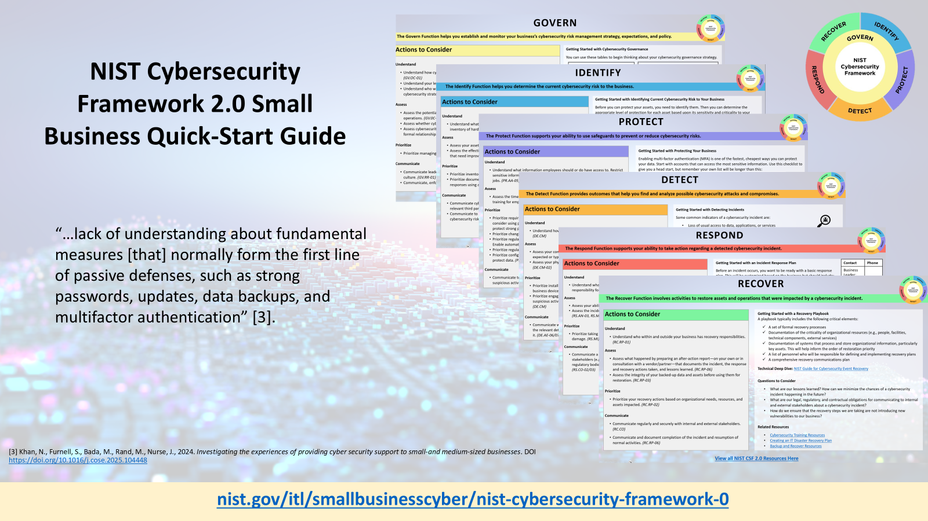

Slide 14


Local Cyber Champions: Where Workforce Development and SMB Support Coalesce
Model | Example(s)
Cybersecurity Clinics | Louisiana State University Cybersecurity Clinic University of Nevada, Las Vegas Cybersecurity Clinic
Student-led SOCS | Metropolitan State University of Denver Security Operations Center
Professional Services | Purdue University CyberTAP
SMB Cyber Centers and Support | Del Mar College Cyber Center Michigan SBDC Small Business, Big Threat
Apprenticeship programs | CyberSC Apprenticeship Program
Internships | George Mason University/Commonwealth Cyber Initiative Cyber Start-Up Internship Program Carolina Cyber Network Cybersecurity Internship Program
NICE Framework in Action:
Can be used as a tool for structuring apprenticeships and internships that clearly identify Work Roles to identify learning needs and skills gaps, determine competencies, and build work-based learning opportunities.
Learning content aligned with the NICE Framework serves as a common language to communicate with and support employer needs and describe learner capabilities.
Questions
Are there existing programs in your area that blend workforce development and SMB support?
What mechanisms are there to collect local SMB cybersecurity/workforce challenges so your program can address their needs adequately?
Are there other successful models supporting SMB that are not mentioned on this slide?
SMB's often don't know which assets to protect and underestimate risks [2].
Reaching out for technical support often reactive, not proactive [3].
Low levels of cybersecurity knowledge among SMB; comprehension, capability and attitudes adversely affect SMB's ability and willingness to act [3].
“…significant disparities between SMEs self-reported cybersecurity practices and evidence from expert assessments [5].
[2] Bada, M., Nurse, J.R., 2019. Developing cybersecurity education and awareness programmes for small-and medium-sized enterprises (SME)
DOI https://doi.org/10.11.1108/ICS-07-2018-0080
[3] Khan, N., Furnell, S., Bada, M., Rand, M., Nurse, J., 2024. Investigating the experiences of providing cyber security support to small-and medium-sized businesses. DOI https://doi.org/10.1016/j.cose.2025.104448
[5] Chidukwani, A., Zander, S., and Koutsakis, P “Beyond self-reporting: Uncovering the operational realities of SME cybersecurity through expert assessment” Computers & Security, Volume 164, May 2026, 104839.
https://doi.org/10.1016/j.cose.2026.104839
Notes:
Here’s where workforce development and SMB support coalesce.
There are quite a few creative approaches to helping close the resource/skills gap for small businesses—many while also providing valuable hands-on learning experiences for students—some much more focused on workforce than others.
The LSU Cybersecurity Clinic (LCC) is a collaborative effort between the University and the Louisiana Small Business Development Center (LSBDC), funded by the NSA. Our core mission is to extend access to pro-bono cybersecurity clinic services to small businesses that otherwise cannot afford to hire a consultant.
LCC runs three specialty sub-clinics:
Threat and Vulnerability Assessment Clinic (Red Team)
Cyber Risk Assessment Clinic (Green Team)
Cyber Defense Clinic (Blue Team)
The UNLV Cyber Clinic is a student-led organization that provides small businesses with cybersecurity measures to reduce the risk of hacking, ransomware, phishing attacks, and other cybercrimes. In collaboration with the UNLV Office of Economic Development and the Nevada Small Business Development Center (SBDC), the clinic works with SBDC clients to identify vulnerabilities in their computer systems and protect them from online threats.
cyberTAP specializes in professional services, including cyber risk assessments, gap analysis, technical testing, and policy & procedure guidance. cyberTAP conducts over 200 projects per year, meeting the demand for quality cyber consultancy, and improving client cyber posture.
The Del Mar College Cyber Center assists small and mid-sized businesses improve cybersecurity through increasing cyber awareness, systems and response plans, policies and employee training. Additionally, the Cyber Center is a resource for companies seeking CMMC Level I compliance.
CyberSC: In collaboration with Apprenticeship Carolina, CyberSC offers tailored support to help small- and medium-sized businesses in South Carolina grow their talent pipeline through registered apprenticeship programs.
GMU’s Cyber Start-Up imitative enables undergraduate students studying cybersecurity and related fields to gain practical real-world experience in the field, while simultaneously providing startups and small businesses with access to much-needed talent. To this end, the Cybersecurity Start-Up Internship supports both the nurturing of the cyber talent pipeline and the growth and development of the Virginia's ecosystem of innovation and entrepreneurship. Startup companies interview candidates and select their interns, who are then put on George Mason University's payroll for $19 an hour. Students work up to 125 hours during the program and are expected to complete projects defined by the host startup. Additionally, participants regularly meet with the program administrators and host companies to ensure maximum growth from the program.
Carolina Cyber Network: The two-tiered structure is designed to support students at different points in their academic journey, ensuring each experience is aligned with their readiness, goals, and future aspirations. All internships are paid at $15/hour, offered in remote or hybrid format, and vary in duration and scope based on host organization needs. Students paired with SMB community through their CyberSafe Communities program. CyberSafe Communities is a community outreach initiative delivered through Carolina Cyber Network member schools to help small businesses, nonprofits, municipalities, and community organizations strengthen cybersecurity awareness and resilience.

Slide 15

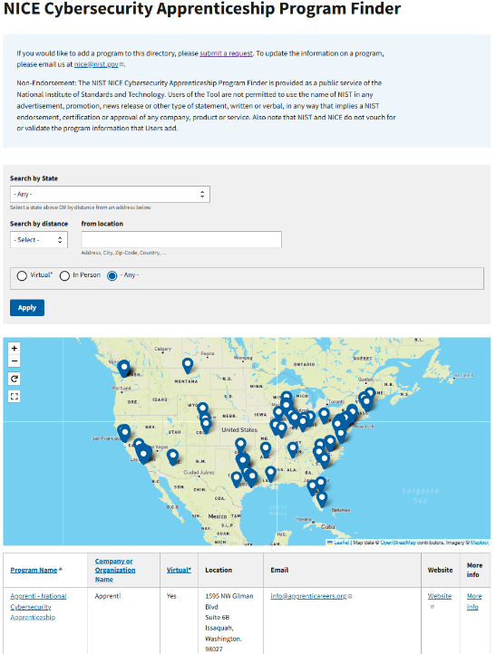
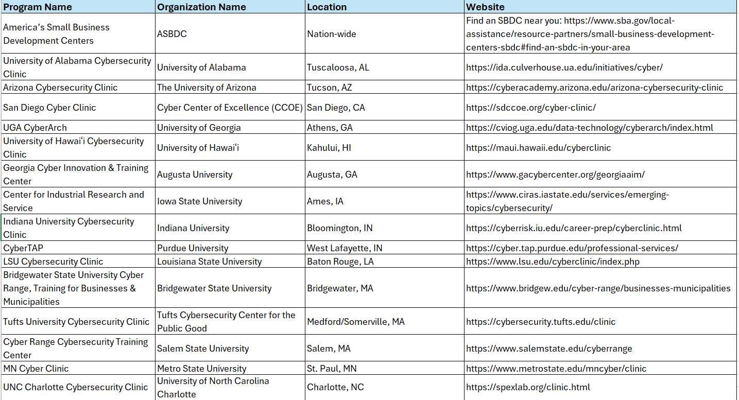
Work in Progress
Small Business Cybersecurity Support Programs Finder
Notes:
The Small Business Cybersecurity Support Programs Finder is a tool to help small businesses; non-profits; state, local, tribal, territorial governments (SLTT); and other under-resourced entities locate programs throughout the United States that are hosted by non-profit institutions and that have dedicated services helping their region’s small business community proactively manage cybersecurity risks. Resources include conducting risk assessments and penetration tests, compliance services, helping with preparedness and response measures, and more. Programs that do not provide direct services are excluded from this list.
Approximately 81 on list from across U.S.
Non-Endorsement: The NIST Small Business Cybersecurity Support Programs Finder is provided as a public service of the National Institute of Standards and Technology. Users of the Tool are not permitted to use the name of NIST in any advertisement, promotion, news release or other type of statement, written or verbal, in any way that implies a NIST endorsement, certification or approval of any company, product or service. NIST does not vouch for or validate the programs listed within the tool.

Slide 16
Longer-Term Options for SMB
Examples
NICE Framework in Action:
Language from the framework can be used to articulate the cybersecurity work that needs to be performed – including what knowledge and skills are needed to complete that work.
The NICE Employer’s Guide goes into detail about how to use the NICE Framework when hiring so that you will be equipped to author and communicate about position responsibilities and find the candidate that meets your goals.
The framework also provides a great starting point to think about career pathways for long-term success.
  Upskilling existing IT staff with cybersecurity skills to make cybersecurity part of their responsibilities.
  Upskilling software developers to equip them with the skills for secure code development as part of a secure software development lifecycle.
Upskilling and Reskilling
  Managed security service providers (MSSPs), cloud service providers (CSPs) and managed detection and response (MDR)
  Virtual Chief Information Security Officers (CISOs) or consultants
  Co-managed or hybrid security
Contracting and Outsourcing
  Full or part time security manager or analyst
  A “bridge-builder” between technical and operational. Cross-functional.
Questions
What skills, beyond technical, need to be developed or demonstrated to ensure the first hire, upskilled staff, or vendor will be successful?
How can we better support upskilling or reskilling staff at small businesses?
Are students equipped to support cybersecurity in resource-constrained environments?
Hiring In-House Cybersecurity Expertise
All these decisions should be based business model, resources, and needs.
Helpful Resources:
Defense Industrial Base Managed Service Provider Shopping Guide for Small & Medium-Sized Businesses (ND-ISAC)
When and How to Get Outside Cybersecurity Support, Cyber Readiness Institute
Notes:
Co-managed security is a hybrid model where an internal IT team works alongside an external managed security service provider (MSSP) to monitor, detect, and respond to threats. This partnership allows organizations to keep internal control of their IT strategy while leveraging external expertise for 24/7 monitoring, advanced tools, and specialized security tasks, providing "the best of both worlds“
MSSPs primarily focus on managing security infrastructure and tools to prevent security breaches, while MDR providers concentrate on identifying and responding to threats. MDR providers offer a comprehensive cybersecurity approach that includes incident response and proactive threat hunting.
The first cybersecureity hire is often responsible for a breadth of internal and external-facing initiatives, such as working closely with engineers, securing laptops, overseeing regulatory compliance, and talking with customers about contracts. “Just as important as it is to build security around your product, it’s prudent to build security into your product,” he shared.
Where does my data exist in the vendor environment?
Does the vendor outsource anything to subcontractors?
If we terminate our relationship with you, what is the process for offboarding and handing back access, data, documentation?

Slide 17

Building a Culture
Where can a small business start?
Role-specific content
Leadership buy-in and support
Explain the “why”
Routine training and awareness
Non-punitive environment
Encourage communication
Policies that are easy to understand and accessible
NICE Framework in Action:
The NICE workforce management guidebook, Cybersecurity is Everyone’s Job, outlines what individuals across an organization, regardless of type or size, can do to protect the organization.
“Results indicate that small business owners are often likely to have the basic tools related to technology risk management in place, but lack the policies, procedures, and training to secure their information resources” [7].
[7] Berry, C. T., & Berry, R. L. (2018). An initial assessment of small business risk management approaches for cyber security threats. International Journal of Business Continuity and Risk Management, 8(1), 1-10.
Questions
Beyond providing one-off services, how can outreach programs help develop a culture of cybersecurity within SMBs?
Additional Resources
Free and Low-Cost Online Cybersecurity Learning Content
NIST Small Business Cybersecurity Corner
Notes:
Most small businesses won’t have staff dedicated to providing cybersecurity awareness training, but there are many resources available to help make sure that this key activity isn’t overlooked. Regularly providing basic and advanced cybersecurity training to new and existing staff helps them understand the security risks associated with their work-related activities and the steps they can take to minimize those risks. You might also be required to provide a certain level of training to your staff based on regulatory, contractual, or legal requirements.
A great place for all businesses, of any size, to start is with providing training opportunities to help all staff understand their role in protecting the business from cybersecurity risks. Building your cybersecurity team involves creating a culture of cybersecurity across the business, at every level.

Slide 18
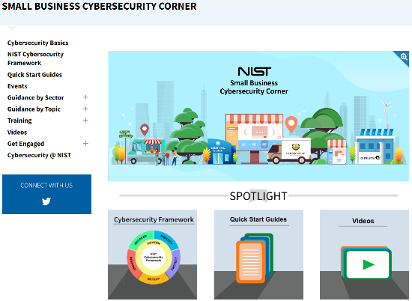
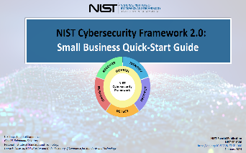
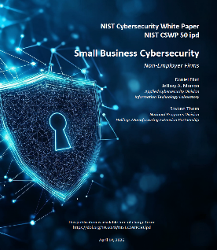
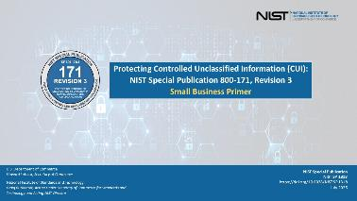
NIST SMB Cybersecurity Resources
www.nist.gov/itl/smallbusinesscyber
Notes:
The hub of our SMB resources is the NIST Small Business Cybersecurity Corner website. The resources on this site are all tailored to small business. These include short videos, tip sheets, case studies, quick start guides, and guidance organized by both topic and industry.
The resources are all free and draw from information produced by federal agencies, including NIST, the FBI, the Department of Homeland Security’s Cybersecurity and Infrastructure Security Agency, or CISA, as well as non-profit organizations.
We do have a specific section on government contractor resources. I have the DIB MSP Shopping Guide for SMB on this page. I wonder if there are other products of this working group that I should include on this page?
I’ve been intentional with how I approach SMB content at NIST. My goal is to create pathways into NIST content. Derivative pieces or extractions of NIST content that helps translate some of the technical language and concepts and that gives businesses a start—recognizing that levels of familiarity with NIST content varies across the SMB community, and the ability to understand and implement varies. So right now I’m trying to work across NIST to create some content that creates an on-ramp to NIST guidance.

Slide 19


NIST SMB Cybersecurity COI
Convening companies, trade associations, and others who can share business insights, expertise, challenges, and perspectives to guide our work and assist NIST to better meet the cybersecurity needs of small businesses.
Over 21,000 individuals have already joined the full COI since
March 6, 2023.
Quarterly meetings to share resources, updates, host guest speakers, and have robust discussion.
2026 meetings:
February 18
June 10
September 16
nist.gov/itl/smallbusinesscyber/join-community-interest
Notes:
On March 6, 2023, NIST launched the small business community of interest that creates more opportunities for the exchange of information, resources, and ideas between NIST and the nation’s small business community. It was designed to bring together the small business community, companies, trade associations, and others who can share business insights, expertise, challenges, and perspectives to guide our work.
Our next call is on June 10, 2026. I’ll share updates to the NIST SMB cybersecurity program, we’ll have a guest speaker from the NIST Cybersecurity Supply Chain Risk Management team.
I’m just one person, so trying to balance making sure that I’m taking plenty of time to engage with the SMB community, both SMB owners and operators and their ecosystem partners, to listen and understand their challenges and see where we might work to support them. Balancing listening with then delivering. These COIs have been a great source of input for me. Participating in forums like this today have also been valuable and I do things like this pretty regularly with various communities, trade associations, etc. Our SMB webinar series has been another great source of input and dialoge. And lurking in Reddit has been great source of seeing what questions SMBs are asking.

Slide 20
Aligning Cybersecurity, ERM, and Workforce

Slide 21
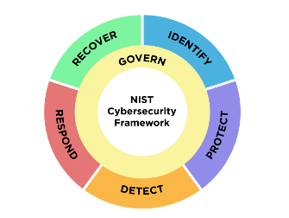
Resources to align cybersecurity, ERM, and workforce management
CSF 2.0: CYBERSECURITY, ERM, AND WORKFORCE MANAGEMENT
QUICK-START GUIDE
RESOURCES TO ALIGN CYBERSECURITY, ERM, AND WORKFORCE MANAGEMENT
Three NIST resources enable users to align their cybersecurity, ERM, and workforce management practices in a streamlined process:
The Cybersecurity Framework (CSF) 2.0 helps organizations—regardless of size, sector, or maturity—understand and communicate their cybersecurity efforts.
The NICE Framework helps organizations improve cybersecurity capabilities, communicate work responsibilities, and develop training.
The NIST IR 8286 series provides a suite of guidance documents and templates to support improved communication between cybersecurity professionals and organizational leadership and to align cybersecurity risk management with broader ERM practices.
This QSG connects the three resources and their respective stakeholder groups in a holistic, workforce-focused cybersecurity risk management process.
5 Steps for Creating and Using
a CSF Organizational Profile
This QSG
Enterprise Risk Management
(ERM)
Scope the Organizational Profile
NIST IR 8286
Gather needed information
Create the Organizational Profile
Workforce Management
(NICE Framework)
Cybersecurity Risk Management
(CSF)
Analyze gaps and create an action plan
Implement action plan and update Profile, repeating cycle as necessary
https://doi.org/10.6028/NIST.SP.1308
Notes:
This year, we published a new CSF 2.0 quick-start guide with our colleagues from NICE—the CSF 2.0 Cybersecurity, ERM, and Workforce Management QSG. This final version went through 2 rounds of public comment—thanks to any of you who contributed during one or both of those periods. This Quick-Start Guide (QSG) draws on concepts and practices from enterprise risk management, cybersecurity risk management, and workforce with the goal to shift workforce planning from reactive hiring to risk-informed decisions tied to CSF outcomes.
The three documents we’re stitching together here are CSF 2.0, NICE Framework, and the NIST IR 8286 series.
The NIST IR 8286 series aligns cybersecurity risk management with broader ERM practices.
The Cybersecurity Framework (CSF) 2.0 helps organizations understand, assess, prioritize and communicate their cybersecurity efforts.
The NICE Framework helps organizations improve cybersecurity capabilities, communicate work responsibilities, and develop training.
Some units within an organization may already use some of these resources; however, our thesis is that organizations will benefit from using all three together.
The guide is organized into the five Cybersecurity Framework Organizational Profile implementation steps, which are shown on the slide. An Organizational Profile describes an organization’s current and/or target cybersecurity posture in terms of cybersecurity outcomes from the Cybersecurity Framework (CSF) Core. They are used to understand, tailor, assess, and prioritize cybersecurity outcomes based on an organization’s mission objectives, stakeholder expectations, threat landscape, and requirements. Once you have a better understanding of all that, then you can begin making informed risk decisions, which can include workforce considerations such as upskilling, hiring, reorganizing, training, augmenting staff with third parties, etc. If workforce-focused risk responses are not appropriate or possible, organizations may consider selecting a different mitigation strategy or changing the risk response type to, for example, accept, avoid, or transfer.
This is an introduction to connecting these three documents. There’s one page for each of the 5 steps, providing considerations for getting started, important notes, related resources, and key terms. Think of it as a prompt for how to begin connecting the dots across these concepts and publications.
The link is on the slide. I encourage you to check it out. And if we can go to the next slide.
-------------------------------
“aligning security decisions with business priorities, leadership expectations, and workforce readiness.
𝐰𝐨𝐫𝐤𝐟𝐨𝐫𝐜𝐞 𝐠𝐚𝐩𝐬 𝐚𝐫𝐞 𝐧𝐨𝐭 𝐬𝐞𝐜𝐨𝐧𝐝𝐚𝐫𝐲 𝐨𝐩𝐞𝐫𝐚𝐭𝐢𝐨𝐧𝐚𝐥 𝐢𝐬𝐬𝐮𝐞𝐬. 𝐓𝐡𝐞𝐲 𝐚𝐫𝐞 𝐜𝐲𝐛𝐞𝐫 𝐫𝐢𝐬𝐤 𝐢𝐬𝐬𝐮𝐞𝐬. the publication shows how organizations can align mission priorities with risk-informed decisions on hiring, upskilling, role design, third-party dependencies, and governance maturity.
A persistent challenge across many organizations is not the lack of frameworks, but the continued separation of decision-making across security, risk, and workforce functions. Security teams may understand the threat landscape, risk leaders may understand exposure, and workforce managers may understand capability constraints. Yet programs often weaken when these perspectives are not brought together early and consistently. NIST SP 1308 addresses that gap directly.

Slide 22
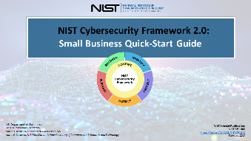
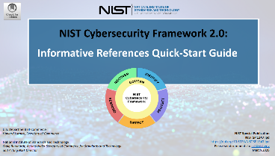
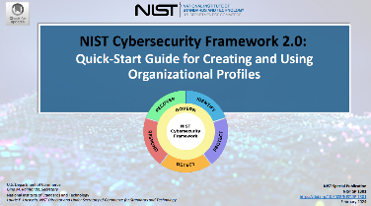
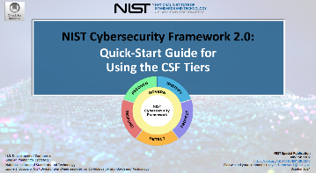
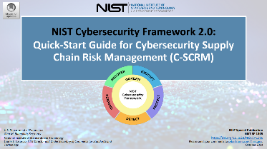
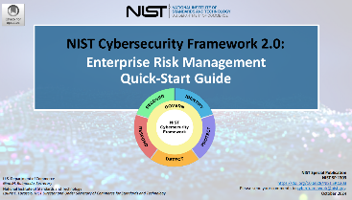
View all CSF 2.0 Quick-Start Guides
CSF 2.0 Overview
Organizational Profiles
Community Profiles
Small Business
Cybersecurity SCRM
Tiers
Enterprise Risk Management
Cybersecurity, ERM and Workforce Management
Informative References
https://www.nist.gov/cyberframework/quick-start-guides
Notes:
I’ll add that this recent QSG is just one of many that we’ve released since February 2024 on various topics as you can hopefully see on the slide.
One that we also released yesterday was a draft that’s open for comment until May 6 on Informative References. What are they, where can you find them, how do they help with cybersecurity risk management. You can view all of the quick-start guides on our CSF 2.0 resource library. And, if there are QSG topics you'd like to see us cover, let us know.
Thank you to the NICE team for allowing me to share these new resources with everyone.
May 5 NSBW event, Buidling Your Cybersecurity Team (outsourcing, upskilling, hiring, apprenticeships or cybersecurity clinics, etc.)

Slide 23

Opportunities and Discussion
Development of SMB-focused CSF Profiles
Continued research into SMB cybersecurity practices
Programming to close the skills gap for small businesses
Sharing best practices and innovative approaches to workforce development efforts that support SMB cybersecurity
Are there areas from this presentation NIST could expand upon?
What additional resources do SMBs need to support their workforce efforts?

Slide 24
Additional Reading
Renaud, k., Weir, G.R., 2016. Cybersecurity and the unbearability of uncertainty. DOI https://doi.org/10.1109/CCC.2016.29
Renaud, K. (2016). How smaller businesses struggle with security advice. Computer Fraud and Security, 8,
10-18. https://pureportal.strath.ac.uk/en/publications/ho w-smaller businesses-struggle-with-security-advice
Bada, M., Nurse, J.R., 2019. Developing cybersecurity education and awareness programmes for small-and medium- sized enterprises (SME) DOI https://doi.org/10.11.1108/ICS-07-2018-0080
Khan, N., Furnell, S., Bada, M., Rand, M., Nurse, J., 2024. Investigating the experiences of providing cyber security support to small-and medium-sized businesses. DOI https://doi.org/10.1016/j.cose.2025.104448
Pearlson, K. How Large Companies Can Help SMEs Strengthen Cybersecurity (MISQE Dec 2024): https://aisel.aisnet.org/misqe/vol23/iss4/4/
Notes:
Keep

Slide 25
Questions?
Daniel.Eliot@nist.gov

Slide 26
Survey on Whova App

