Slide 1
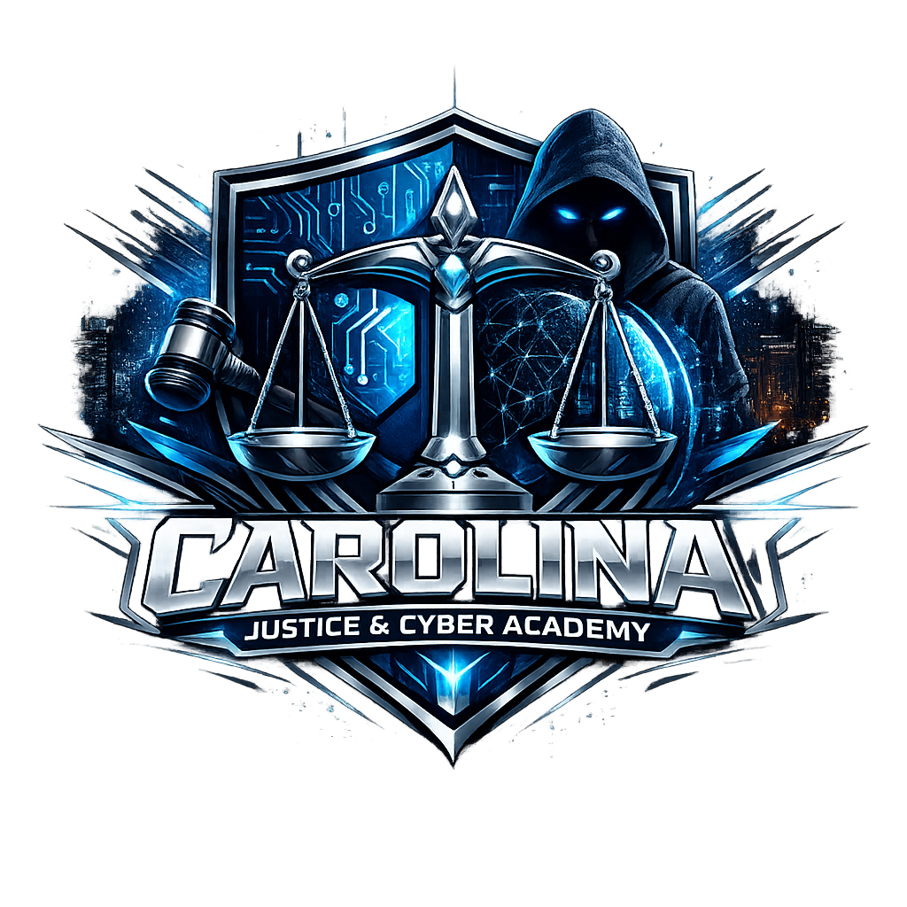
Strengthening Statewide Virtual Pathways into Cybersecurity and Tomorrow’s Workforce
Building digital skills for future cybersecurity careers
Dr.Robert Brzenchek & Tiffany Reeves
Notes:
---

Slide 2

Dr.Robert Brzenchek
Founder and School Leader of the Carolina Justice & Cyber Academy (CJCA), a South Carolina nonprofit focused on justice, cybersecurity, and workforce‑aligned education.
Former Navy Intelligence Specialist and experienced cyber practitioner, bringing operational, academic, and leadership expertise to K–12 cyber education.
Information Technology & Law Enforcement educator, known for coaching top‑performing CyberPatriot teams, including a state‑winning Gold Tier team.
Background spans law enforcement, military intelligence, emergency management, and higher‑education administration, providing a multidisciplinary foundation for CJCA’s mission.
Published author and researcher in security, threat assessment, gangs, and homeland/international security, with work used across public and private sectors.
Recognized for advancing cyber readiness, student career pathways, and community‑focused safety education across South Carolina.

Slide 3

Tiffany Reeves
Cybersecurity Program Manager supporting Carolina Justice and Cyber Academy initiatives.
Active contributor to South Carolina cybersecurity educator training, including SCDE computer programs.
Experienced in cybersecurity curriculum development, educator support, and student readiness for cyber careers.
Collaborates with statewide partners to strengthen K–12 and CTE cybersecurity pathways.
Passionate about expanding access to hands‑on cyber learning, digital safety, and workforce‑aligned training.

Slide 4


Understanding the Cybersecurity Workforce Gap
Notes:
The Cybersecurity Workforce Challenge

Slide 5

Session Introduction and Context
Addressing Cybersecurity Workforce Gap
  Session highlights growing shortage of skilled cybersecurity professionals and urgent workforce demand gap.
Innovative Educational Models
  Focus on scalable, inclusive virtual education models overcoming geographic and economic barriers.
Carolina Justice and Cyber Academy
  Introducing CJCA, a pioneering statewide virtual public charter school launching in 2027 to build talent pipelines.
Practical Strategies and Alignment
  Session provides replicable strategies linking education, industry, and public service for workforce sustainability.
Notes:
---
This slide references information from the following file: https://psaschoolorg-my.sharepoint.com/personal/robert_brzenchek_psaschool_org/_layouts/15/Doc.aspx?sourcedoc=%7B8E3C3DC7-89FF-415A-A1D8-AF41284A4448%7D&file=Strengthening%20Statewide%20Virtual%20Pathways%20into%20Cybersecurity%20and%20Tomorrow_v2.docx&action=default&mobileredirect=true
This breakout session introduces a forward-looking, statewide approach to strengthening virtual pathways into cybersecurity careers, aligned with the NICE Conference theme, “From Foundations to the Future.” Led by Dr. Robert Brzenchek and Tiffany Reeves, the session is situated within the Academic Innovation and Experiential Learning strand and is designed to address one of the most pressing national challenges: the cybersecurity workforce shortage. The presentation establishes the urgency of the issue by highlighting the growing gap between workforce demand and the available pipeline of skilled, credentialed, and career-ready cybersecurity professionals. It also frames the need for scalable, inclusive, and innovative educational models that can reach students regardless of geographic, economic, or institutional barriers. Attendees are oriented to the structure of the session, the interactive nature of the breakout, and the relevance of the Carolina Justice and Cyber Academy (CJCA) as a first-of-its-kind statewide virtual public charter school launching in 2027. The introduction emphasizes how the session will move beyond theory to provide concrete, replicable strategies, artifacts, and design principles that participants can adapt within their own regional or statewide contexts. By grounding the discussion in both workforce data and educational innovation, this opening segment sets a clear purpose: to demonstrate how intentional alignment between education, industry, and public service can build sustainable cybersecurity talent pipelines for tomorrow’s workforce.

Slide 6


The Cybersecurity Workforce Challenge
Root Causes of Workforce Shortage
  Rapid tech advances, evolving threats, and limited early cybersecurity education contribute to workforce shortages.
Equity and Access Issues
  Fragmented pathways and regional constraints limit access for underserved and rural students.
Importance of Early Skill Development
  Delaying cybersecurity exposure until postsecondary education creates gaps in foundational skills.
Virtual Models as Scalable Solutions
  Virtual education models can scale access while ensuring rigor and relevance in cybersecurity training.
Notes:
---
This slide references information from the following file: https://psaschoolorg-my.sharepoint.com/personal/robert_brzenchek_psaschool_org/_layouts/15/Doc.aspx?sourcedoc=%7B8E3C3DC7-89FF-415A-A1D8-AF41284A4448%7D&file=Strengthening%20Statewide%20Virtual%20Pathways%20into%20Cybersecurity%20and%20Tomorrow_v2.docx&action=default&mobileredirect=true
The cybersecurity workforce shortage represents a complex, multi-dimensional challenge affecting government, industry, education, and national security. This segment explores the root causes of the shortage, including rapid technological advancement, evolving threat landscapes, and limited access to early, high-quality cybersecurity education. Many existing pathways are fragmented, regionally constrained, or inaccessible to students in rural or underserved communities. Additionally, traditional models often delay meaningful exposure to cybersecurity until postsecondary education, leaving a critical gap in foundational skill development at the secondary level. The presentation underscores the importance of addressing not only technical skill deficits but also issues of equity, diversity, and inclusion within the cybersecurity pipeline. By examining these challenges through a statewide lens, this section makes the case for virtual models as a powerful solution capable of scaling access while maintaining rigor and relevance. The discussion also connects workforce shortages to broader economic and public safety implications, reinforcing why early intervention and systemic redesign are essential. This framing prepares participants to understand why CJCA’s integrated, virtual, and workforce-aligned approach is not simply innovative, but necessary to meet current and future cybersecurity demands.

Slide 7


Vision for a Statewide Virtual Cyber Pathway
Statewide Virtual Access
  Virtual structure removes geographic barriers, enabling consistent cybersecurity education across the entire state.
Comprehensive Pathway Design
  Curriculum spans grades 9–12, progressing from digital literacy to advanced cybersecurity and career exploration.
Contextualized Cybersecurity Education
  Instruction integrates real-world applications in justice, public safety, and digital forensics for career relevance.
Future-Ready Framework
  Program launch aligned with NICE Workforce Framework and emerging technologies to meet evolving workforce needs.
Notes:
---
This slide references information from the following file: https://psaschoolorg-my.sharepoint.com/personal/robert_brzenchek_psaschool_org/_layouts/15/Doc.aspx?sourcedoc=%7B8E3C3DC7-89FF-415A-A1D8-AF41284A4448%7D&file=Strengthening%20Statewide%20Virtual%20Pathways%20into%20Cybersecurity%20and%20Tomorrow_v2.docx&action=default&mobileredirect=true
This section outlines the vision behind a statewide virtual cybersecurity pathway designed to bridge education, workforce readiness, and public service. The Carolina Justice and Cyber Academy model is presented as a cohesive ecosystem rather than a standalone program. Its virtual structure enables statewide reach, removing geographic barriers while maintaining consistent instructional quality and alignment. The vision emphasizes intentional pathway design across grades 9–12, ensuring that students progress from foundational digital literacy and cybersecurity ethics to advanced technical competencies and career exploration. Central to this vision is the belief that cybersecurity education should be contextualized within real-world applications, particularly in justice, public safety, and digital forensics. By embedding these contexts into instruction, students gain a clearer sense of purpose, relevance, and career identity. The session also highlights how launching in 2027 allows CJCA to be purpose-built around the NICE Workforce Framework, emerging technologies, and evolving workforce needs, rather than retrofitted onto existing structures. This vision serves as a blueprint for participants seeking to design or refine their own statewide or regional cyber pathways.

Slide 8
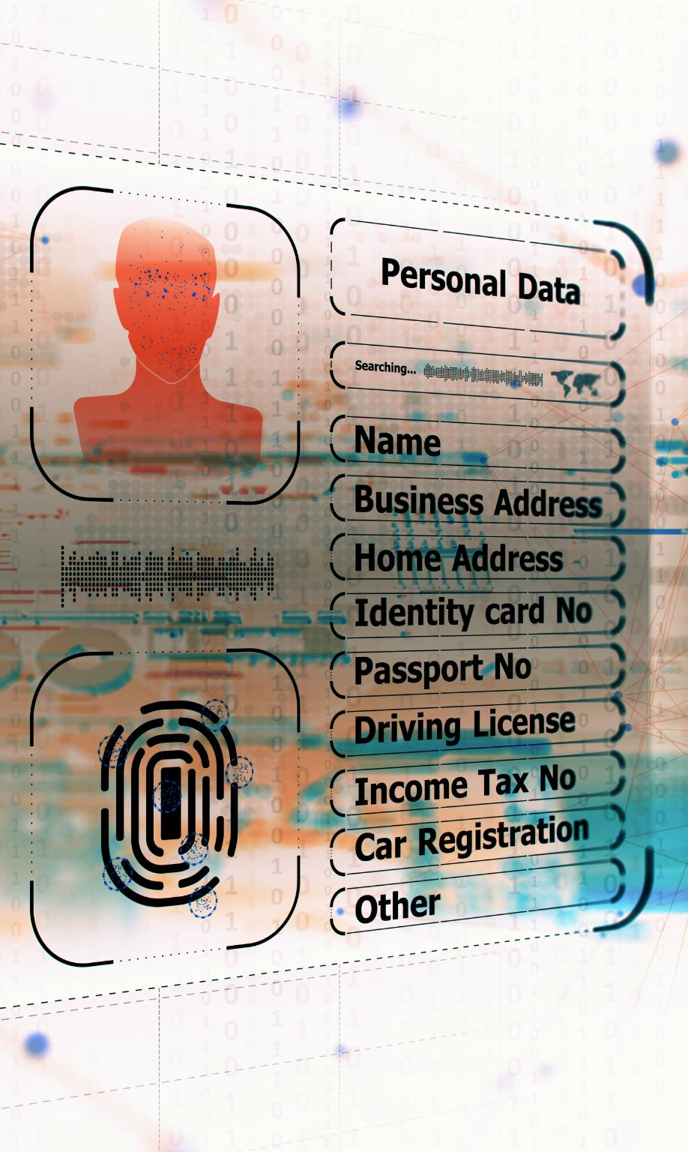
The CJCA Model
Framework Alignment
  The CJCA model aligns curriculum, instruction, and assessment with critical workforce needs in cybersecurity work roles and competencies for relevance.
Scenario-Based Cyber Ranges
  Scenario-based cyber ranges simulate real-world incidents, enabling students to apply their technical cybersecurity knowledge authentically.
Industry-Recognized Credentials
  The model embeds industry credentials as milestones signaling students’ readiness to employers and postsecondary opportunities.
Integration of Standards and Ethics
  Academic standards, workforce expectations, and ethics are integrated, emphasizing cybersecurity as a technical and civic discipline.
Notes:
---
This slide references information from the following file: https://psaschoolorg-my.sharepoint.com/personal/robert_brzenchek_psaschool_org/_layouts/15/Doc.aspx?sourcedoc=%7B8E3C3DC7-89FF-415A-A1D8-AF41284A4448%7D&file=Strengthening%20Statewide%20Virtual%20Pathways%20into%20Cybersecurity%20and%20Tomorrow_v2.docx&action=default&mobileredirect=true
At the core of the CJCA model is deliberate alignment with the NICE Workforce Framework, ensuring that curriculum, instruction, and assessment are directly connected to recognized cybersecurity work roles and competencies. This segment explains how NICE-aligned curriculum mapping is used to create coherence across grade levels, helping students understand how individual skills build toward specific career pathways. The model integrates scenario-based cyber ranges that simulate real-world incidents, allowing students to apply technical knowledge in authentic contexts. Industry-recognized credentials are embedded into the pathway, providing students with tangible milestones that signal readiness to employers and postsecondary institutions. The discussion also emphasizes the importance of aligning academic standards, workforce expectations, and ethical considerations, reinforcing cybersecurity as both a technical and civic discipline. By operationalizing NICE alignment rather than treating it as a conceptual reference, CJCA demonstrates how frameworks can drive instructional design, student outcomes, and workforce relevance simultaneously.

Slide 9

Key Instructional and Program Components
Structured Pathway Mapping
  Pathway mapping across grades 9-12 creates a clear, scalable learning progression for students in the virtual program.
Scenario-Based Cyber Learning
  Students engage in realistic cybersecurity challenges through scenario-based learning within cyber ranges.
AI-Supported Personalized Instruction
  AI tools personalize learning and monitor student skill progression, tailoring instruction to individual needs.
Workforce Partnerships
  Strong partnerships with industry ensure learning stays aligned with workforce demands and emerging technology trends.
Notes:
---
This slide references information from the following file: https://psaschoolorg-my.sharepoint.com/personal/robert_brzenchek_psaschool_org/_layouts/15/Doc.aspx?sourcedoc=%7B8E3C3DC7-89FF-415A-A1D8-AF41284A4448%7D&file=Strengthening%20Statewide%20Virtual%20Pathways%20into%20Cybersecurity%20and%20Tomorrow_v2.docx&action=default&mobileredirect=true
This portion of the presentation details the key components that make the statewide virtual pathway effective and scalable. These include structured pathway mapping across grades 9–12, scenario-based learning through cyber ranges, AI-supported instruction for personalization, and strong workforce partnerships. Each component is designed to reinforce the others, creating an integrated learning experience rather than isolated activities. Scenario-based learning allows students to engage with realistic cybersecurity challenges, while AI-supported tools help differentiate instruction and monitor skill progression. Workforce partnerships ensure that learning remains aligned to current industry needs and emerging trends. The session emphasizes that these components are not dependent on a single vendor or platform, making the model adaptable to different state or regional contexts. Participants gain insight into how thoughtful design choices can balance innovation with sustainability.

Slide 10

Cross-Sector Integration: Cyber, Justice, and Public Safety
Interdisciplinary Student Engagement
  Cross-sector integration enhances student engagement by linking cybersecurity with justice and public safety domains.
Curriculum and Simulations
  Curriculum design incorporates simulations and partnerships reflecting real-world public sector cybersecurity applications.
Career Awareness and Talent Pipeline
  Integrating multiple sectors broadens career paths and prepares students for collaborative roles in diverse fields.
Notes:
---
This slide references information from the following file: https://psaschoolorg-my.sharepoint.com/personal/robert_brzenchek_psaschool_org/_layouts/15/Doc.aspx?sourcedoc=%7B8E3C3DC7-89FF-415A-A1D8-AF41284A4448%7D&file=Strengthening%20Statewide%20Virtual%20Pathways%20into%20Cybersecurity%20and%20Tomorrow_v2.docx&action=default&mobileredirect=true
A defining innovation of the CJCA pathway is its cross-sector integration of cybersecurity with justice, public safety, and digital forensics. This segment explains how interdisciplinary connections enhance student engagement and broaden career awareness. By situating cybersecurity within public service contexts, students see how technical skills support community safety, legal processes, and ethical decision-making. The presentation discusses how these integrations are reflected in curriculum design, simulations, and partnerships with public sector organizations. This approach not only diversifies the talent pipeline but also prepares students for roles that require collaboration across technical and non-technical domains. Participants are encouraged to consider how similar cross-sector integrations could strengthen relevance and impact within their own programs.

Slide 11

Student Experience and Learner Perspective
Hands-on Learning Importance
  Students value hands-on, scenario-based activities that are authentic and challenging for deeper engagement.
Learner Voice Impact
  Student feedback shaped decisions on pacing, support structures, and career exploration opportunities.
Identity and Motivation
  Design focuses on motivation and identity development, especially for underrepresented students in cybersecurity.
Engagement and Persistence
  Intentional design for engagement and belonging promotes student persistence and long-term success.
Notes:
---
This slide references information from the following file: https://psaschoolorg-my.sharepoint.com/personal/robert_brzenchek_psaschool_org/_layouts/15/Doc.aspx?sourcedoc=%7B8E3C3DC7-89FF-415A-A1D8-AF41284A4448%7D&file=Strengthening%20Statewide%20Virtual%20Pathways%20into%20Cybersecurity%20and%20Tomorrow_v2.docx&action=default&mobileredirect=true
Centering the student experience is critical to the success of any virtual pathway. This section shares insights gathered during CJCA’s pathway design process, including student feedback on virtual learning environments, cyber range engagement, and interdisciplinary connections. Students expressed the importance of hands-on, scenario-based activities that feel authentic and challenging. The presentation highlights how learner voice informed decisions around pacing, support structures, and career exploration opportunities. Attention is also given to identity development and motivation, particularly for students who may not initially see themselves represented in cybersecurity fields. By intentionally designing for engagement, belonging, and relevance, the pathway aims to improve persistence and long-term success. This learner-centered perspective reinforces the idea that effective workforce development begins with meaningful educational experiences.

Slide 12
Curriculum and Pathway Design
Notes:
Sample Curriculum Map

Slide 13

Sample Curriculum Map
Foundational Skills in Grade 9
  Grade 9 introduces digital literacy, cybersecurity awareness, ethics, and citizenship as foundational skills.
Intermediate Cybersecurity in Grade 10
  Grade 10 focuses on networking fundamentals, operating systems, and basic security principles.
Applied Cybersecurity in Grade 11
  Grade 11 emphasizes applied operations with incident response, threat analysis, and cyber range simulations.
Advanced Learning and Workforce Preparation
  Grade 12 involves capstone projects, internships, and apprenticeships linking to workforce opportunities.
Notes:
This slide presents a sample curriculum map illustrating how a four-year high school cybersecurity pathway can be structured for clarity, progression, and workforce relevance. The pathway begins in grade 9 with foundations such as digital literacy, cybersecurity awareness, ethics, and citizenship. In grade 10, students deepen their understanding through networking fundamentals, operating systems, and basic security principles. Grade 11 emphasizes applied cybersecurity operations, including incident response, threat analysis, and scenario-based simulations using cyber ranges. By grade 12, students engage in advanced topics, capstone projects, internships, or apprenticeships that connect learning directly to workforce or postsecondary opportunities. This structured progression helps students understand how individual skills build toward specific NICE-aligned work roles. The curriculum map also supports scalability, allowing schools or states to adopt, adapt, and expand the model without relying on a single vendor or platform. By visualizing the pathway, the slide provides a concrete artifact that participants can use as a starting point for their own program design.

Slide 14

Credentials and Workforce Signals
Notes:
Embedded Industry-Recognized Credentials

Slide 15

Embedded Industry-Recognized Credentials
Integration of Credentials
  Credentials like CompTIA and FEMA ICS are embedded in coursework, not treated as separate add-ons, ensuring relevance.
Signals of Readiness
  These credentials provide tangible proof of skills that employers and institutions recognize and value.
Motivation and Career Clarity
  Earning credentials motivates students and builds confidence, providing clarity for career paths and education.
Strengthening Partnerships
  Credentials foster collaboration between education, industry, and government to align skills with workforce needs.
Notes:
This slide highlights the role of industry-recognized credentials as milestones within the CJCA pathway. Credentials such as CompTIA ITF+, Network+, Security+, FEMA Incident Command System (ICS), and introductory digital forensics certifications are embedded into coursework rather than treated as add-ons. This approach provides students with tangible signals of readiness that are recognizable to employers, postsecondary institutions, and public sector agencies. Embedding credentials also helps align instruction with workforce expectations and ensures that learning outcomes remain relevant as technology evolves. The slide emphasizes that credentials serve multiple purposes: motivating students, validating skills, and strengthening partnerships with industry and government. By earning credentials before graduation, students gain confidence, career clarity, and a competitive advantage as they transition into higher education, apprenticeships, or entry-level roles. This strategy reinforces the session’s central theme of connecting foundations to future workforce opportunities.

Slide 16
Student-Centered Design
Notes:
Student Persona Case Study

Slide 17

Student Persona Case Study
Learner Profile and Interest
  The student persona illustrates a typical learner interested in technology with limited cybersecurity experience initially.
Learning Pathway and Growth
  The case study follows the student’s progression through foundational skills, certifications, and advanced coursework.
Career Aspirations
  The persona’s career goals include roles like Security Operations Center analyst and digital forensics technician.
Support and Inclusion
  The narrative highlights support systems, motivation, identity development, and inclusivity for underrepresented students.
Notes:
This slide introduces a student persona case study to center the learner perspective and illustrate pathway impact. The persona, such as a student named Alex, represents a typical CJCA learner with an interest in technology but limited prior exposure to cybersecurity careers. The case study traces Alex’s journey from early curiosity and foundational skill-building to advanced coursework, certifications, and career aspirations such as a Security Operations Center (SOC) analyst or digital forensics technician. By following a single learner narrative, the slide helps participants understand how curriculum, instruction, support structures, and mentorship intersect over time. The persona also highlights considerations around motivation, identity development, and belonging, particularly for students from underrepresented backgrounds. This learner-centered approach reinforces the importance of designing pathways that are not only technically rigorous but also engaging, supportive, and inclusive. It provides a practical storytelling tool that participants can use in planning, advocacy, and stakeholder communication.

Slide 18

Student Engagement and Interactive Design
Live Polling for Challenges
  Live polling engages students by aligning with regional workforce challenges and encouraging real-time participation.
Hands-On Microsimulation
  Microsimulation maps cyber incidents to work roles, fostering experiential learning in a practical context.
Interactive Q&A Discussion
  Interactive Q&A sessions allow studemts to discuss barriers and share insights for implementation.
Collaborative Design Sprint
  Design sprints encourage attendees to collaboratively sketch pathway models, promoting active problem-solving.
Notes:
---
This slide references information from the following file: https://psaschoolorg-my.sharepoint.com/personal/robert_brzenchek_psaschool_org/_layouts/15/Doc.aspx?sourcedoc=%7B8E3C3DC7-89FF-415A-A1D8-AF41284A4448%7D&file=Strengthening%20Statewide%20Virtual%20Pathways%20into%20Cybersecurity%20and%20Tomorrow_v2.docx&action=default&mobileredirect=true
To model effective experiential learning, the session incorporates high-interaction engagement strategies aligned with NICE conference preferences. This segment describes the use of live polling to surface regional workforce challenges, a hands-on microsimulation mapping a cyber incident to NICE work roles, and a student persona case study illustrating progression from foundational to advanced skills. An interactive Q&A allows participants to discuss implementation barriers, while a collaborative design sprint invites attendees to sketch their own pathway models. These strategies are intentionally designed to move participants from passive listening to active problem-solving. By experiencing these methods firsthand, attendees gain practical ideas they can replicate in professional development, classrooms, or program planning sessions.

Slide 19
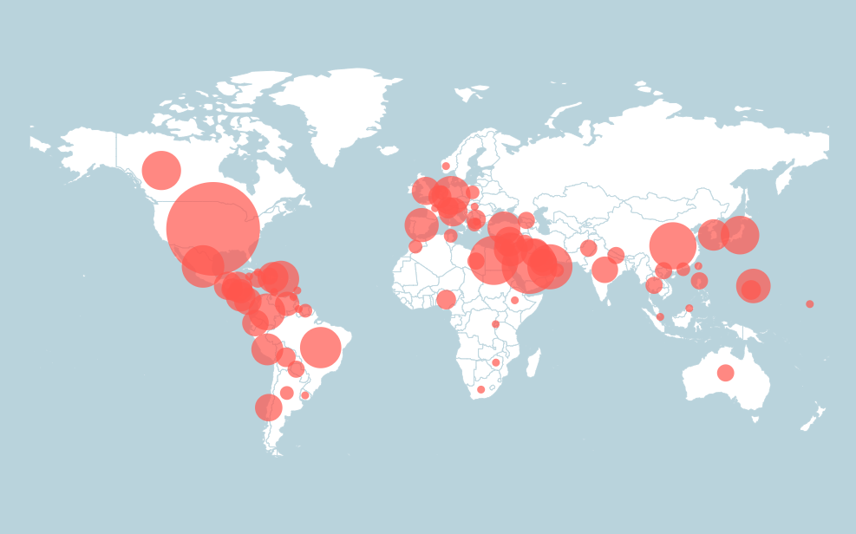
The Cognia Network
130
years of knowledge and expertise
in continuous improvement
40,000
schools and systems
100+
countries
The world’s largest accreditation and improvement network

Slide 20
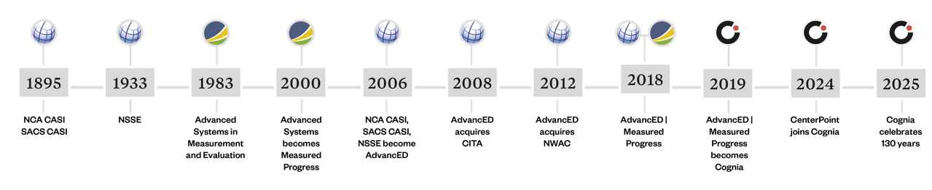





History

Slide 21

The Performance Standards
Thirty-one (31) standards organized around four Key Characteristics
Applicable to all institution types except for:
  Early Learning
  Extended Learning
  State Education Agencies
  Education Service Organizations (including Charter School Authorizers)

Slide 22


Thirty-one Standards organized by
Key Characteristics
Culture of Learning
Leadership for Learning
Engagement of Learning
Growth in Learning

Slide 23


Live Mentimeter
  Mentimeter link
  QR CODE
Notes:
This slide introduces a live polling activity using Mentimeter or Slido to immediately engage participants and surface regional workforce challenges. The poll asks attendees to identify their biggest cybersecurity workforce or education challenge, such as lack of access, limited qualified instructors, misalignment with industry needs, or equity gaps. By collecting real-time responses, the session models interactive engagement strategies that NICE encourages and demonstrates how data-informed discussion can shape program design. The poll also allows presenters to adapt emphasis during the session based on audience needs and backgrounds. This approach reinforces the idea that workforce development solutions must be responsive to local conditions while still aligning with national frameworks like NICE. In addition, the polling activity serves as a practical example that participants can replicate in classrooms, professional development sessions, or stakeholder meetings. It shows how technology can be used not only for instruction but also for needs assessment and collaborative problem-solving. This slide transitions the audience from passive listeners to active contributors, reinforcing the session’s commitment to applied, participant-centered learning.
QR code directing participants to the live Mentimeter or Slido poll and the CJCA pathway toolkit.

Slide 24

Innovation and Originality of the Model
Early Integration of NICE Roles
  The model integrates NICE cybersecurity work roles early and continuously for effective workforce preparation.
AI-Supported Personalization
  AI technology personalizes learning experiences to meet individual student needs and enhance engagement.
Industry and Public Sector Alignment
  The curriculum aligns intentionally with both industry standards and public sector cybersecurity demands.
Flexible Future-Ready Framework
  The model focuses on adaptable design principles that evolve with technology and workforce needs.
Notes:
---
This slide references information from the following file: https://psaschoolorg-my.sharepoint.com/personal/robert_brzenchek_psaschool_org/_layouts/15/Doc.aspx?sourcedoc=%7B8E3C3DC7-89FF-415A-A1D8-AF41284A4448%7D&file=Strengthening%20Statewide%20Virtual%20Pathways%20into%20Cybersecurity%20and%20Tomorrow_v2.docx&action=default&mobileredirect=true
This section emphasizes the innovative aspects that distinguish CJCA from traditional cybersecurity education models. As a statewide virtual school explicitly designed around cybersecurity and public safety pathways, CJCA represents a new approach to K–12 workforce development. Key innovations include early and sustained integration of NICE work roles, AI-supported personalization, and intentional alignment with both industry and public sector needs. The presentation highlights how these elements work together to create a coherent, future-ready learning ecosystem. By focusing on design principles rather than proprietary solutions, the model offers a flexible framework that can evolve alongside technology and workforce demands.

Slide 25

Outcomes and Replicable Strategies
Improved Education-Workforce Alignment
  The CJCA pathway strengthens the connection between education programs and workforce needs, enhancing career readiness.
Expanded Cybersecurity Education Access
  Efforts focus on broadening access to cybersecurity education to reach more diverse student populations effectively.
Cross-Sector Partnerships
  Building stronger partnerships among education, industry, and community sectors ensures pathway success and sustainability.
Scalability, Sustainability, and Equity
  Strategies emphasize scalable and sustainable designs that promote equity for diverse learners over time.
Notes:
---
This slide references information from the following file: https://psaschoolorg-my.sharepoint.com/personal/robert_brzenchek_psaschool_org/_layouts/15/Doc.aspx?sourcedoc=%7B8E3C3DC7-89FF-415A-A1D8-AF41284A4448%7D&file=Strengthening%20Statewide%20Virtual%20Pathways%20into%20Cybersecurity%20and%20Tomorrow_v2.docx&action=default&mobileredirect=true
Participants leave the session with a clear understanding of the outcomes associated with the CJCA pathway and how those outcomes can be replicated elsewhere. These include improved alignment between education and workforce needs, expanded access to cybersecurity education, and stronger cross-sector partnerships. The session shares sample artifacts, design strategies, and planning considerations that attendees can adapt to their own contexts. Emphasis is placed on scalability, sustainability, and equity, ensuring that pathways are designed to serve diverse student populations over time. This focus on practical takeaways reinforces the session’s value beyond the conference setting.

Slide 26

Call to Action and Future Directions
Collaborative Efforts Needed
  Educators, policymakers, and workforce leaders must collaborate to build stronger cybersecurity pipelines.
Utilizing Virtual Models
  Leveraging virtual models and cross-sector partnerships can expand access and prepare students for cybersecurity careers.
Long-Term Vision and Innovation
  Addressing cybersecurity workforce shortages requires a long-term vision and willingness to innovate.
Statewide Virtual Pathways
  Statewide virtual pathways like CJCA provide a promising blueprint for developing the future cybersecurity workforce.
Notes:
---
This slide references information from the following file: https://psaschoolorg-my.sharepoint.com/personal/robert_brzenchek_psaschool_org/_layouts/15/Doc.aspx?sourcedoc=%7B8E3C3DC7-89FF-415A-A1D8-AF41284A4448%7D&file=Strengthening%20Statewide%20Virtual%20Pathways%20into%20Cybersecurity%20and%20Tomorrow_v2.docx&action=default&mobileredirect=true
The session concludes with a call to action for educators, policymakers, and workforce leaders to collaborate in building stronger cybersecurity pipelines. Participants are encouraged to leverage virtual models, cross-sector partnerships, and framework-aligned design to expand access and prepare students for high-demand careers. The discussion reinforces that addressing the cybersecurity workforce shortage requires collective effort, long-term vision, and willingness to innovate. By connecting foundations to future opportunities, statewide virtual pathways like CJCA offer a promising blueprint for developing tomorrow’s cybersecurity workforce.

Slide 27

Questions, Collaboration, and Next Steps
Encouraging Dialogue
  The slide invites questions and discussion to foster an interactive and community-oriented session ending.
Call to Action
  Participants are urged to collaborate in building stronger cybersecurity pipelines for future workforce readiness.
Long-term Vision
  Emphasizes shared responsibility and connects individual insights to broader systemic change in cybersecurity education.
Ongoing Partnership
  Contact information supports continued dialogue, partnership, and resource sharing beyond the conference.
Notes:
The final slide invites questions, discussion, and collaboration, reinforcing the session’s interactive and community-oriented design. Participants are encouraged to reflect on how the presented model aligns with their own regional or organizational needs and to share implementation challenges or successes. This slide also serves as a call to action, urging educators, policymakers, industry leaders, and workforce professionals to collaborate in building stronger cybersecurity pipelines. By emphasizing shared responsibility and long-term vision, the conclusion connects individual takeaways to broader systemic change. Contact information is provided to support continued dialogue, partnership development, and resource sharing beyond the conference. This closing reinforces the central message of the session: that intentional, inclusive, and framework-aligned virtual pathways can play a critical role in preparing tomorrow’s cybersecurity workforce.

Slide 28

Omertà in the Classroom
The Silent Code. The Lasting Damage. Breaking the Culture of Silence in Our
Schools
A hidden “schoolhouse mafia” quietly governs education through power, silence, and retaliation
Principals rule like sovereigns; assistant principals enforce unwavering loyalty
HR shields the system, not the people working inside it
Federal dollars vanish into shadowy, opaque initiatives
Retaliation arrives disguised as support, wrapped in bureaucratic language
The “hit”: slow, procedural elimination of anyone who challenges the hierarchy
A culture built on loyalty, respect, silence—where speaking up can cost you everything
The book arms educators with legal tools, documentation tactics, reporting pathways, scripts, and templates
A call to rebuild schools on courage, trust, and truth instead of fear

Slide 29
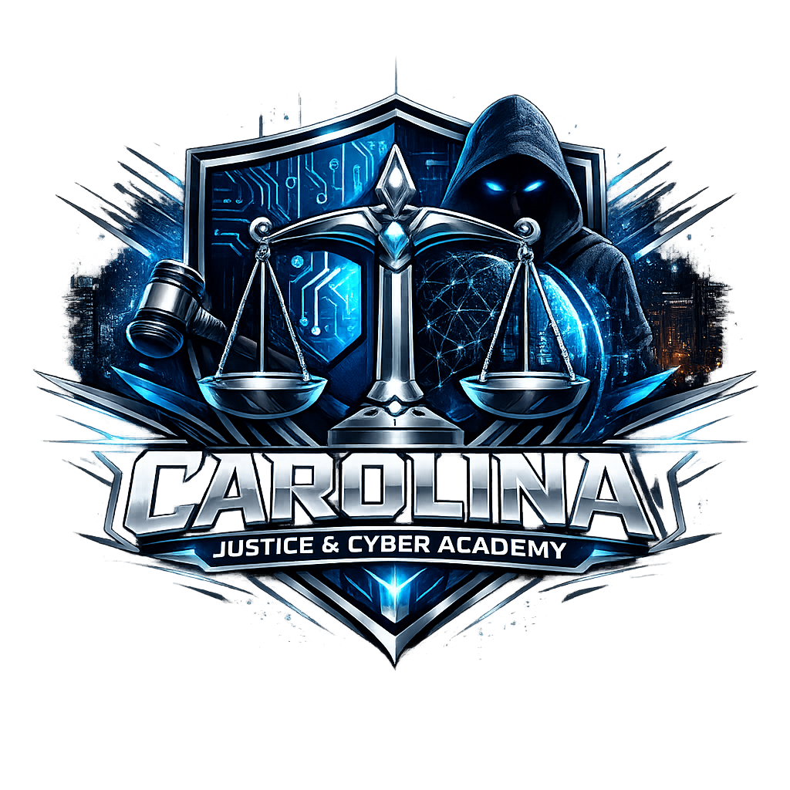
Contact Information
Carolina Justice and Cyber Academy
cjca.2027@gmail.com

