Slide 1
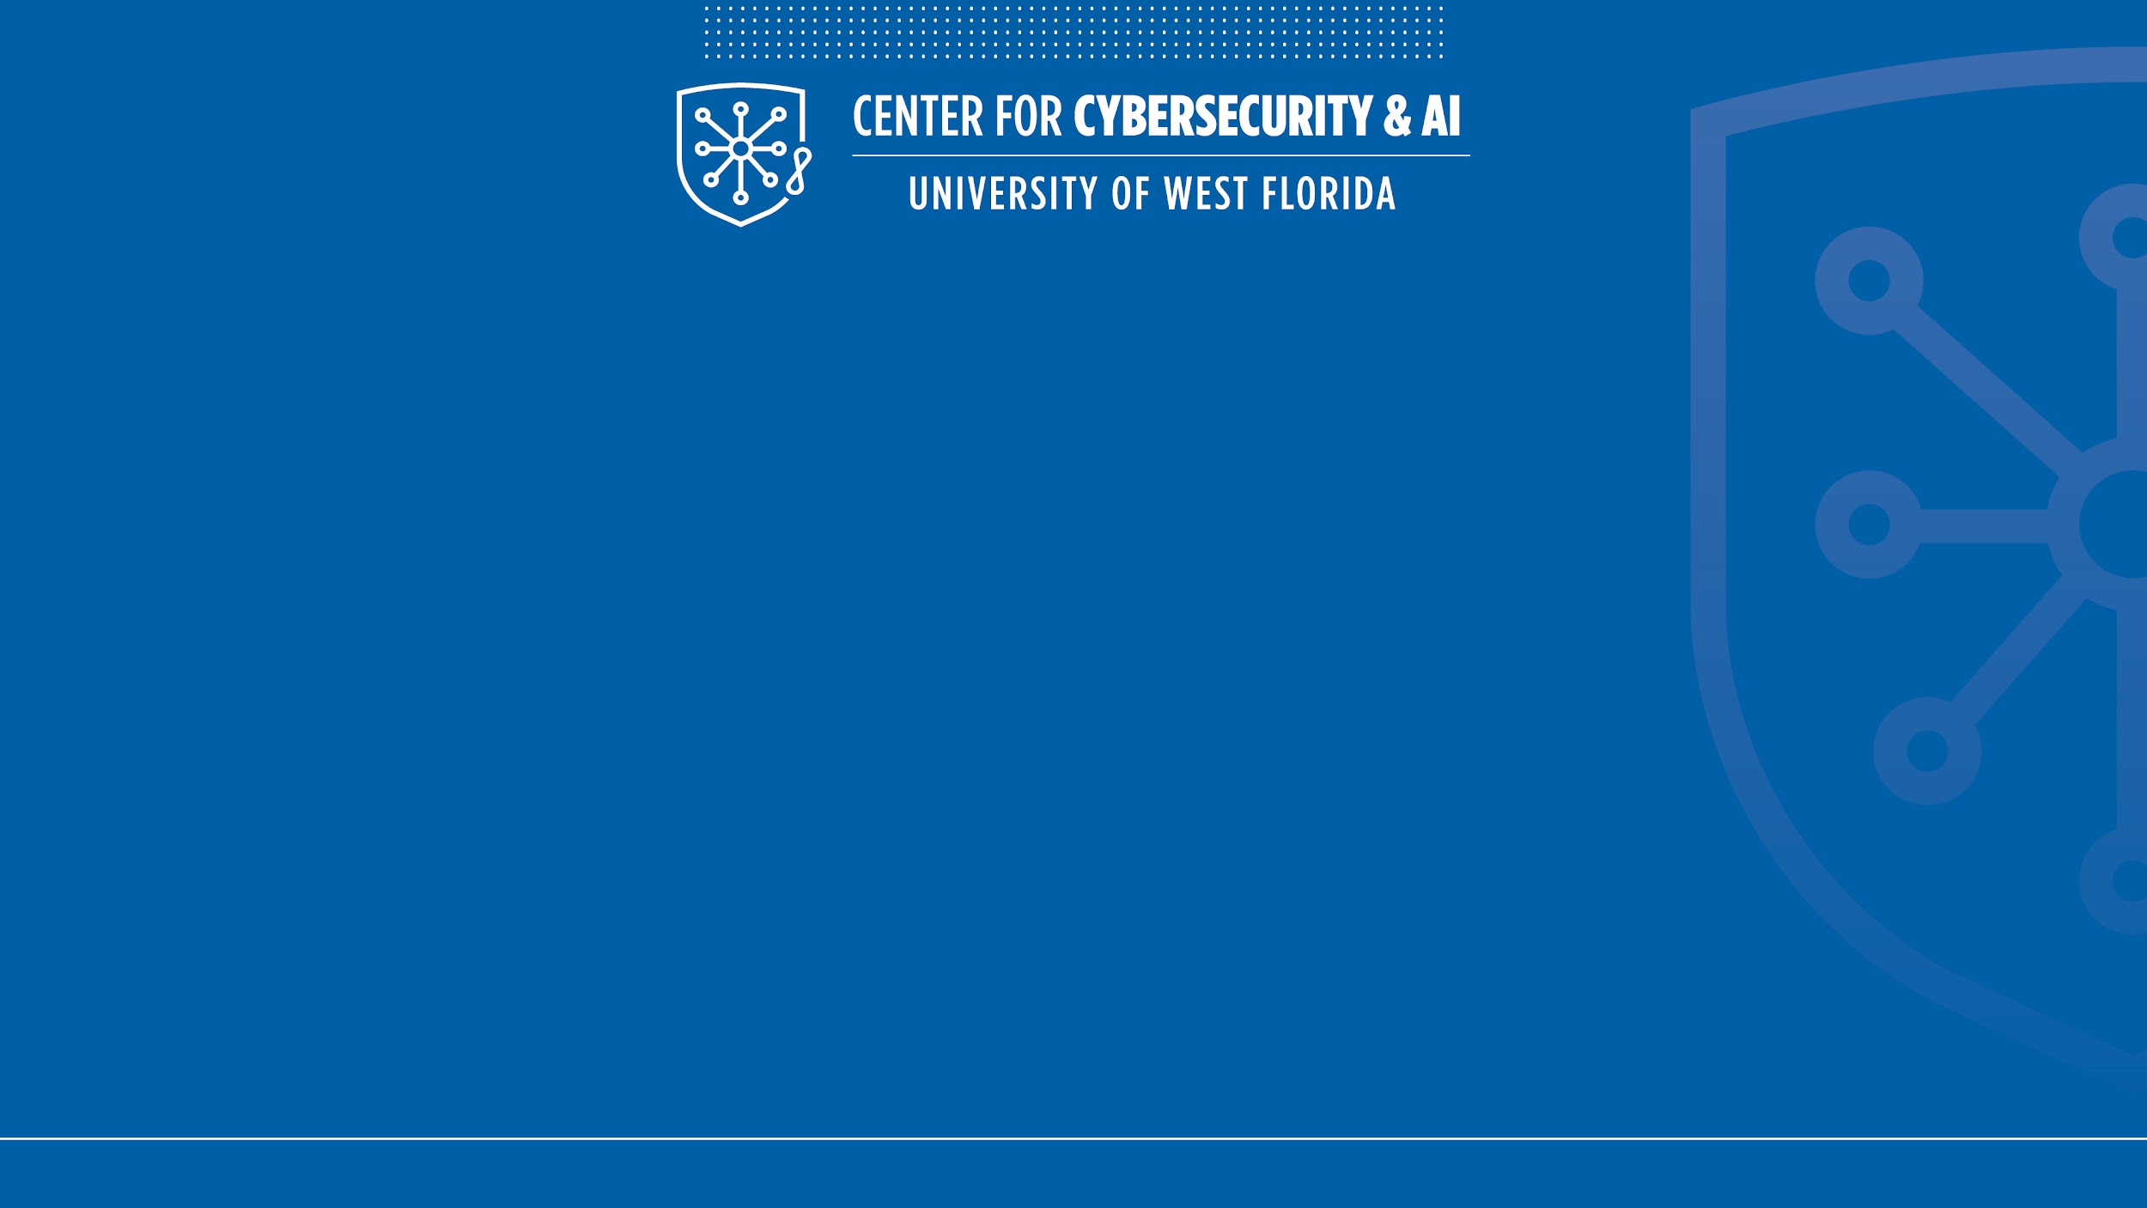
Sherlock Holmes Teaches Social Engineering
Using Narrative to Teach Cybersecurity Across Disciplines
NICE Conference
June 3, 2026
Dr. Elizabeth Rasnick
Center for Cybersecurity and AI
University of West Florida
© UWF Center for Cybersecurity and AI, uwf.edu/cyberai

Slide 2
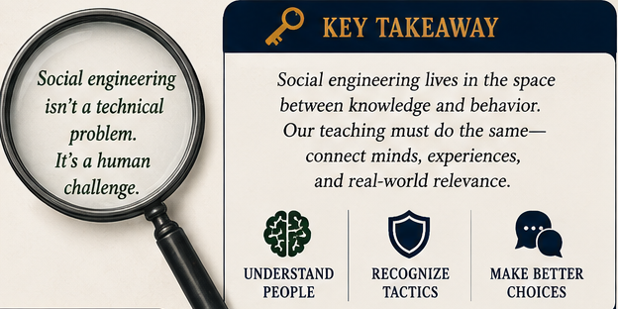
Why Social Engineering Is Hard to Teach
• Cyber feels 'too technical'
• Students (People) underestimate human threats
• Awareness training is forgettable
• Definitions don’t stick
Notes:
Discuss engagement and workforce challenges.

Slide 3
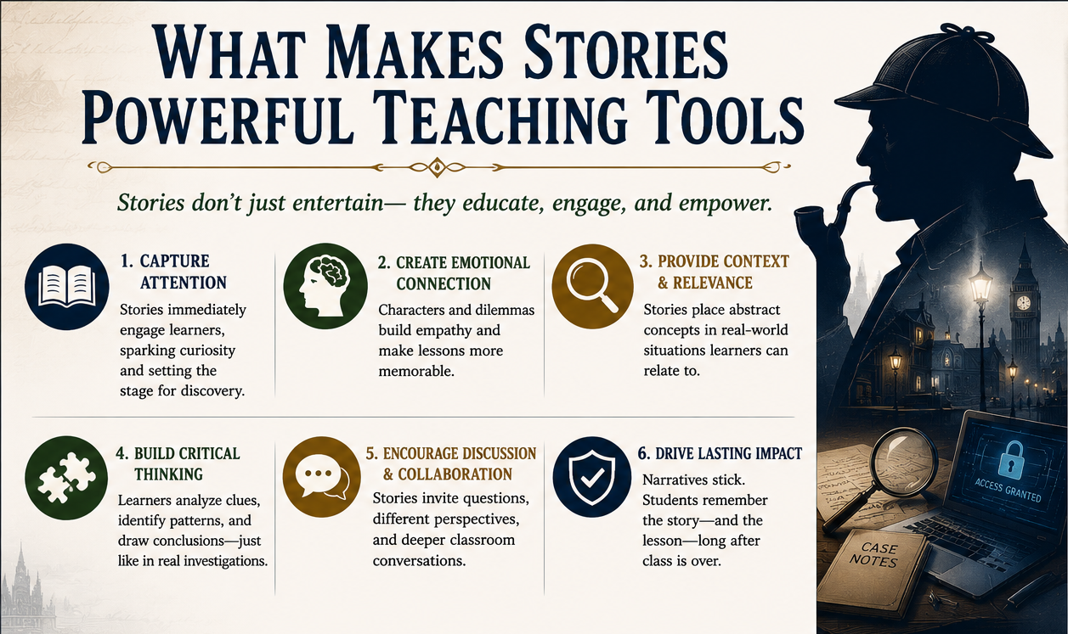
What Makes Stories Powerful Teaching Tools?
Stories create:
• Engagement
• Emotional memory
• Context
• Transfer of learning
Notes:
Introduce narrative pedagogy and experiential learning.

Slide 4

Why Sherlock Holmes?
Holmes stories naturally teach:
Impersonation
Deception
Urgency
Authority exploitation
Elicitation
Notes:
Arthur Conan Doyle accidentally wrote a social engineering curriculum.

Slide 5
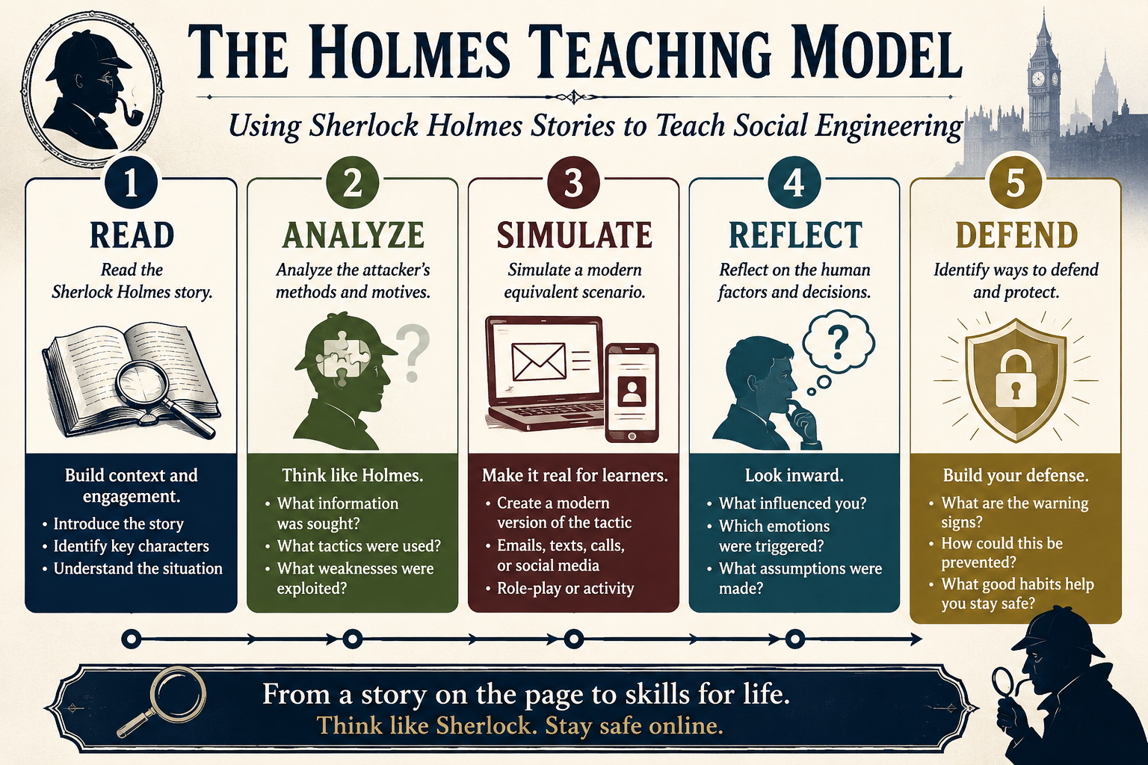
The Holmes Teaching Model
READ → ANALYZE → SIMULATE → REFLECT → DEFEND
Notes:
Explain reusable instructional framework.

Slide 6
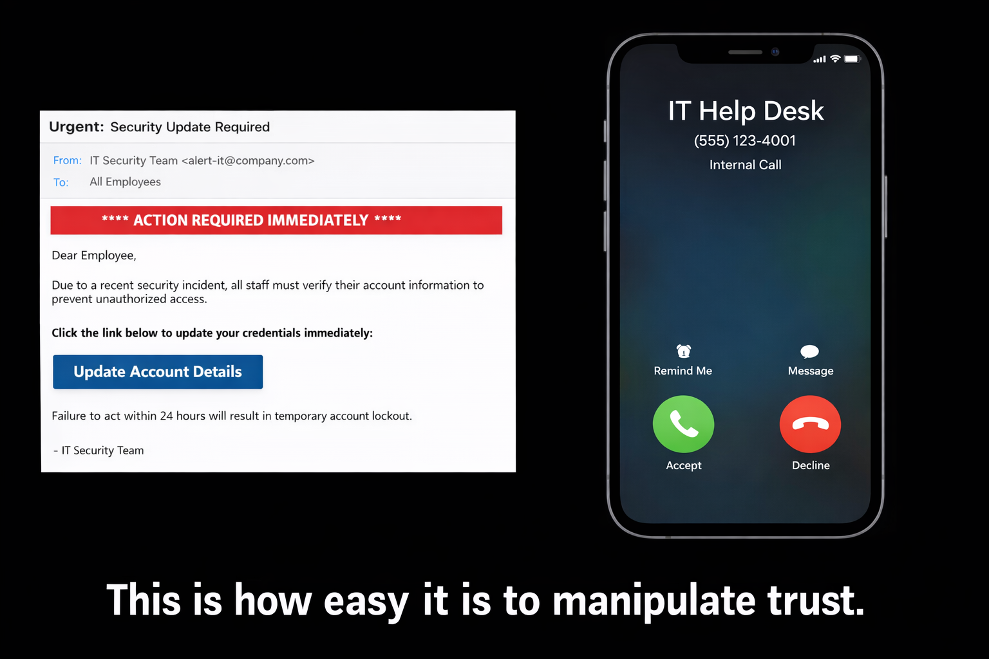
Live Social Engineering Demo
Email: "URGENT: Your account has been compromised. Click here to secure it immediately."
Who clicks?
Notes:
Run interactive exercise. Add authority and personalization.

Slide 7
Live Social Engineering Demo
Email: "URGENT: Your account has been compromised. Click here to secure it immediately."
Message appears to be from IT
Now, who clicks?
Notes:
Run interactive exercise. Add authority and personalization.

Slide 8
Live Social Engineering Demo
Email: "URGENT: Your account has been compromised. Click here to secure it immediately."
Message appears to be from IT
Uses your company logo
How about now?
Notes:
Run interactive exercise. Add authority and personalization.

Slide 9
Live Social Engineering Demo
Email: "URGENT: Your account has been compromised. Click here to secure it immediately."
Message appears to be from IT
Uses your company logo
Mentions you by name
Who’s clicking?
Notes:
Run interactive exercise. Add authority and personalization.

Slide 10
Live Social Engineering Demo
You ignore the email.
Then your phone rings.
“Hi, this is IT. We saw suspicious activity. Did you just get an email?”
Notes:
Ask: “Who trusts this call now?”

Slide 11
Debrief:
What changed?
What happened?
Multi-channel attack
Reinforced authority
Built trust through confirmation
Lever 1: Authority | Lever 2: Familiarity | Lever 3: Urgency
Message from IT | Company Logo Used | Crisis Maintained
(Bypasses Suspicion) | Real Name Mentioned | Time Pressure Applied
Notes:
The attack adapts when you resist.

Slide 12
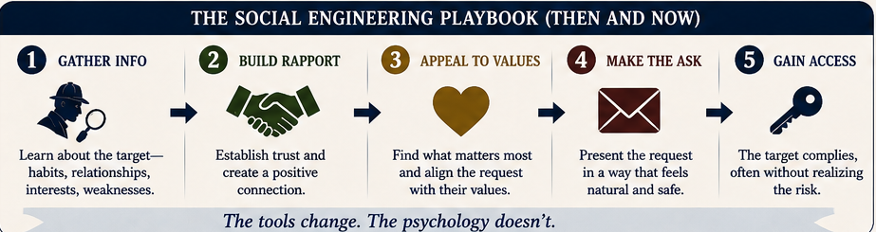
A Scandal in Bohemia
Holmes disguises himself as a clergyman. By appearing as a harmless clergyman, Holmes bypasses suspicion and gains proximity to his target.
Teaches:
• Urgency
• Emotional manipulation
• Disclosure under stress
Modern Parallel: phishing urgency
Notes:
Tell the fake fire story and connect to phishing.

Slide 13
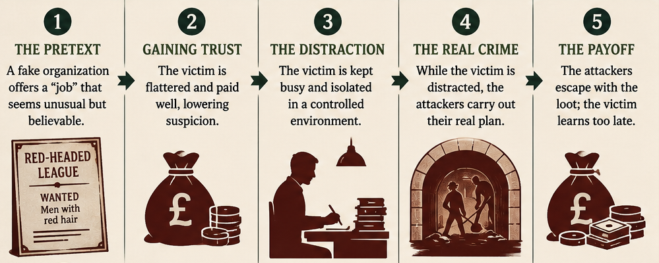
The Red‑Headed League
A fake job targeting red‑haired men distracts a pawnbroker for hours daily, enabling criminals to tunnel into a bank next door to his pawn shop.
Teaches:
• Pretexting
• Distraction
• Trust exploitation
How would this scam work today?
• Phishing
• Fake job scams
• SMS lures
Notes:
Connect to fake jobs and scams.
Promote transfer learning.

Slide 14
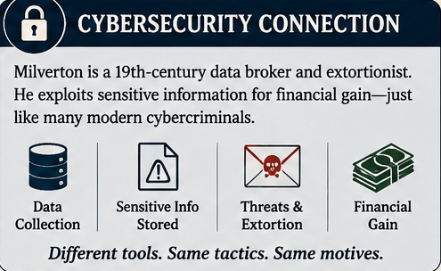
Charles Augustus Milverton
In this case, Holmes assumes the identity of a plumber. No one thinks twice about allowing him in and out of the house. Beyond physical disguise, Holmes exploits the psychological shortcut of authority itself.
Teaches:
• Extortion
• Coercion, may be subtle
• Insider risk
Ethical discussion: Should Holmes break the law to stop a blackmailer? Should we to catch ransomware/extortionist?
Notes:
Bridge from blackmail to ransomware/extortion.

Slide 15
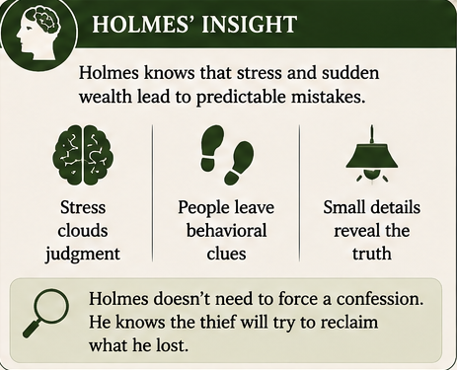
The Blue Carbuncle
A thief’s panic leads him to hide a gem inside a goose, assuming no one would think to search something so mundane.
Teaches:
• Predictability
• Panic
• Behavioral analysis
Holmes solves cases by anticipating
how people will behave under pressure.
How can we?
Notes:
Explain human predictability.

Slide 16
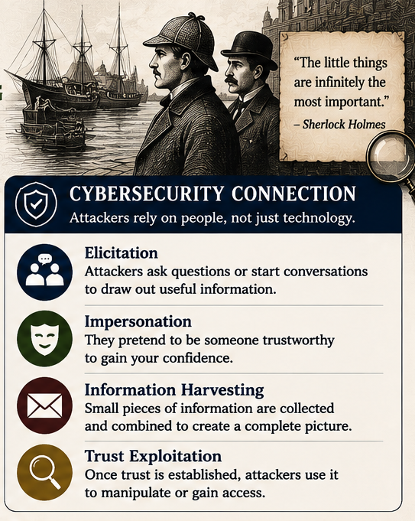
Sign of Four
Holmes disguises himself as a dock worker and strategically questions people connected to the suspect, using familiarity and perceived shared identity to elicit information they would not normally reveal.
Teaches:
• Elicitation
• OSINT
• Trust exploitation
Reconnaissance is the foundational competent of a strong attack or defense.
Notes:
Connect to recon/social engineering.

Slide 17
Holmes Teaches Social Engineering Techniques
Case | Technique | Modern Parallel
A Scandal in Bohemia | Emotional manipulation, urgency | Phishing urgency, MFA fatigue
The Red-Headed League | Pretexting, distraction | Business email compromise setup
The Man with the Twisted Lip | Identity deception | Insider threat, false identity
Charles Augustus Milverton | Blackmail, coercion | Ransomware/extortion
The Norwood Builder | Staged evidence | False flag / misdirection
The Blue Carbuncle | Exploiting panic | Data exfiltration via insider panic
The Boscombe Valley Mystery | Trust exploitation | Social trust attacks
The Speckled Band | Hidden attack vector | Covert malware / persistence
Notes:
Summary table of cases with their social engineering techniques and modern parrallels.

Slide 18

Cybersecurity Can Be Taught Anywhere
English
Psychology
History
Business
Computer Science
Ethics
Math (Dancing Men - ciphers, Musgrave Ritual - geometry)
Music (Hound of the Baskervilles - steganography)
Art / Math (The Valley of Fear - binary beads)
International Politics (The Adventure of the Naval Treaty)
Notes:
Cross-disciplinary opportunities.

Slide 19
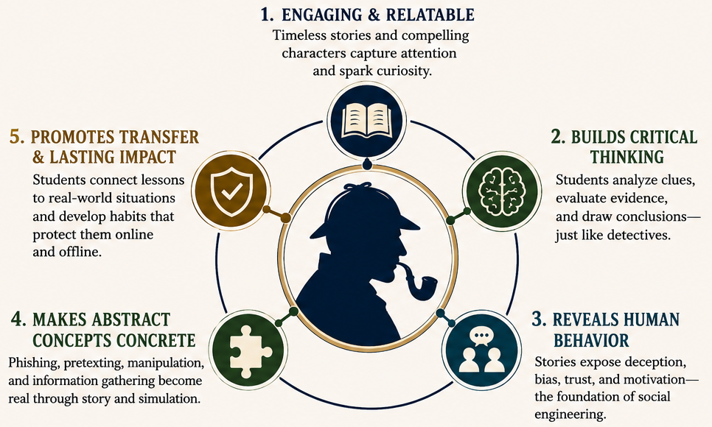
Why This Works
Narrative increases:
Engagement
Retention
Confidence
Transfer
Students may forget a definition of social engineering…
but they won’t forget Sherlock Holmes causing a fake fire to recover a picture for a king.
Notes:
Cybersecurity becomes less intimidating when students know the story.

Slide 20
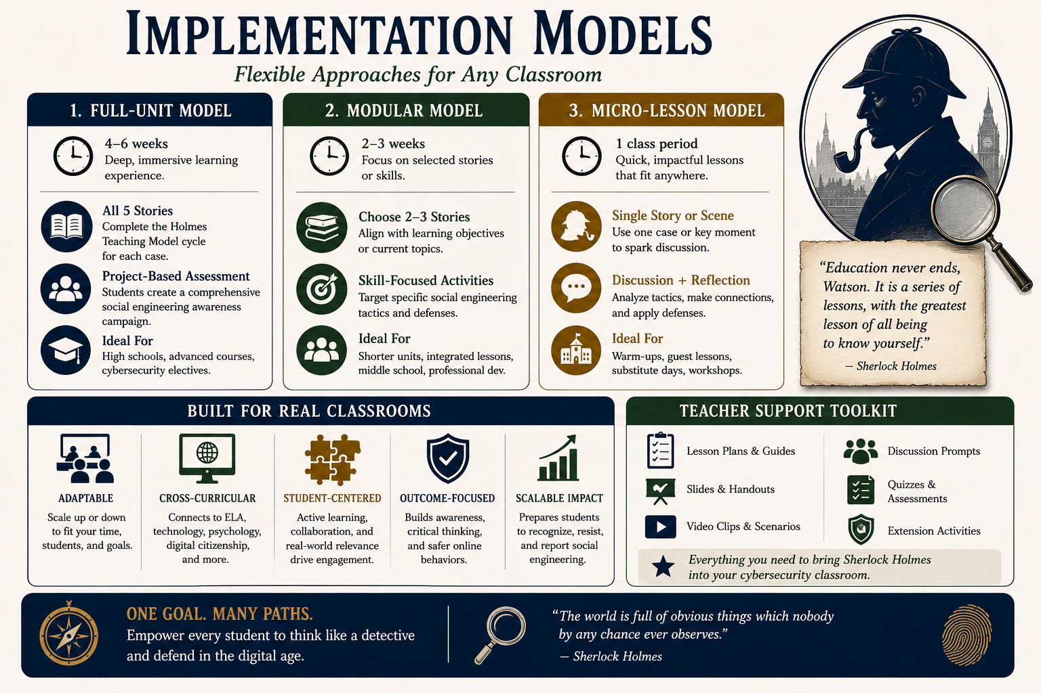
Implementation Models
Broadly applicable
K–12
General Education
Cyber Programs
Professional Development
Sherlock Holmes provides an interdisciplinary, scalable, and experiential framework for teaching cybersecurity thinking.
Notes:
Stress scalability.

Slide 21

NICE Workforce Relevance
Critical thinking
Communication
Skepticism
Behavioral analysis
Using Sherlock Holmes as a narrative pedagogy model broadens cybersecurity participation by making social engineering concepts accessible, experiential, and transferable across disciplines while simultaneously supporting workforce-relevant human-centered cybersecurity competencies.
Notes:
Human skills are cyber skills.

Slide 22
Holmes Addresses NICE Goals 1 - 3
NICE Goal | Holmes-Based Cybersecurity Education Contribution | NICE Alignment / Workforce Impact
1. Broadening Participation in Cybersecurity | Makes cybersecurity accessible to non-technical learners through familiar stories and narrative-based instruction. Lowers intimidation barriers and increases engagement for students who might not otherwise pursue cyber education. | Expands the cybersecurity talent pipeline by engaging general education students, non-cyber majors, K–12 learners, and pre-service teachers.
2. Building Cybersecurity Workforce Readiness | Develops human-centered cyber competencies including skepticism, critical thinking, behavioral analysis, adversarial thinking, communication, and ethical reasoning. | Prepares students for workforce-relevant cybersecurity behaviors, especially social engineering awareness and human-layer defense.
3. Interdisciplinary Cybersecurity Education | Embeds cybersecurity concepts into non-technical disciplines using literature as an instructional scaffold. | Demonstrates that cybersecurity is behavioral, ethical, communicative, and social—not only technical—supporting NICE interdisciplinary goals.
Notes:
Human skills are cyber skills.

Slide 23
Holmes Addresses NICE Goals 4 - 7
NICE Goal | Holmes-Based Cybersecurity Education Contribution | NICE Alignment / Workforce Impact
4. Experiential & Active Learning | Supports scenario-based learning, simulations, reflection, and problem-solving through narrative case studies and interactive demonstrations. | Aligns with active-learning pedagogies valued by NICE, including experiential learning, case-based instruction, and authentic problem solving.
5. Cybersecurity Awareness & Literacy | Helps students understand why social engineering works through stories that reveal manipulation, persuasion, and trust exploitation. | Builds cybersecurity thinking rather than rote rule-following, improving long-term cyber literacy and digital resilience.
6. Scalable & Replicable Educational Practice | Offers a low-cost, adaptable instructional model that can be implemented across institutions without specialized technical infrastructure. | Supports dissemination and scalability by enabling instructors to teach cybersecurity concepts without cyber ranges or advanced technical labs.
7. Supporting the NICE Workforce Framework | Encourages competencies related to Analyze, Protect & Defend, Investigate, and human-centered cybersecurity through behavioral analysis and adversarial thinking. | Reinforces workforce-relevant competencies such as problem-solving, communication, critical thinking, and threat recognition.
Notes:
Human skills are cyber skills.

Slide 24
Key Takeaways
1. Stories make cyber memorable
2. Holmes provides case studies
3. Narrative improves engagement
4. Social engineering (and cybersecurity) becomes teachable
Sherlock Holmes transforms cybersecurity from a technical subject into a human story, making cybersecurity concepts more accessible, interdisciplinary, and workforce relevant.
Notes:
Summarize actionable outcomes.

Slide 25
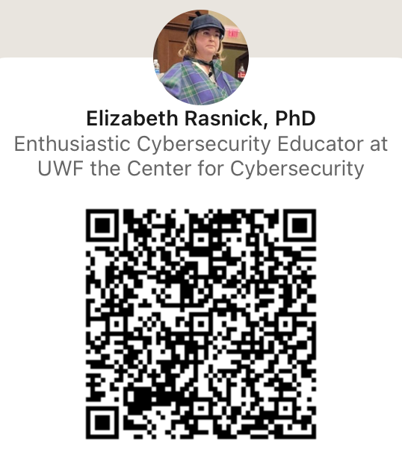
Questions?
Thank you!
erasnick@uwf.edu
uwf.edu/cyberai
cyberai@uwf.edu
© UWF Center for Cybersecurity and AI, uwf.edu/cyberai

