Slide 1





Bridging and Expanding Pathways into Cybersecurity Careers
Presented by Rhonna Novy
  Director of Tech Talent & Cybersecurity Chair (Volunteer) for TechSTL
  Midwest Regional Lead for NICE Cybersecurity Ambassador Program
  Women in Cybersecurity St. Louis Affiliate Board Member
  ISC2 St. Louis Region/Scott AFB Member Coordinator
  CompTIA Security+ Volunteer Teacher Assistance CyberUp

Slide 2

Agenda
Rich Lacy Photos
  Identify gaps
  Evaluate volunteer work-based pathways
Notes:
Learning Outcomes
• Identify common gaps between cybersecurity education and employer expectations
• Evaluate experiential and work-based pathway models that improve job readiness
• Apply practical strategies to align training, certifications, and real-world experience
• Adapt volunteer-driven and community-based approaches within their own organizations
Apply training, certifications, and real-world volunteer experience
Identify gaps between cybersecurity education and employer expectations for early career
Evaluate volunteer work-based pathway models that improve job readiness for students, early career to senior career
shorten the bullets on the Agenda

Slide 3


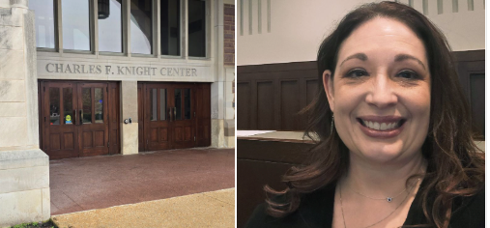
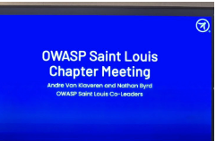
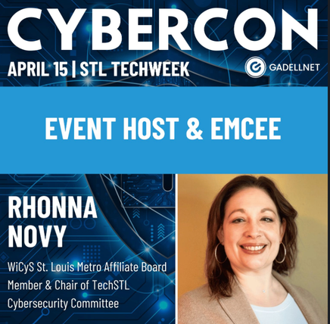


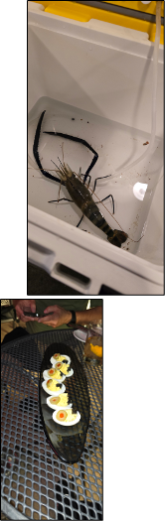
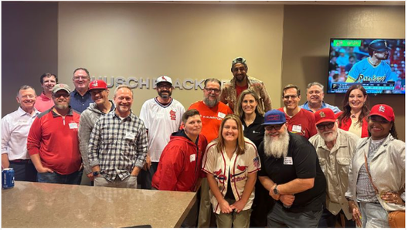

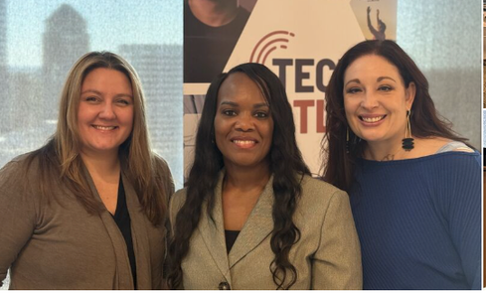

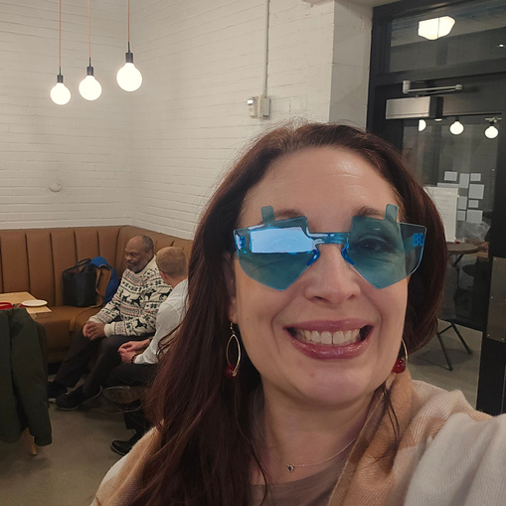
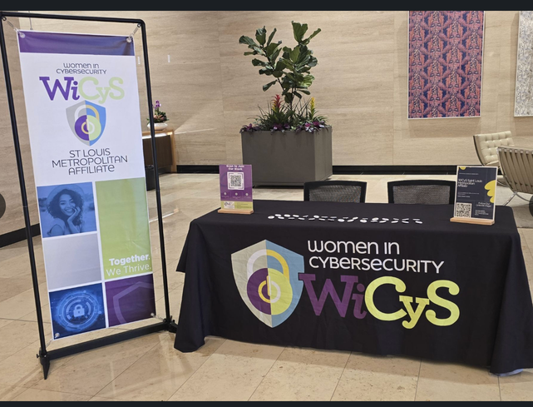

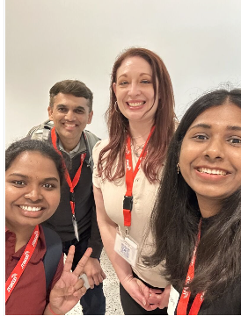
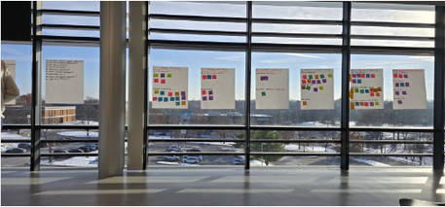

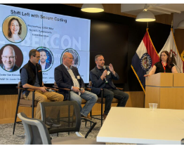
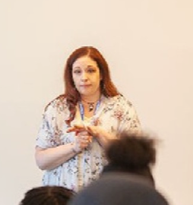

About me
CISSP

Slide 4
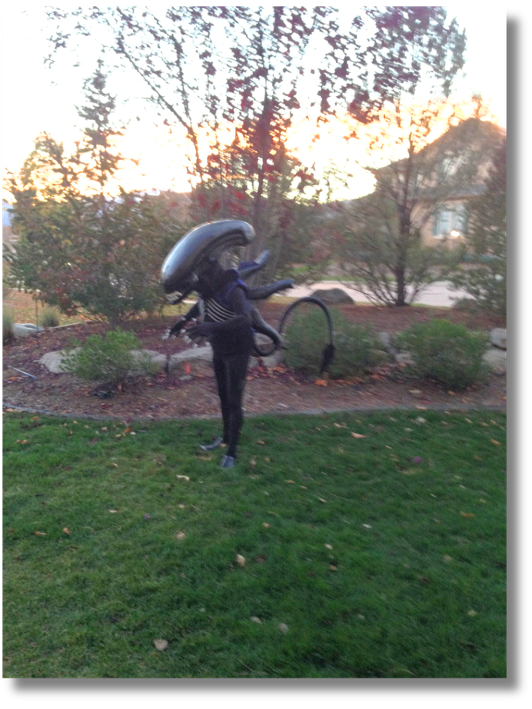
Poll
  How many people know people who have been laid off or have been laid off themselves?
  How many people are students and going into cyber?
Rich Lacy Photos
Notes:
ask how many students who may of just graduated or looking for interships
find someone who is now a citizens
non profits organizations trying to find work

Slide 5
Education-to-Employment Gap in Cybersecurity!
How do you close the gap?
3 years - standard
5 years - expected
Do you need to meet all bullets?
Notes:
Like to play around, solve puzzles, vs traditional education
certificates
give type of work, portfolio and use AI to review <promt>
git hub
hack the box
capture the flags
free cloud
diiferent certs
anything else in expectations for job postings

Slide 6

The Job Market is Changing Fast
My interviewing experiences
  Made changes while interviewing
  Not always a refection of you
  HR has so many applications
Rich Lacy Photos
Rich Lacy Photos

Slide 7

What is the Impact of AI?
Experience’s I have had
Rich Lacy Photos
  AI interviews
  AI reviewing the resume
  AI writing my resume
  AI responses to emails
  Just have AI do it!

Slide 8

Skills
Rich Lacy Photos
The How to
  Pivot volunteering into real-world job skills
  Apprenticeship-style experiences
    Industry collaboration ie projects
Rich Lacy Photos
Notes:
Pivot, give you something you didn't think about until you open yourself to new opportunities
everyone helps networking
Keep skills sharp

Slide 9
What Are the Public Groups That Help Cyber Education in <enter city>
AI Prompt
Local Community & Professional Groups
  ISC2 Philadelphia Chapter (ISC2 Philly)
  Black Tech Philly
  Women in CyberSecurity (local Affiliate)
  Cybersecurity Association of Pennsylvania (PennCyber)
City & Workforce Initiatives
  Power Up Tech Corps City of Philadelphia Digital Skills Courses

Slide 10

Real-world Examples of Volunteer -Driven Pathways
That Build Job Related Skills
  Look for industry conferences
  Social Outings: ie 5ks, running clubs, etc
  MeetUps, Eventbrite, Facebook Groups
  Talking to People
  Code n Coffee
  Don’t be afraid to start your own networking event
  Start Ups - https://startupproject.org/
  https://www.philafound.org/engaging-volunteers/individuals/

Slide 11
Suggested AI Prompt
Transferable skills
I want to identify the transferable skills I have into cyber security skills. I will provide you what I am currently doing/working on and then please with out inflating or lying provide me transferable skills for this <industry> I am going into. Then I would also like some possible interview questions with answers in the STAR format that a hiring manager and recuriter may ask. To further help, I have provided my resume <insert resume> and the job description <insert job description>

Slide 12
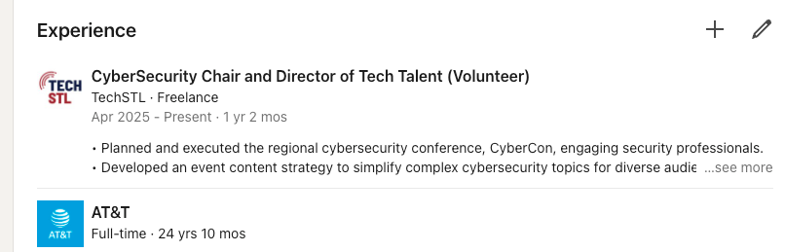
How to Showcase
The Talent You Have
  Add to LinkedIn your Transferable skills & Volunteering Activities
  Don’t be afraid to tailor the resume based on the job you are applying too

Slide 13
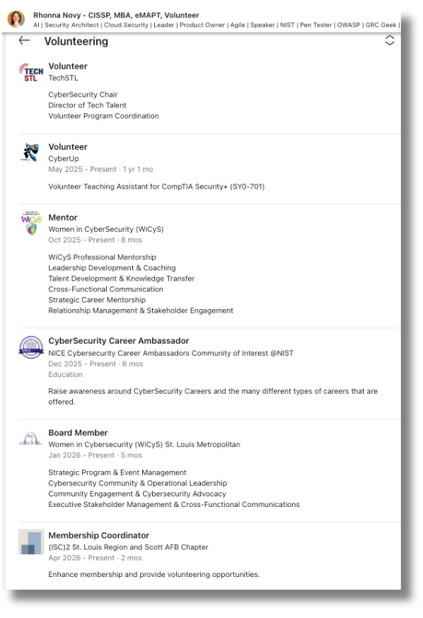
Use the Volunteer Section as Well

Slide 14
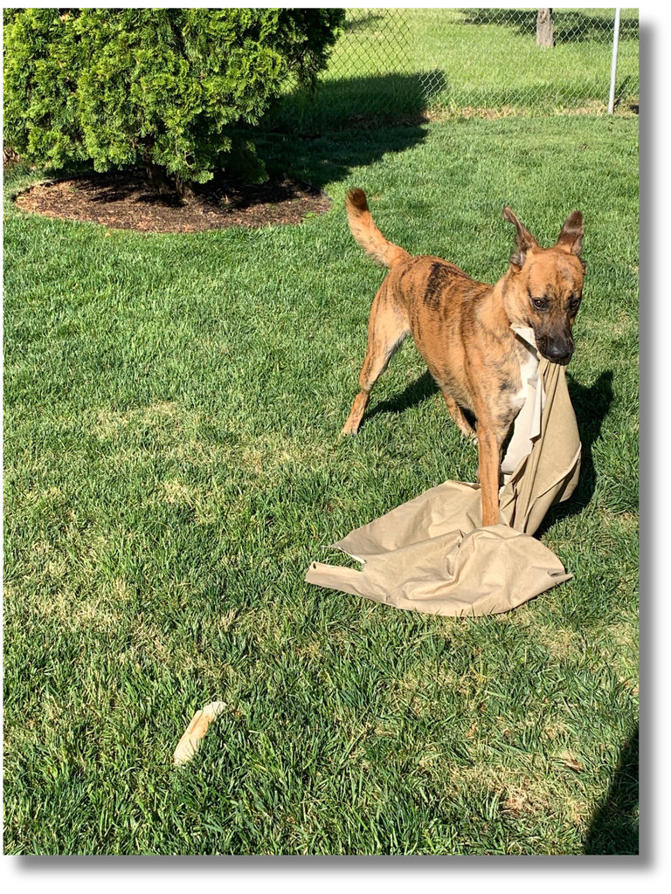
Lessons Learned
  Pick what motivates you!!!!!!!!!!!!!
  Volunteering can become a full-time job
  Leverage public resources i.e. the Library
  It isn’t you
  Prioritize yourself
Rich Lacy Photos
Notes:
speaks to your soul
help with networking
incorporate personal items

Slide 15

Discussion/Questions
Rich Lacy Photos
Notes:
discussion on how attendees can adapt these approaches across education, workforce, and industry partnerships.

Slide 16
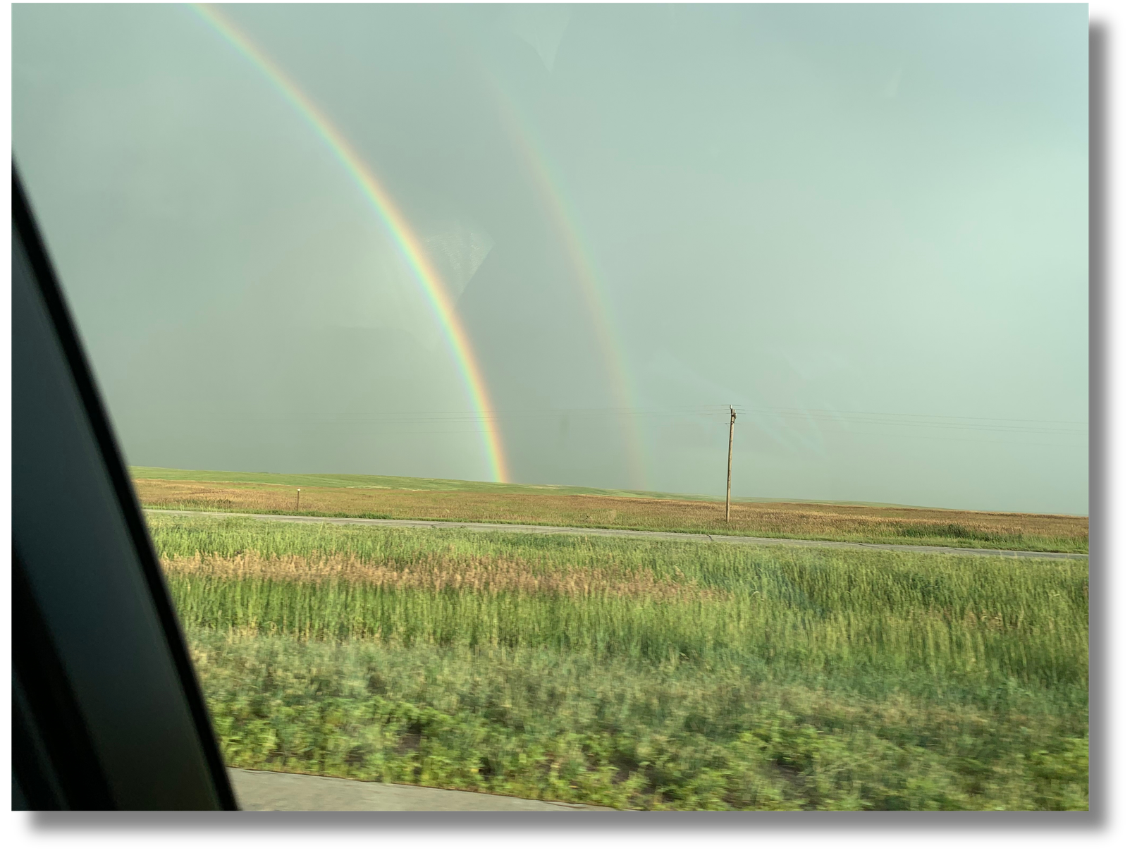
Key Take Away
Rich Lacy Photos

Slide 17
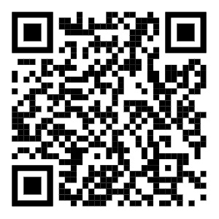
When Leaving, Leave With a Play List!
All I have No More Tears,
I had my Final Countdown.
It’s a Cobra Kai Cruel Summer.
But Another One Bites the Dust.
Now, Like a Virgin, I need to Harden My Heart and take the Highway to the Danger Zone and look for jobs.
Eventually will find the right one and it will be just like seeing the Bellagio fountains playing Fly Me to the Moon again.
Rhonna’s playlist

Slide 18
References
  https://www.isc2.org/Insights/2025/12/2025-ISC2-Cybersecurity-Workforce-Study
  https://www.linkedin.com/pulse/class-20252027-your-first-job-already-being-repriced-joel-abraham-lzouc/?trackingId=33T5swAGRfS2BB44zzDjvg%3D%3D
  COMMS_2025_Cybersecurity_WFS_Report_Whitepaper.pdf from ISC2
  https://www.isc2.org/Insights/2025/06/cybersecurity-hiring-trends-study

Slide 19


Thank You
Rhonna Novy
CISSP, MBA, eMAPT, Mentor, Volunteer
rhonnacybertechlead@gmail.com
https://www.linkedin.com/in/rhonna-novy/

