Slide 1
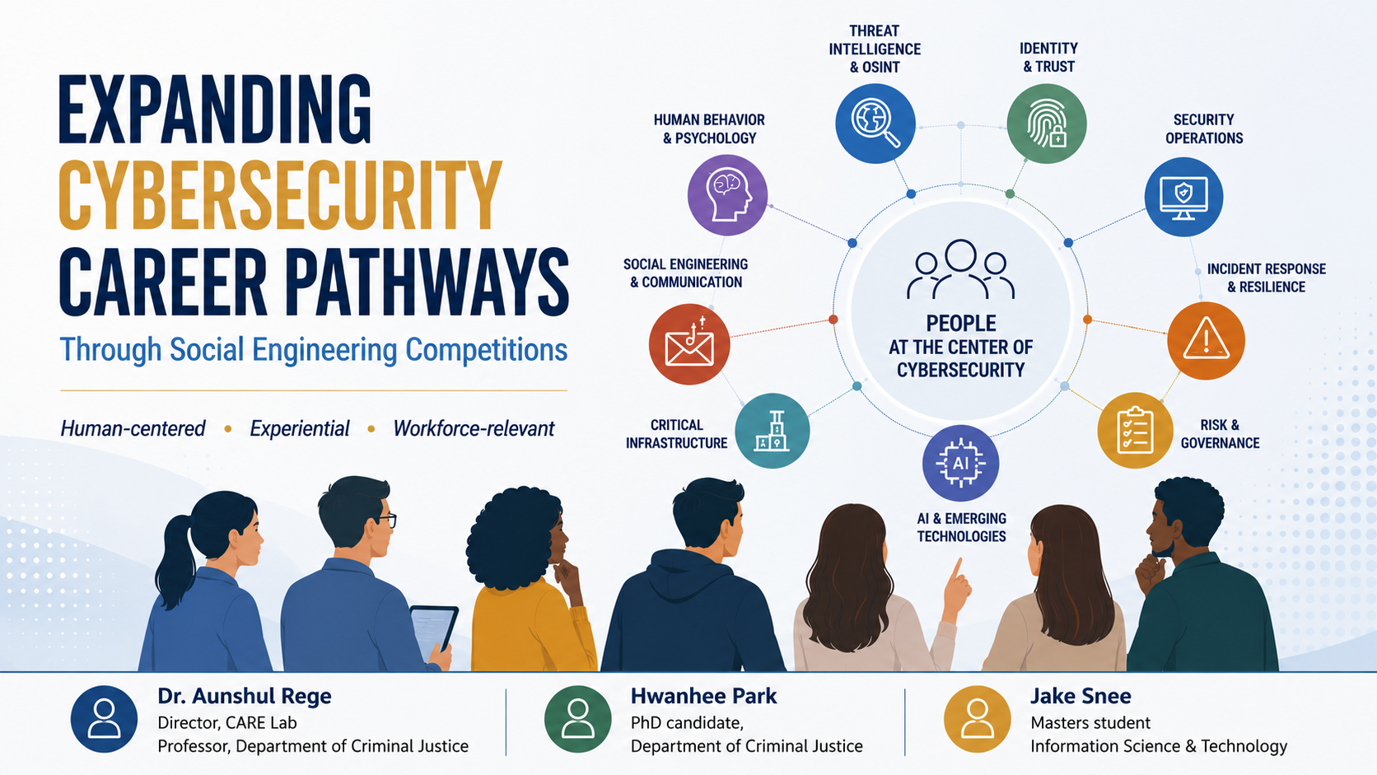

Slide 2
Agenda
Reframing cybersecurity pathways
Five-year competition model
Learning through artifacts
Student perspectives, workforce alignment & transferability
Next steps & resources
Acknowledgements
NSF Award # 2032292
Temple IRB, CAT, Legal, Risk Management, IT Services
Our many SMEs
Our sponsors/funders

Slide 3
Reframing Cybersecurity Pathways

Slide 4
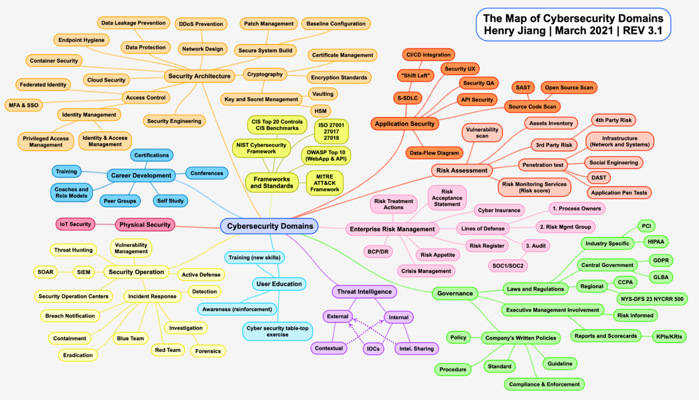
Where do humans matter in cybersecurity?

Slide 5
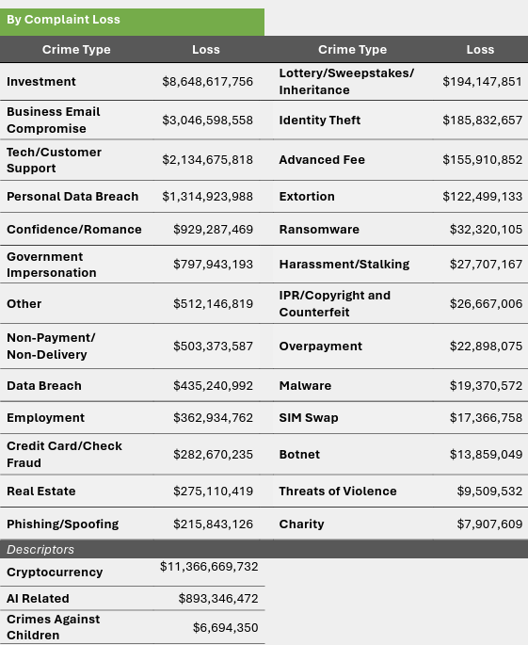
What is social engineering (SE)?
Manipulating human behavior/psychology to get individuals to:
  Reveal information
  Provide access
  Perform an action
Why address SE?
Consequences¹:
  Direct financial loss
  Recovery cost
  Productivity loss
  Operation disruption
  Reputation damage
https://www.ic3.gov/AnnualReport/Reports/2025_IC3Report.pdf
1 https://www.graphus.ai/blog/the-five-agonies-of-social-engineering-cyber-attacks/

Slide 6
Rethinking cybersecurity talent & training
Cybersecurity needs different ways of thinking
  Human, social, psychological, and behavioral perspectives
  Creative problem solving for complex, multi-faceted challenges
  Interdisciplinary strengths as cybersecurity assets
Adversaries are diverse — the workforce should be too
  Global threat landscape: culture, language, context
  Adversarial mindsets & target-specific vulnerabilities
  Multiple entry points into cybersecurity careers
Humans are cybersecurity’s strongest asset
  People as defenders, analysts, communicators, investigators
  Experiential learning through formal and informal pathways

Slide 7
Five-Year Competition Model

Slide 8
SEC overview
Completely virtual
International
No registration or other fees
High school, undergraduate, graduate
Three-day event for each track (Friday-Sunday)
Mostly asynchronous with some real-time engagement
Different theme every year

Slide 9
Design philosophy behind the competition
Theme-driven & evidence-based
  Grounded in real-world incidents, loss data & current threat trends
  Informed by interviews with subject-matter experts (SMEs)
Campaign-level thinking (not isolated attacks)
  OSINT → Persona → Pretext → Phish/Vish → Outcome
  Multi-channel, cumulative social engineering design
Disciplinary & role-based breadth
  Psychological, behavioral, and social dimensions
  Roles: penetration tester, fraud analyst, negotiator

Slide 10
Design philosophy behind the competition (ctd)
Cybersecurity + cyber hygiene + AI
  Identity governance & digital exposure awareness
  AI as a force multiplier in deception and defense
Pedagogically aligned & workforce-oriented
  Developed in partnership with CAT
  Learning goals aligned with NICE TKS mappings
Complementary to traditional CTFs
  Expands into the human attack surface
  Supplementary training aligned with workforce needs

Slide 11
SE, ethics, and emerging technology
Ethics board
Risk management office
Introduction of AI
  Legal counsel
  IT services
REQUIRED code of conduct forms for students and advisors

Slide 12
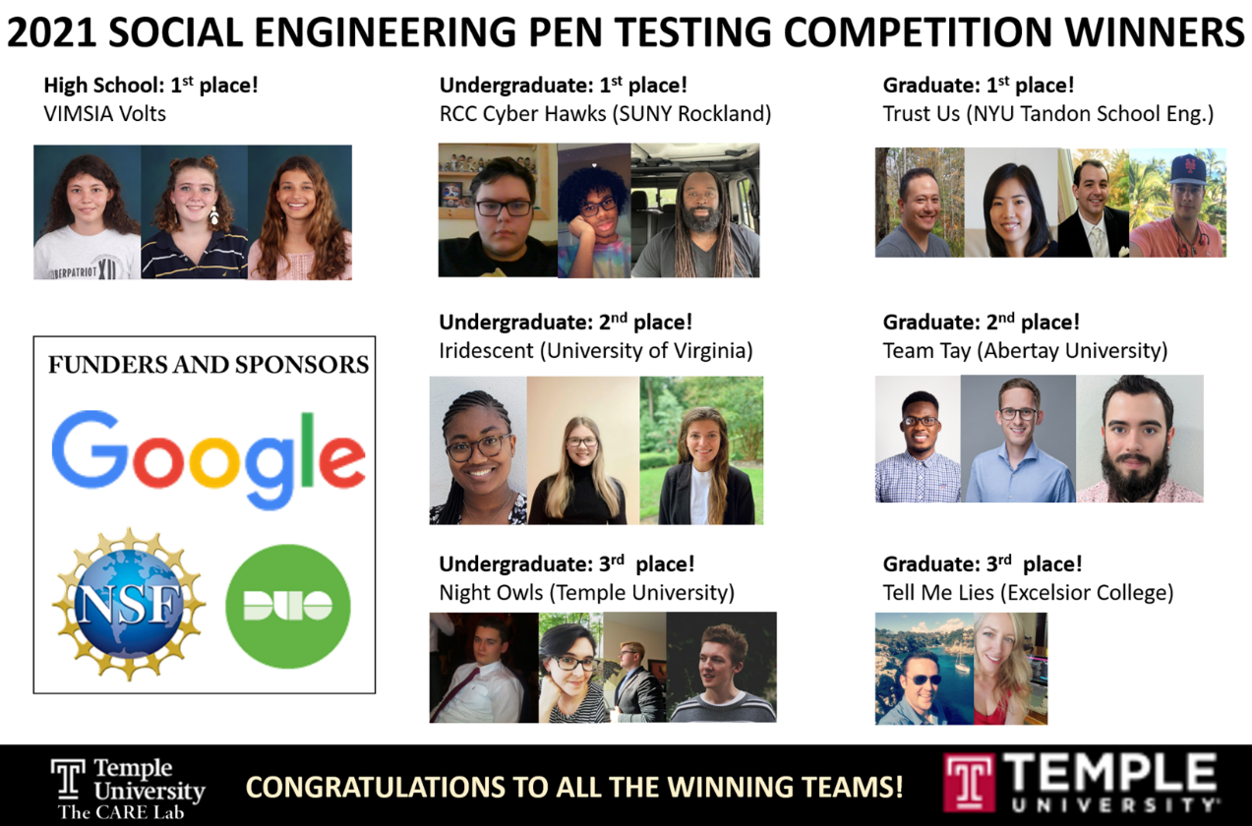
2021: SE pen test
Context: SE Pen Test for CARE Lab
Student teams’ role: Pen testers
Deliverables: Formal report + oral presentations
Partners: CISA, ATT&CK, Google

Slide 13
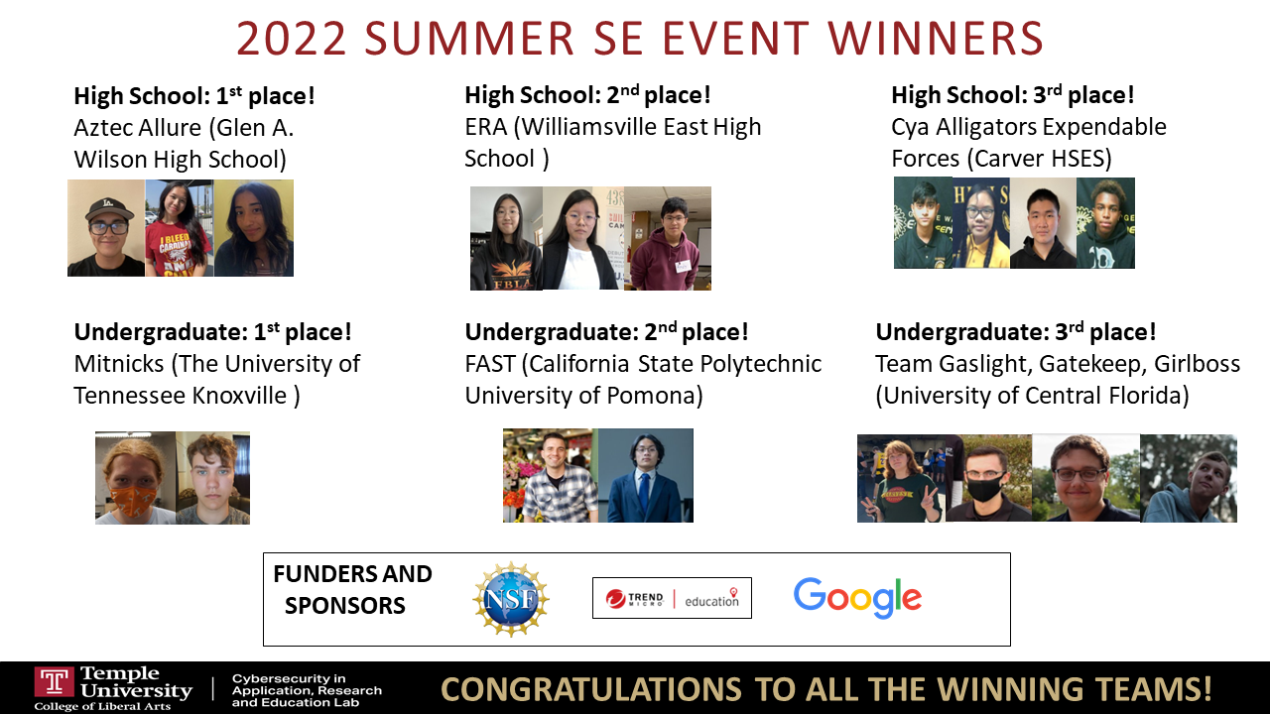
2022: Ransomware
Inspiration: Colonial Pipeline Ransomware Attack¹
Context: CARE Lab hit with ransomware
Student teams’ role: Negotiators
Deliverables: Formal report + oral presentations
Partners: CISA, ATT&CK,
NICE, SentinelOne
1 https://www.cisa.gov/news-events/news/attack-colonial-pipeline-what-weve-learned-what-weve-done-over-past-two-years

Slide 14
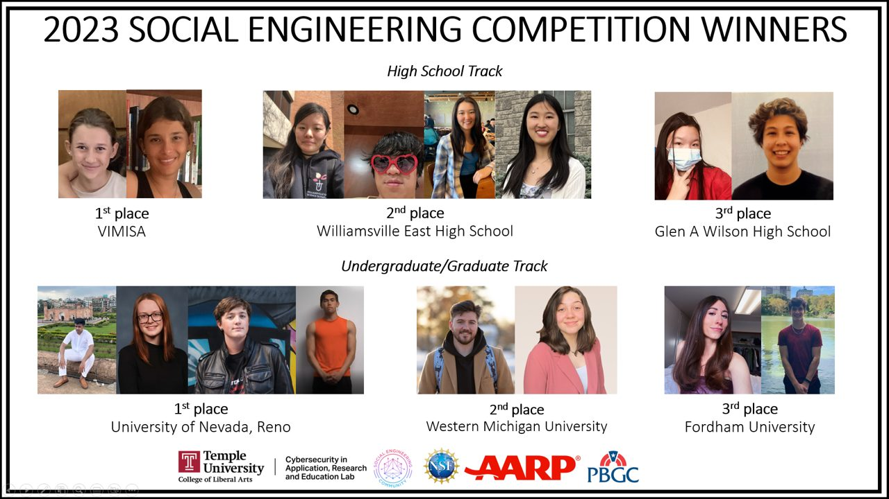
2023: Romance scams
Inspiration: FTC Report
  2021: $547 million¹
  2022: $1.3 billion²
Context: CARE Lab help an elderly victim of romance scam
Student teams’ role: Fraud fighters
Partners: CISA, NICE,
PBGC, AARP
1 https://www.ftc.gov/news-events/data-visualizations/data-spotlight/2022/02/reports-romance-scams-hit-record-highs-2021
2 https://www.ftc.gov/news-events/data-visualizations/data-spotlight/2023/02/romance-scammers-favorite-lies-exposed

Slide 15
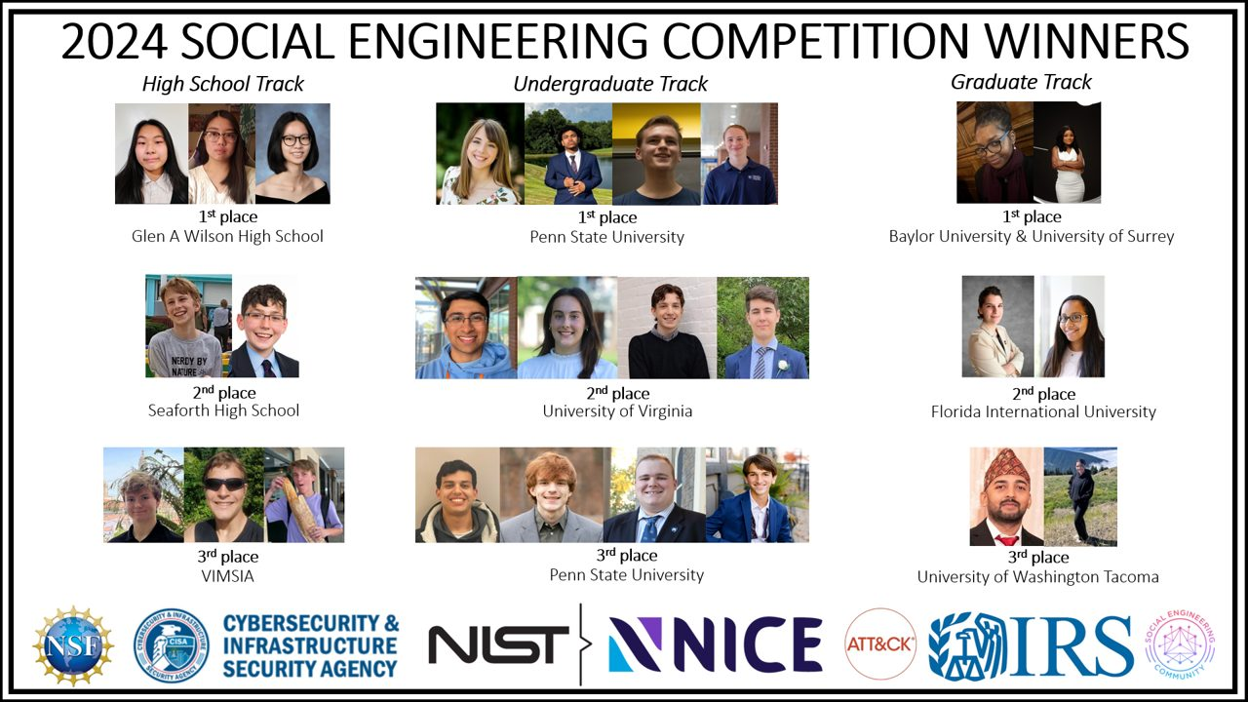
2024: Employment/tax scams
Inspiration: TU student experience
Context: CARE Lab help a young adult experiencing employment scam
Student teams’ role: Fraud fighters
Partners: CISA, NICE,
ATT&CK, IRS

Slide 16
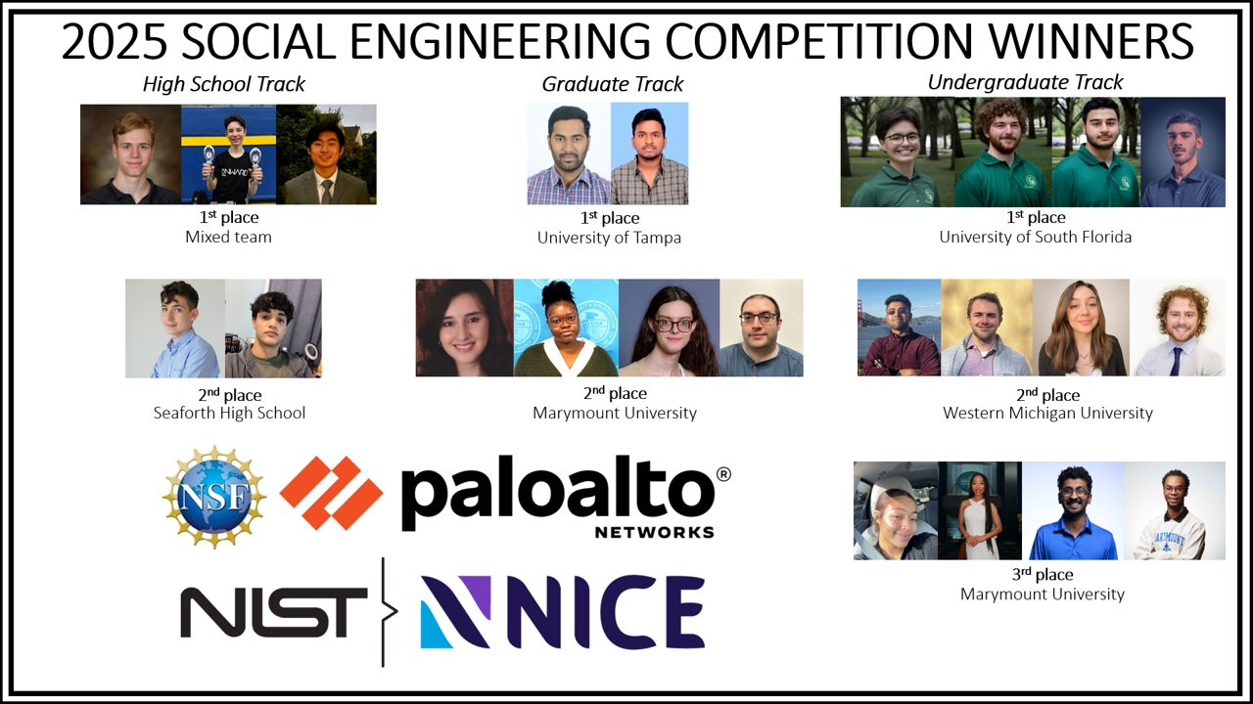
2025: Critical infrastructure (transportation)
Inspiration: 2023 Polish Railway cyberattack¹
Context: SE Pen Test for fictitious transportation organization
Student teams’ role: Pen testers
Partners: CISA, NICE, Palo Alto Networks
1 https://www.bbc.com/news/world-europe-66630260

Slide 17
2026: Critical infrastructure (healthcare)
Inspiration: 2025 Ponemon Healthcare Cybersecurity Report¹
  93% experienced a cyberattack in the past year
Context: SE Pen Test for fictitious community-based pharmacy
Student teams’ role: Pen testers
Partners: CISA, NICE, OWASP Philly
1 https://www.proofpoint.com/us/resources/threat-reports/ponemon-healthcare-cybersecurity-report

Slide 18
Learning Through Artifacts

Slide 19
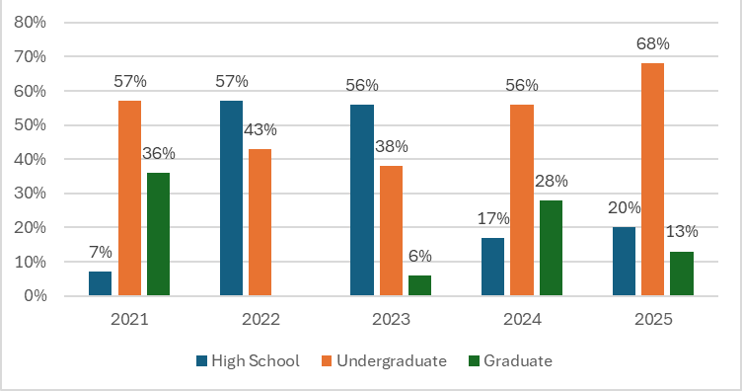
Team level (2021-2025)

Slide 20
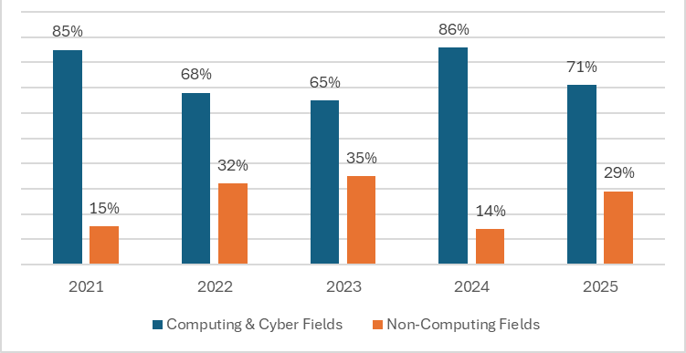
Disciplinary background (2021-2025)

Slide 21
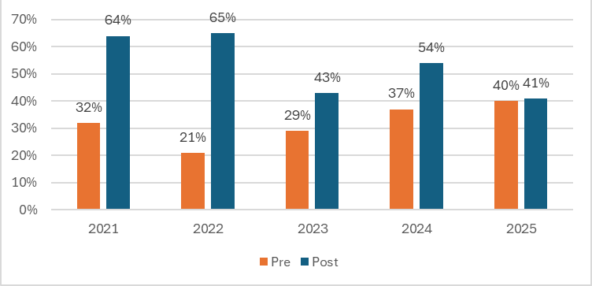
SE relevance to cybersecurity (2021-2025)

Slide 22
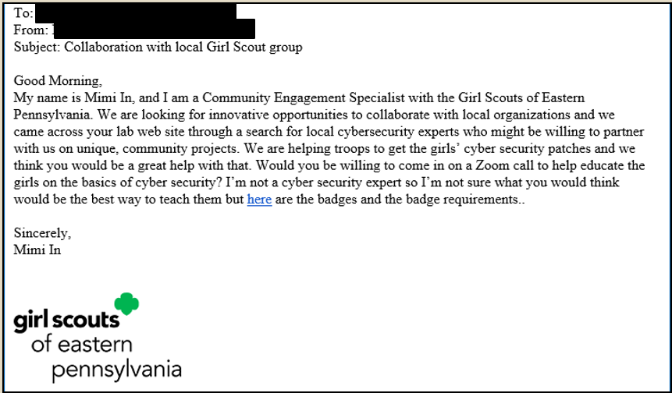
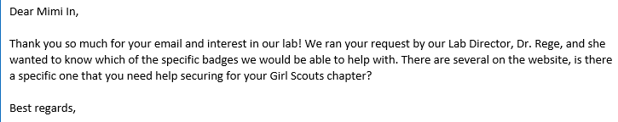
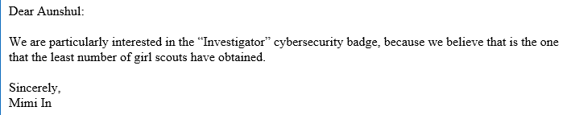
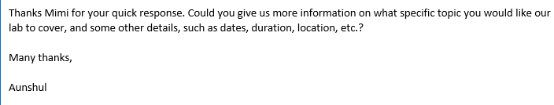
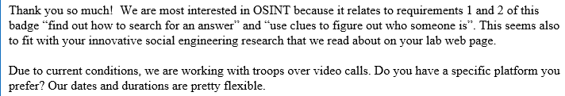
2021: SE Pen Test
Track: High school
Objective: secure collaboration

Slide 23
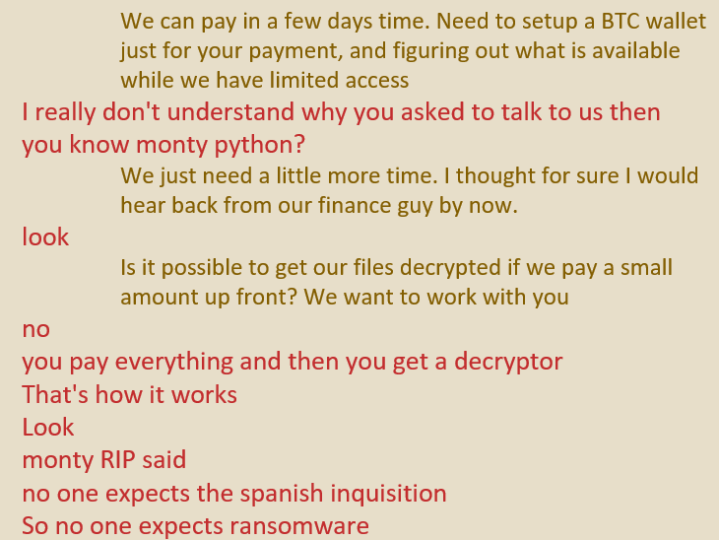
2022: Ransomware
Track: Undergraduate
Objectives: Buy time, get decryption proof via negotiations

Slide 24
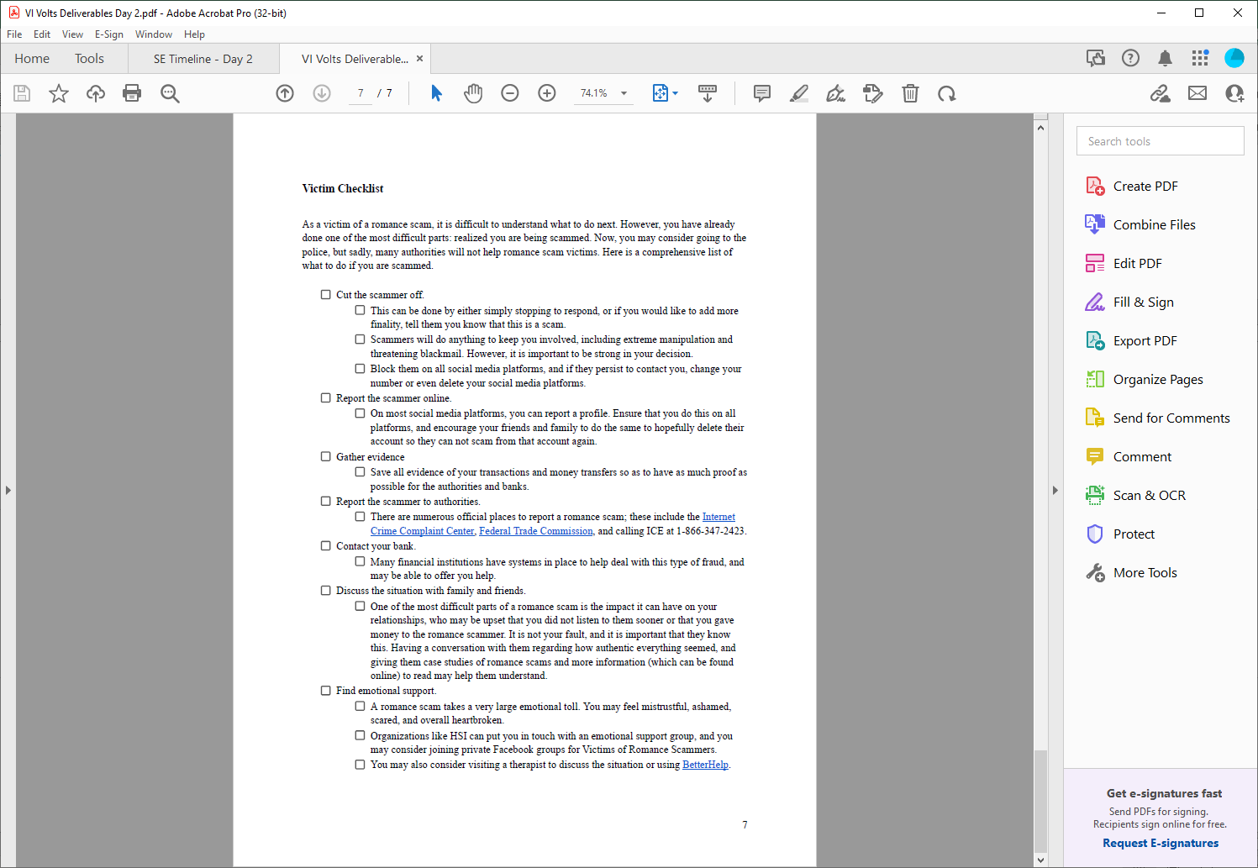
2023: Romance scams
Track: High school
Objective: Generate victim checklist

Slide 25
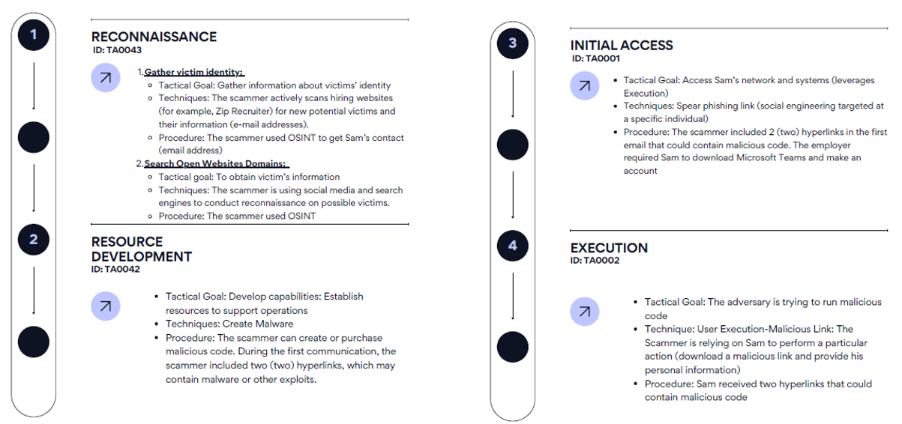
2024: Employment/tax scams
Track: Graduate
Objectives: Map timeline to ATT&CK framework

Slide 26

2025: Critical infrastructure (transportation)
Track: Undergraduate
Objectives: Get details about cybersecurity training

Slide 27
Student Perspectives, Workforce Alignment & Transferability

Slide 28
Student perspectives
“Partaking in this competition was a great experience for me and my team. For the most part we were exposed to another aspect of cybersecurity that is not normally covered in the classes or in most workplaces. So it was quite a learning curve. But overall great experience.” – 2021 competitor
“Participating in the competition improved my understanding, ability, and confidence in [SE] by engaging in hands-on experience.”- 2024 Competitor
“From this year’s Social Engineering (SE) event, I learned how critical human factors are in cybersecurity. Technical defenses are important, but people often remain the easiest targets. I gained hands-on experience in crafting realistic phishing emails and vishing scripts, which taught me how small details — like tone, timing, and word choice — can dramatically impact the success of an attack. I also learned the importance of preparation, adaptability, and ethical responsibility when conducting SE exercises. Most importantly, the event showed me how vital continuous security awareness training is for organizations to strengthen their overall defense.“ – 2025 competitor

Slide 29
Cross-sector partnerships
Pipeline to Defcon SECVC
  Last year’s winning HS team
Government and federal agencies
  NICE/NIST, CISA, PBGC, IRS
Nonprofit and research organizations
  MITRE ATT&CK, AARP
Industry collaborators
  Sentinel One, Palo Alto, Google, DUO, Trend Micro

Slide 30
Industry, Government and Nonprofit perspectives
“Higher profile targets have been attacked via SE … it’s a big blind spot that a lot of schools and companies don’t think about as much; they are concerned with the technical controls and not with the people controls”
– Industry representative
“I recognized that hardly anyone is doing [SE]… it’s rare to be able to exercise and practice this skill ethically… [it] is hard to teach… it needs to happen, we need more of it, but really… being in that type of education environment… was fun!”
– Government representative
“The more eyes we can get on this problem, and the more thoughts we can put into this [SE] space, maybe we can produce something [that is meaningful]… cybersecurity is a shared problem… when you see how the real world works, you realize it’s all connected. You can either play in your silo and lose the battle or you can open up to new ideas and realize you can’t solve the problem by yourself”
– Nonprofit representative

Slide 31
Workforce readiness
Client report
  In depth analysis of findings
  Mimic industry
Client presentation
  Executive summary
  Highlight most glaring vulnerabilities
Beyond exploitation
  Mirrors professional practices

Slide 32
Workforce-relevant skills embedded in SEC design
OWASP Mappings
  Threat categorization & prioritization
  Human exploitation pathways
  Evidence-based mitigation recommendations
ATT&CK Framework
  Attack lifecycle exposure
  Tactics, techniques & procedures
  Adversarial thinking & attack chaining
NIST Phish Scale
  Email realism & contextual cues
  Premise credibility & targeting
  Detection complexity & user susceptibility

Slide 33
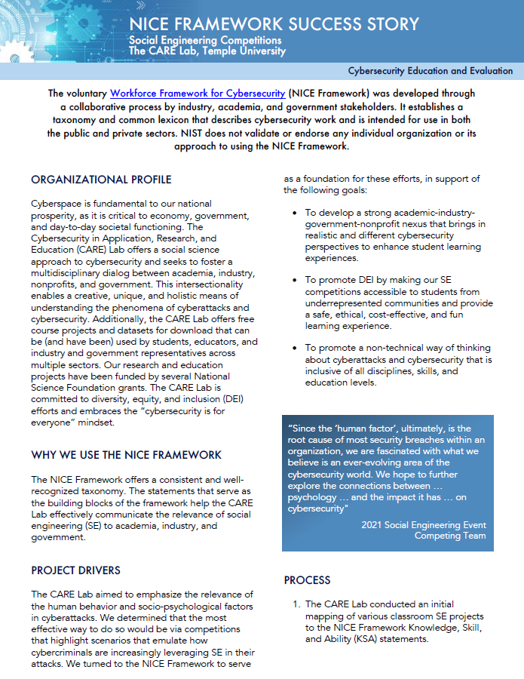
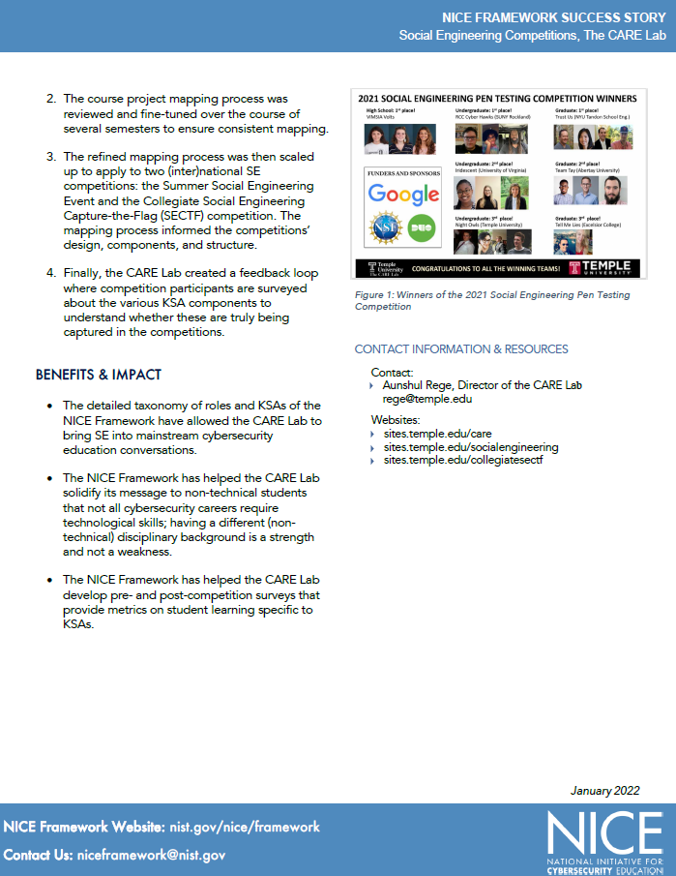
SEC is a NICE framework success story
https://www.nist.gov/itl/applied-cybersecurity/nice/nice-framework-resource-center/nice-framework-success-story-social

Slide 34
SE is not one domain
OSINT
  Threat Intelligence
  Reconnaissance
  Risk Assessment
Persona & Pretext Development
  Human Behavior
  Identity & Trust
  Organizational Risk
Phishing/Vishing
  IAM
  Communications Security
  Incident Detection

Slide 35
SE is not one domain (ctd)
AI-generated personas, TTS, synthetic media
  AI Security
  Application Security
  Identity Verification
Client Debrief & Recommendations
  GRC
  Risk Management
  Organizational Resilience

Slide 36
Next steps & resources

Slide 37
SE & AI
2025
  Text AI to generate
    Personas
    Pretexts
    Phish texts
    Vish scripts
  Image AI to generate personas
2026
  Text-to-speech to generate synthetic vishing
AI & LLM risk integration + ethical/responsible AI use

Slide 38
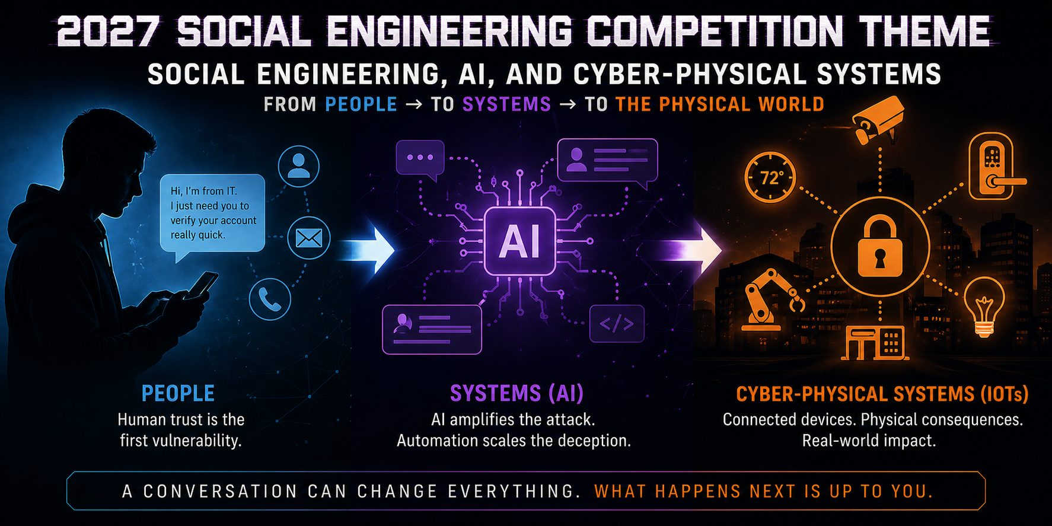
Where we’re headed
Different themes and roles for SEC
Assessment & research expansion
  Pre/post learning analytics align with workforce readiness metrics
  Publication and dissemination efforts

Slide 39
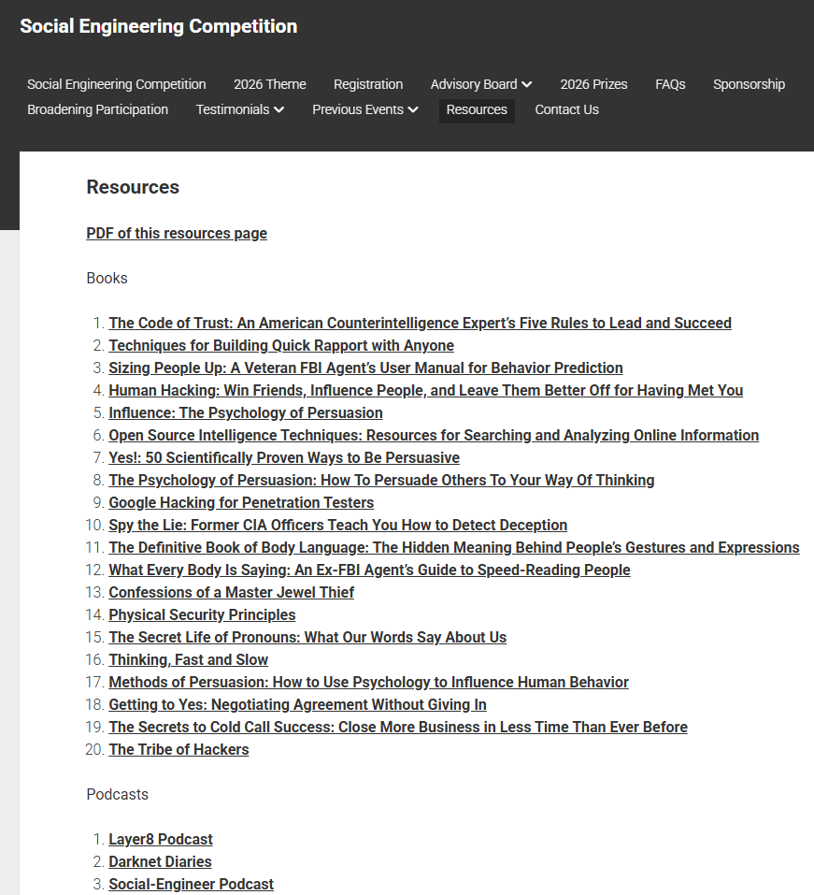
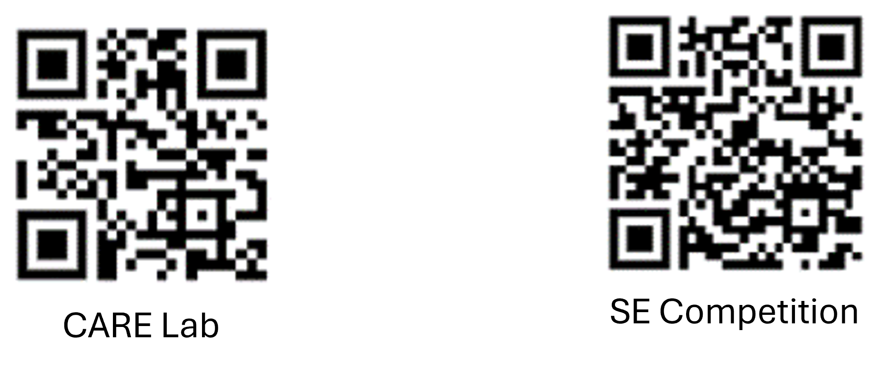
Resources for students and faculty¹
Books
Podcasts
Videos
Websites

Slide 40
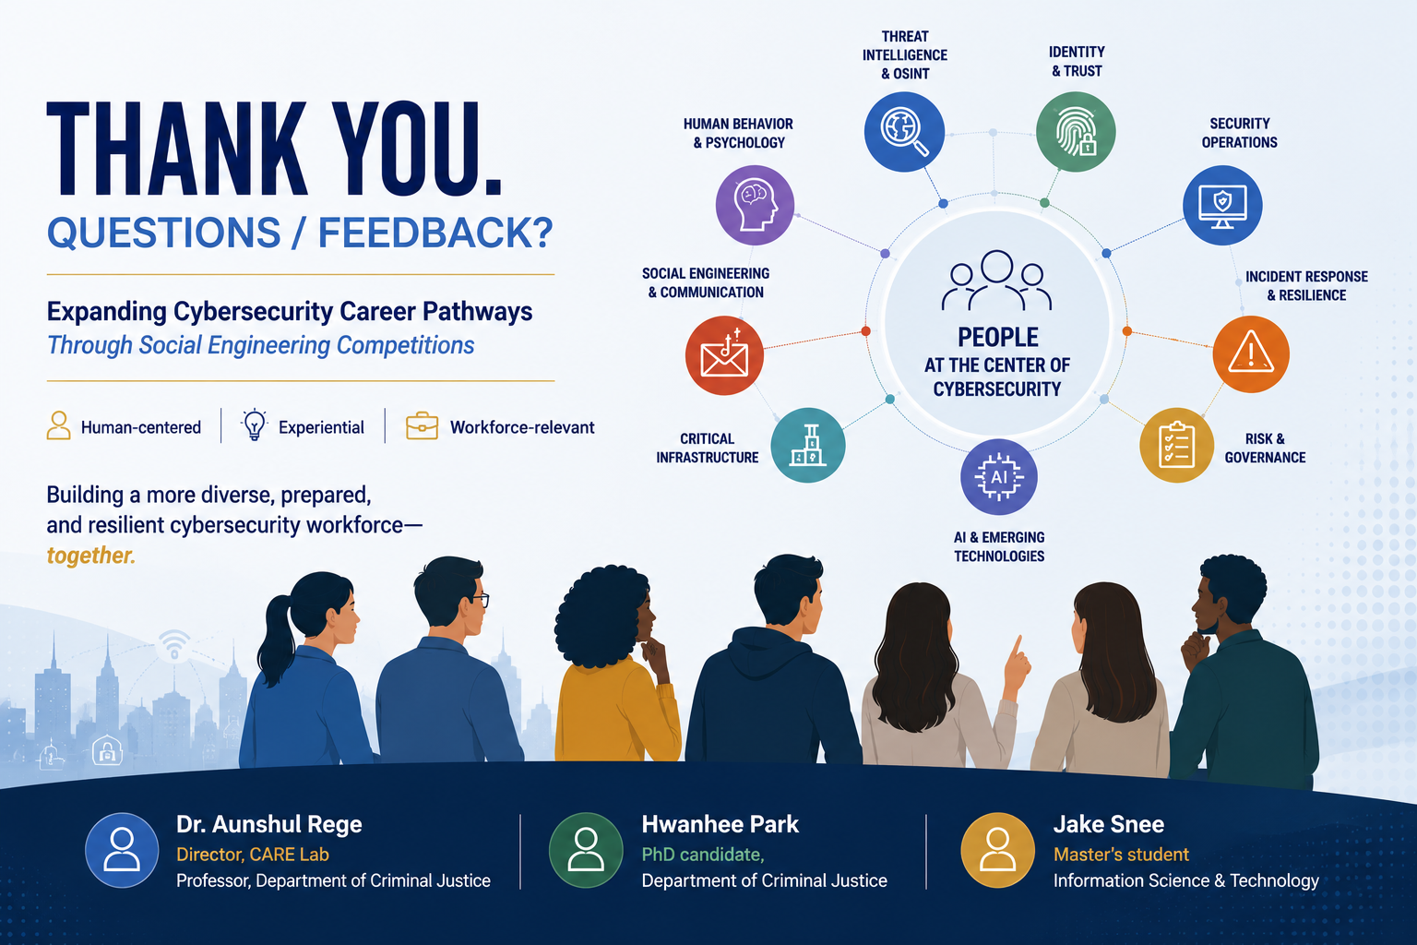

Slide 41
Publications
Rege, A., Park, H., Snee, J. (forthcoming). “Artificial Intelligence as a Force Multiplier in Social Engineering: An Experiential Learning Approach”. In The International Conference on Cybersecurity, Situational Awareness and Social Media
Park, H., Bleiman, R., & Rege, A. (2025, March). Understanding Behavioral and Psychological Aspects of Employment and Tax Scams via a Social Engineering Competition. In 2025 IEEE Integrated STEM Education Conference (ISEC) (pp. 1-8). IEEE.
Bleiman, R., Park, H. & Rege, A. (2025). “Educating students on the behavioral and psychological aspects of romance scam victimization via a social engineering competition”. Journal of Cybersecurity Education Research and Practice (JCERP): Vol 2025: No 1, Article 3.
Rege, A. & Bleiman, R. (2024). “A Case Study of a Ransomware and Social Engineering Competition.” Proceedings from the 14th IEEE Cyber Science Conference.
Rege, A., Bleiman, R. & Williams, K. (2023). “The Relevance of Social Engineering Competitions in Cybersecurity Education”. Proceedings from the IEEE Cyber Science Conference.

