Slide 1

From Foundations to Futures:
Guiding Students into Cybersecurity Careers
Kristine Christensen, PhD.
PI, Explore Cyber
Professor, CIS & Director, Faculty Development
Moraine Valley Community College
Dr. Deanne Cranford-Wesley
Director of Cybersecurity Programs
North Carolina Central University
Explore Cyber,, is funded by the National Science Foundation Advanced Technological Education grant #2500740. Any opinions, findings, and conclusions or recommendations expressed in this material are those of the author(s) and do not necessarily reflect the views of the National Science Foundation

Slide 2

📍 PHILADELPHIA, 1706-1790
Benjamin Franklin left school at age 10
Through self-education, mentorship, curiosity, and persistence, he became a printer, author, inventor, scientist, diplomat, and one of America's Founding Fathers.
Franklin's career path was anything but linear. He explored opportunities, built skills, and continuously reinvented himself throughout his life.
Many students today face a similar challenge. They have strengths and potential, but they may not yet see the pathways available to them.
That's where advisors, counselors, and educators make a difference.
“
An investment in knowledge pays the best interest.

Slide 3


📍 PHILADELPHIA, 1976
Nobody Believed
He Could Run
Those Steps.
Rocky Balboa wasn't the obvious choice. He was overlooked, underestimated — working a dead-end job with no credentials, no connections, and no clear path forward. Until Mickey saw something in him nobody else did.
Mickey didn't give Rocky talent,
he gave him direction.

Slide 4
What we’ll cover
The cybersecurity workforce gap & why counselors & advisors matter
Overview of Explore Cyber
Jungian personality types & career fit
Hands-on: mapping personality type to work roles
AI tools for resume & career materials
The Explore Cyber Toolkit & free training
Ways to get involved

Slide 5
What is the biggest challenge when helping students explore cybersecurity careers?
Lack of student awareness
Limited advisor and counselor knowledge
Too many career options
Misconceptions about cybersecurity
Career readiness concerns
Competing with other disciplines

Slide 6
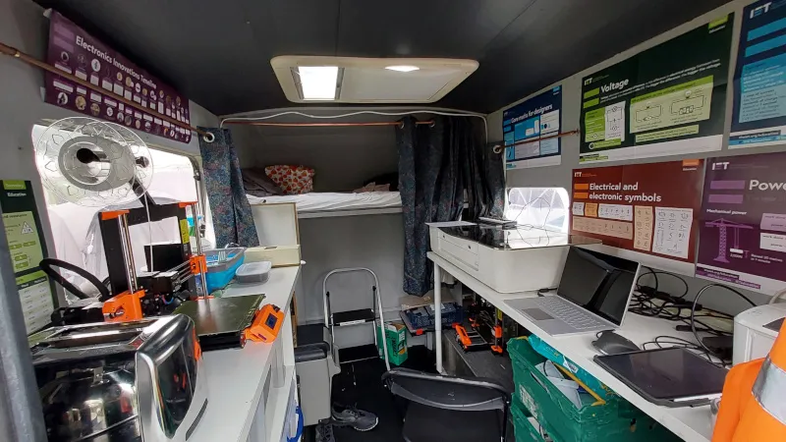


What do you think most people think of when they hear the word cybersecurity?

Slide 7
The Cybersecurity Workforce Challenge Isn't Just a Talent Problem. It's an Awareness Problem.
1
Hundreds of thousands of cybersecurity positions remain open
The U.S. alone has 500,000+ unfilled roles, and the gap is growing every year
CyberSeek / CompTIA, 2025
2
Many counselors & advisors report limited familiarity with cyber career pathways
78.6% of participants had little to no knowledge of the cybersecurity career landscape
3
Cybersecurity is often misunderstood
Many people associate cybersecurity primarily with hackers, cybercrime, and highly technical work, overlooking roles focused on protection, education, and risk management.
4
Students may not see themselves in cybersecurity
Cybersecurity careers span business, healthcare, education, communications, law, policy, manufacturing, and technology, yet many students believe the field is only for programmers and hackers
Result: Students may never discover cybersecurity careers that align with their interests, strengths, and goals. That's the gap this toolkit is designed to address.

Slide 8
Cybersecurity Workforce Gap
Severe Workforce Shortage: There are an estimated 4 million unfilled cybersecurity jobs globally, with over 500,000 vacancies in the U.S. alone (Cyberseek).
Rising Demand: Cybersecurity job growth is projected to increase 35% from 2021 to 2031, significantly outpacing the average job growth rate (Bureau of Labor Statistics).
Increasing Cyber Threats: The rapid rise of cybercrime, ransomware, and nation-state attacks has heightened the need for a skilled cybersecurity workforce.
Shortage of Qualified Professionals: Many job applicants lack the necessary hands-on skills, certifications, and specialized training required to meet industry demands.
Continues to Hold National Attention: White House Office of the National Cyber Director (ONCD)

Slide 9
Career Counselors & Academic Advisors help students with:
Self-discovery
use assessments to identify strengths, interests and values – crucial factors in career satisfaction
Informed decision-making
provide in-depth information about various careers, including job descriptions, educational requirements, salary ranges, empowering student to make informed decisions
Goal setting & planning
help individuals set realistic career goals and develop a roadmap to achieve them
Improved job search skills
provide counselors on effective resumes, cover letters, and interview skills

Slide 10
Career Counselors & Academic Advisors:
Support during transitions
offer guidance and support during career changes, job loss, or re-entry into the workforce – career paths aren’t always linear
Bridge the knowledge gap
By providing accurate information about cybersecurity roles and understanding industry trends, demands, and employment opportunities can lead to better student guidance
Highlight diverse career pathways
By providing clear information of the pathways from education to various cybersecurity roles including formation on the steps and qualifications needed to progress in them
Can access and share up-do-date resources
Provide guides and toolkits on cybersecurity careers, including online resources and platforms for latest industry information

Slide 11
We want to help advisors and counselors:
Correct Misconceptions About Cybersecurity
Show that cybersecurity includes communication, policy, education, risk management, and technical roles, not just hacking and programming
Understand the Value of Certifications
Explain how industry certifications support skill development, career exploration, and workforce readiness
Explore Experiential Learning Opportunities
Promote clubs, competitions, internships, apprenticeships, research, and volunteer experiences that build cybersecurity skills
Build Confidence in Guiding Students toward Cybersecurity Career Pathways
Provide advisors with the knowledge and resources needed to guide students toward cybersecurity pathways

Slide 12
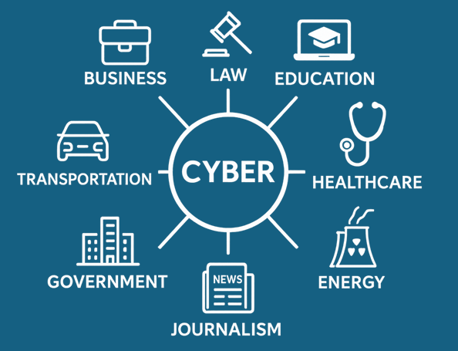
Interdisciplinary Demand for Cybersecurity Skills
Cyber touches every field: healthcare, law enforcement, agriculture, education, and manufacturing
Smart devices + data = growing risk across all sectors
Professionals need cyber awareness, not just cyber specialists
Employers want job-ready workers with both technical and domain-specific knowledge

Slide 13


Slide 14
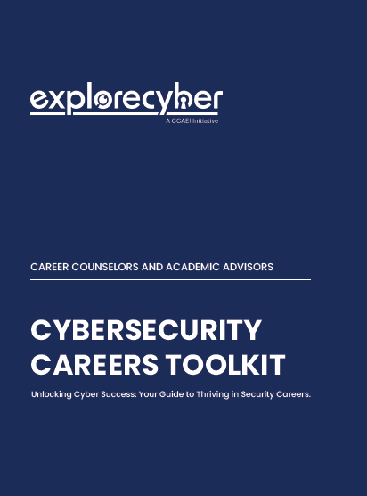
Cybersecurity Career Awareness Toolkit
Career Guide – Supports counselors and advisors in guiding students into cybersecurity careers.
Education Pathways – Covers degrees, certifications, and scholarships.
Career Tools – Features NICE & DCWF Frameworks, CyberSeek, and CYBER.ORG resources.
Hands-on Experience – Highlights competitions and workforce readiness programs.
Available at ExploreCyber.org

Slide 15
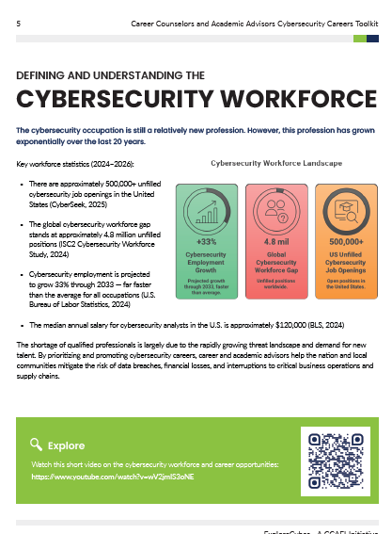
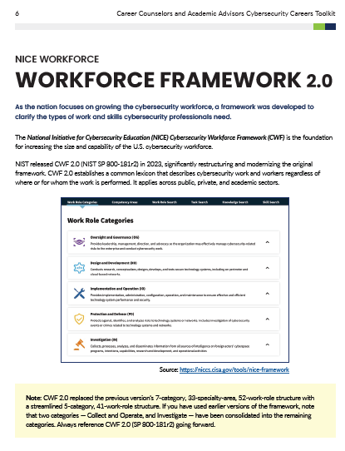
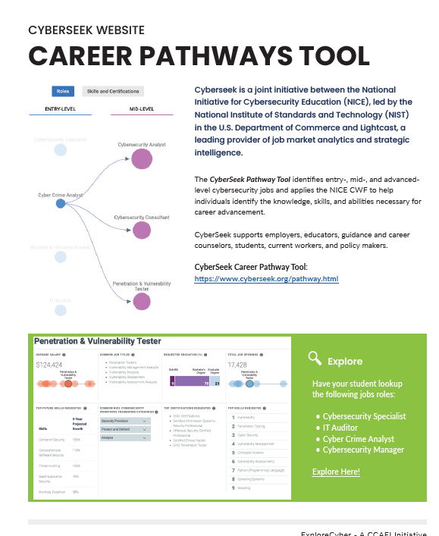
Cybersecurity Career Awareness Toolkit
Available at ExploreCyber.org

Slide 16
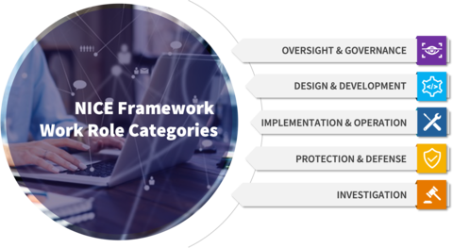
NICE Cybersecurity Workforce Framework
Purpose: Standardize cybersecurity workforce categories and roles
Goal: Help organizations identify, recruit, and develop cybersecurity talent
Structure: Hierarchical organization of work functions, specialty areas, and work roles
Benefit: Creates consistency across cybersecurity career paths
Source: https://niccs.cisa.gov/tools/nice-framework

Slide 17
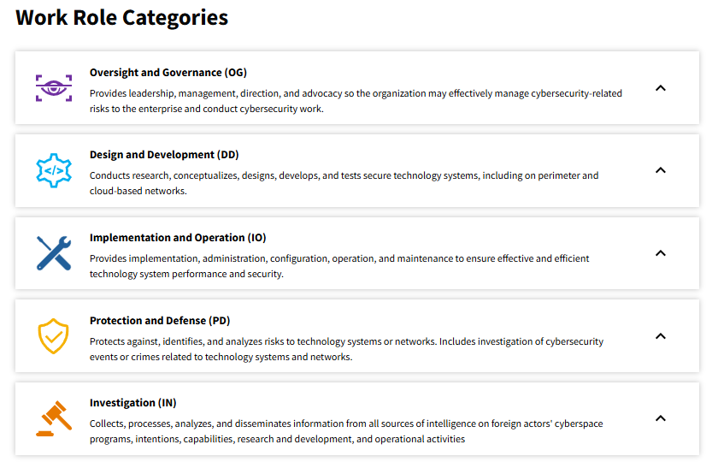
NICE Cybersecurity Work Role Categories
The NICE Framework includes the following components:
Work Role Categories: A high-level grouping of common cybersecurity functions.
Work Roles: A grouping of work for which someone is responsible or accountable. Please note, Work Roles are not synonymous to job titles or occupations.
Task, Knowledge and Skill Statements: A set of discrete building blocks that describe the work to be done (in the form of Tasks) and what is required to perform that work (through Knowledge and Skills).
Competency Areas: Clusters of related Knowledge and Skill statements that correlate with one’s capability to perform Tasks in a particular domain.
Source: https://niccs.cisa.gov/tools/nice-framework

Slide 18
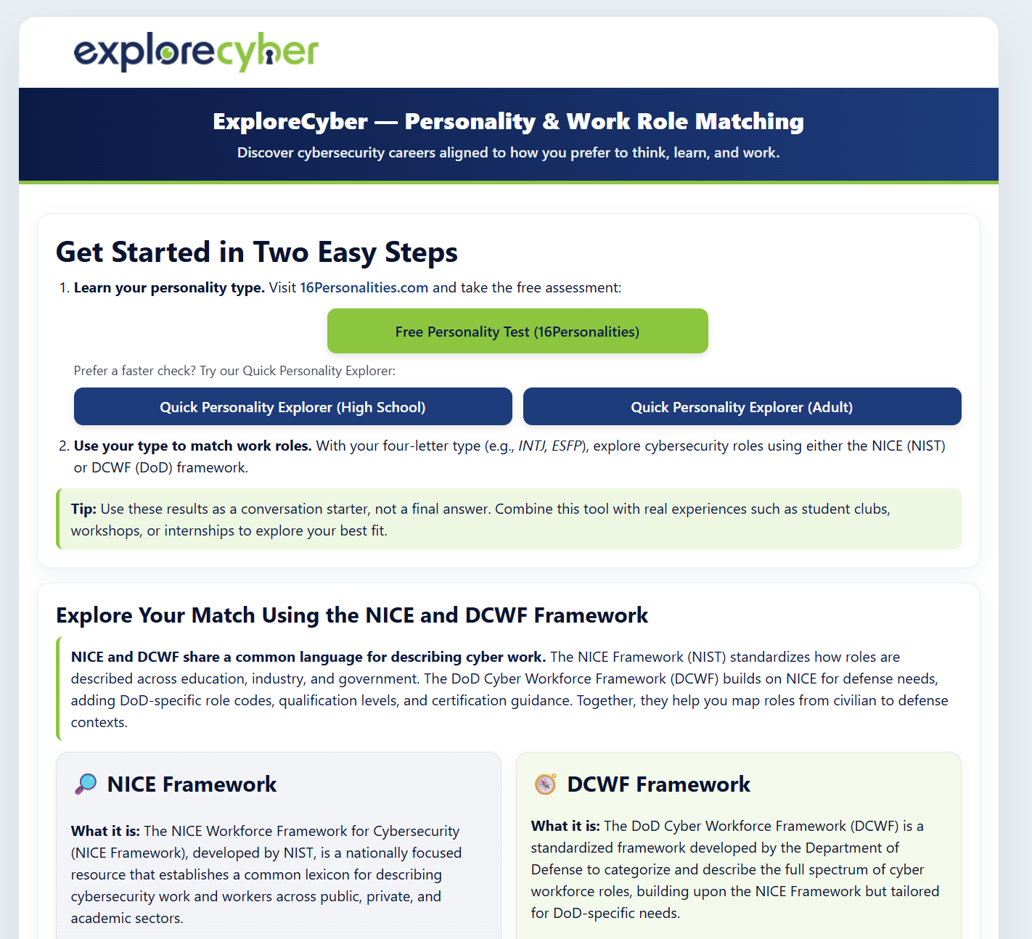

Personality Exploration & Work Role Matcher
i.explorecyber.org

Slide 19
There is no "perfect" personality type
⚠️
A note before we begin: personality frameworks are exploratory tools, not verdicts.
They are a starting point for conversation, not a definition of who you are, what you can do, or where you belong.

Slide 20
Personality Types & Cybersecurity
Dimension | Preference | Characteristics | Cybersecurity Examples
Energy | Extraversion (E) | Energized by interaction, discussion, and collaboration | Security Awareness, Training, Consulting, Leadership, Customer Success
 | Introversion (I) | Energized by reflection, focus, and independent work | Threat Analysis, Security Architecture, Digital Forensics, Research
Information | Sensing (S) | Practical, detail-oriented, focused on facts and evidence | Compliance, Auditing, Digital Forensics, Vulnerability Management
 | Intuition (N) | Big-picture thinker, enjoys patterns and possibilities | Threat Modeling, Security Strategy, Architecture, Risk Analysis
Decision Making | Thinking (T) | Logical, analytical, objective decision-making | Penetration Testing, Incident Response, Security Engineering, Risk Assessment
 | Feeling (F) | Values people, relationships, and organizational impact | Security Awareness, Policy Development, Workforce Development, Governance
Work Style | Judging (J) | Organized, structured, prefers planning and predictability | Governance, Risk & Compliance (GRC), Project Management, Policy
 | Perceiving (P) | Adaptable, flexible, enjoys dynamic environments | Incident Response, Threat Hunting, Red Teaming, Security Operations

Slide 21
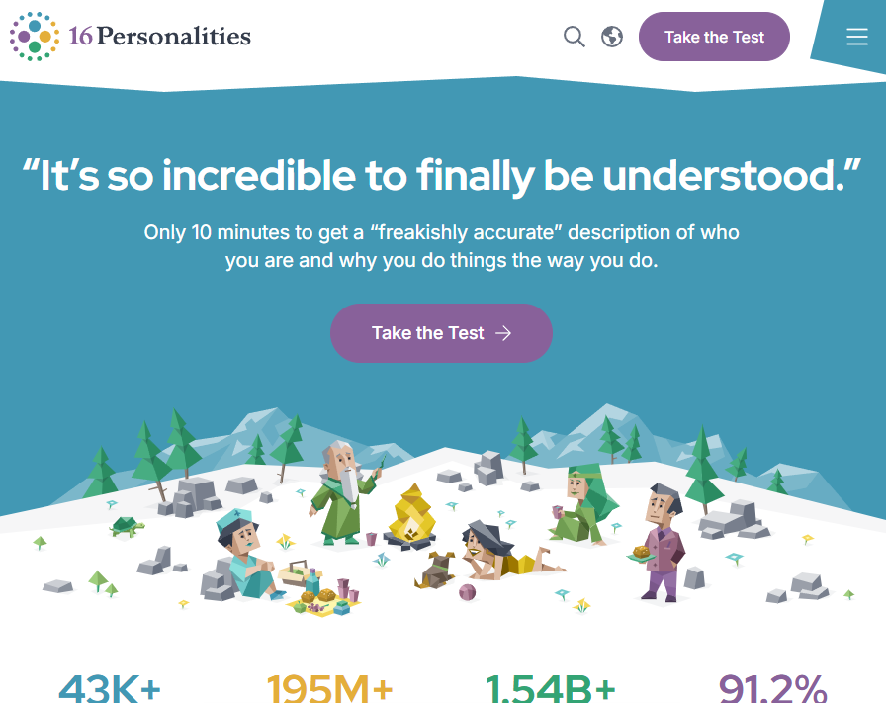
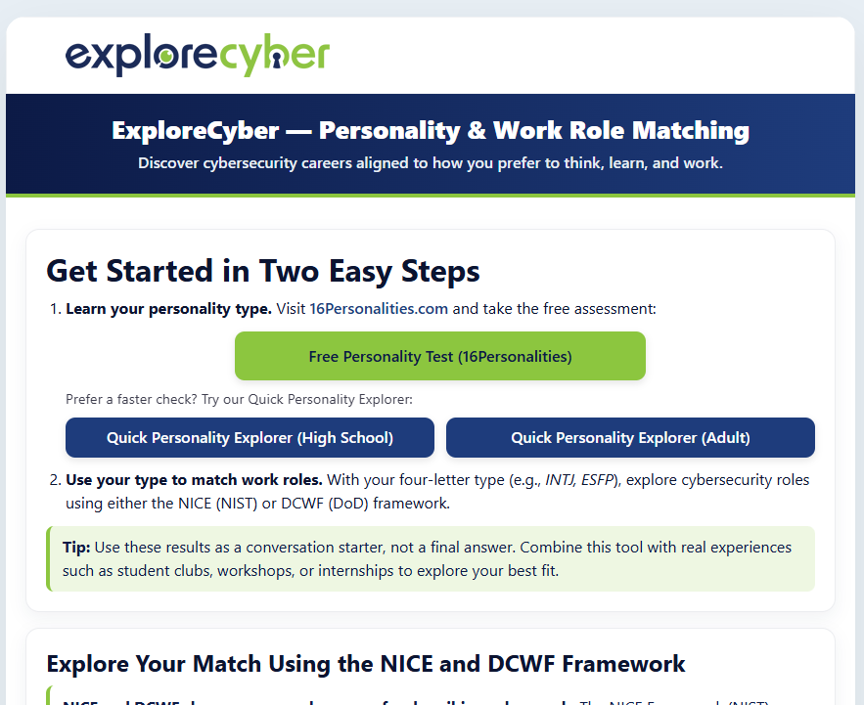

1. Find Your Personality Type
16personalities.com
i.explorecyber.org

Slide 22
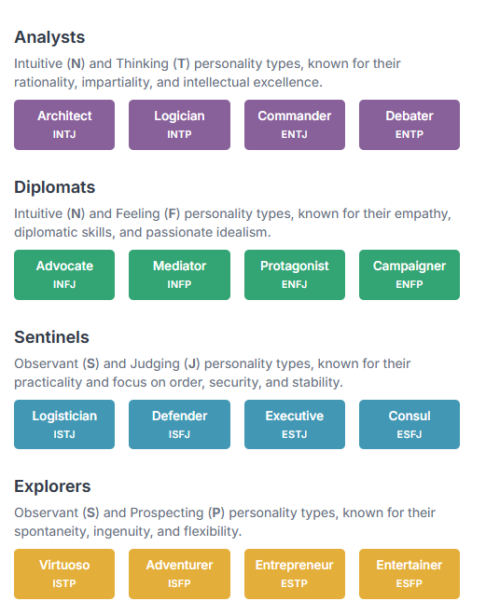
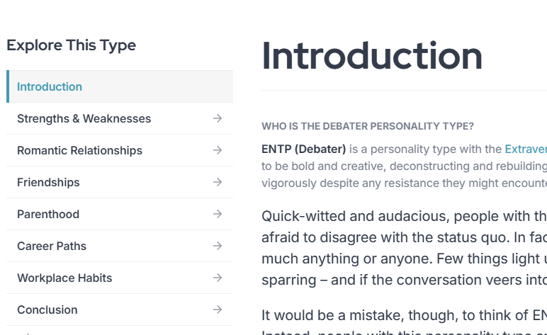
16 Personalities

Slide 23
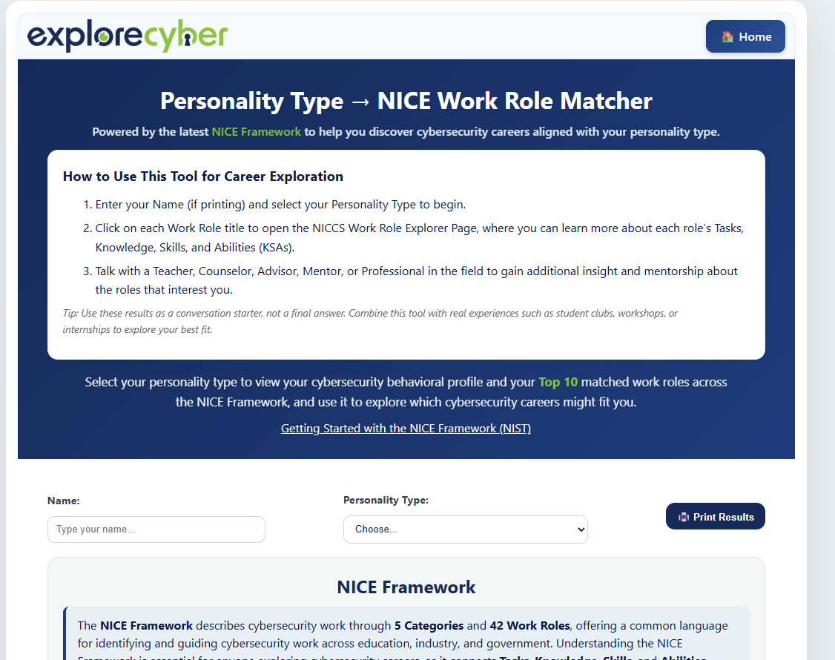
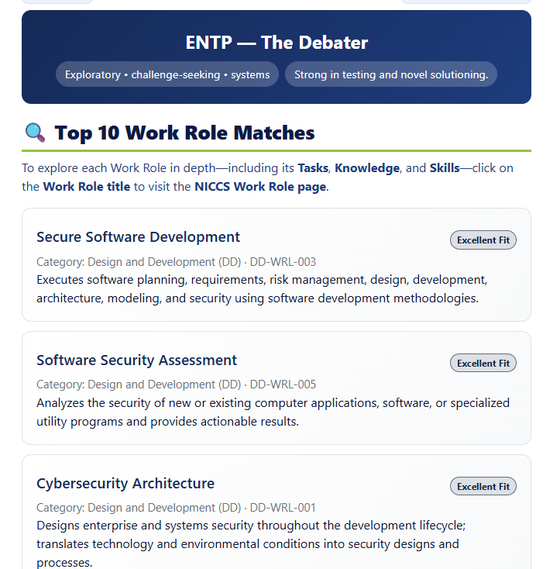
2. Match Your Personality Type with a Work Role

Slide 24
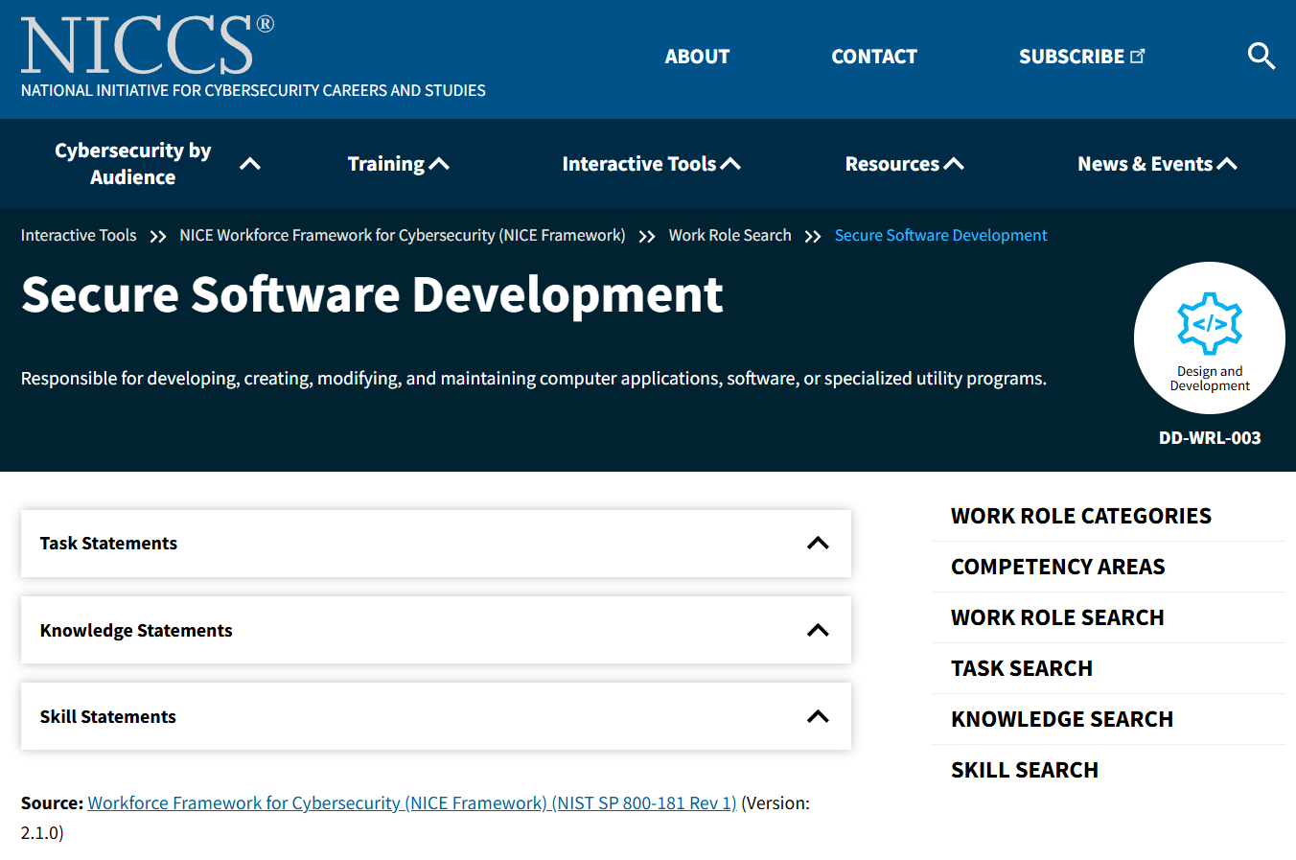
3. Explore Your Matches

Slide 25
Work Role Category & Student Interest
Career Area | What They Do | Ideal For Students Who…
Security Analyst | Monitor systems and respond to incidents | Like problem-solving, puzzles, and patterns
Penetration Tester (Ethical Hacker) | Test systems to find vulnerabilities | Enjoy challenges, games, or “catching the bad guy”
Cyber Forensics Specialist | Investigate breaches and gather digital evidence | Like criminal justice or investigative work
Network Defender | Protect systems from attacks and maintain security tools | Are detail-oriented and technical
Risk Analyst / Policy Specialist | Evaluate risks, write policies, ensure compliance | Enjoy writing, communication, or law
Security Engineer / Architect | Design and build secure systems | Like designing, planning, and building
Cyber Educator / Trainer | Teach or train others in cybersecurity | Like mentoring and helping people learn

Slide 26
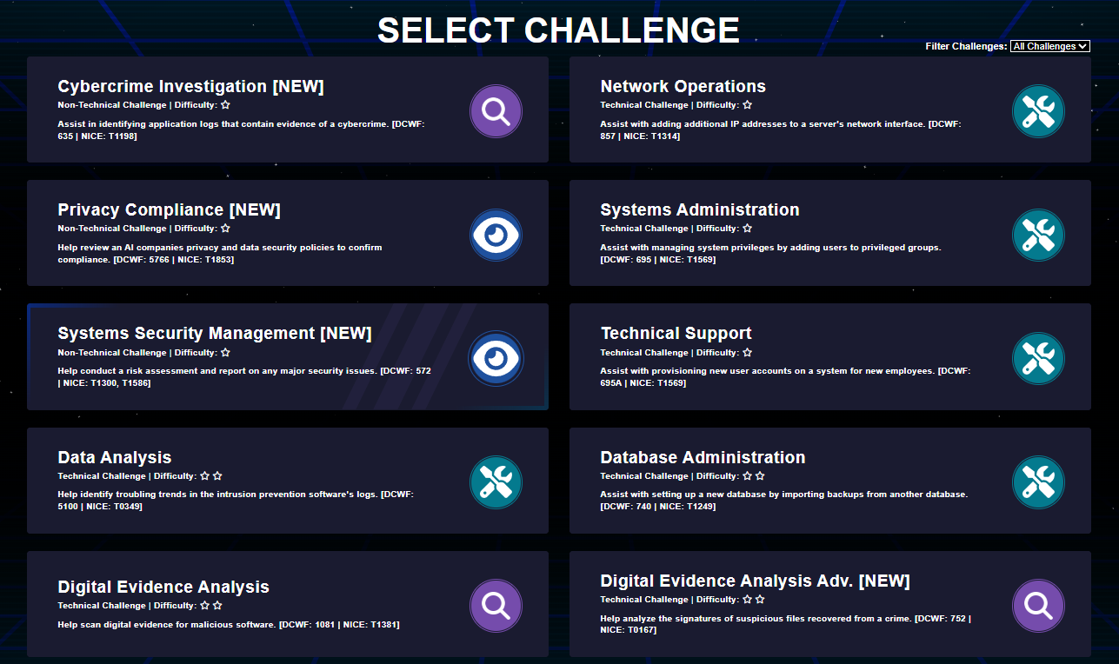

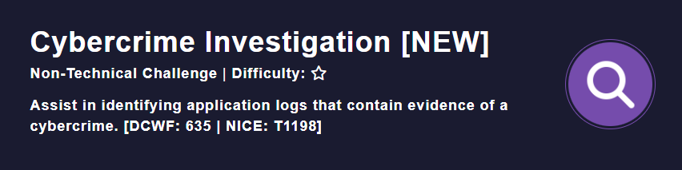
Cyber Work Role Discovery & Exploration (trycyber.us)
trycyber.us

Slide 27
Using AI in Career Counseling & Advising
1
Identify student strengths & interests
Gather major, personality insights, soft skills, and career motivators. Sample prompt: "Student is a Com major, detail-oriented, motivated by helping people, interested in law. What NICE roles fit?"
2
Map interests to NICE roles
Have Claude or another GAI suggest 3 – 5 relevant NICE work roles with brief rationale for each one.
3
Tailor the resume & LinkedIn profile
Reframe existing experience using cybersecurity-relevant language. Sample prompt: "Rewrite internship bullets for a GRC Analyst role using NICE Framework knowledge statements."
4
Build a 6-month pathway plan
Generate a structured action plan: certs to pursue, competitions to join, and professional communities to engage. Sample prompt: "Create a 6-month plan for a student targeting SOC Analyst with no cyber certs yet."

Slide 28
Additional Prompting Strategies
5
Help students recognize transferable skills.
Many students do not realize they already have cybersecurity-relevant experience from their retail, healthcare, military service, customer service, or volunteer work. Sample prompt: "Identify transferable cybersecurity skills from this student's experience as a pharmacy technician."
6
Compare Career Options
Help students evaluate multiple pathways. Sample prompt: "Compare SOC Analyst, GRC Analyst, and Digital Forensics Investigator careers including typical duties, required skills, salary, and advancement opportunities.
7
Explore Industry-Specific Cyber Careers
Show students cybersecurity opportunities within their chosen field. Sample prompt: "A student is majoring in criminal justice. What cybersecurity roles align with their interests and educational background?."
Human-in-the-loop notice: AI should support, not replace, professional advising. Advisors and counselors provide the human judgment, context, encouragement, and relationship-building that students need to make informed career decisions.

Slide 29
RICO Prompting Tips
Letter | Meaning | Example Element
R – Role | Assign AI an identity or perspective | "You are an academic advisor specializing in career development for community college students…"
I – Instructions | Clearly define the task | "Create a personalized academic plan with recommended courses and milestones…"
C – Context | Provide details like audience, level, or goals | "For a second-year student exploring a career change into cybersecurity with no prior tech background."
O – Output | Specify format and scope | "Output as a semester-by-semester plan with a brief rationale for each recommendation and 3 reflection questions for the student."

Slide 30
Next Steps
Develop discipline-specific career exploration worksheets that connect cybersecurity concepts to students' fields of interest.
Create Healthcare Cybersecurity worksheets highlighting patient privacy, medical devices, healthcare IT, and regulatory compliance.
Develop Automotive Cybersecurity activities exploring connected vehicles, autonomous systems, vehicle networks, and transportation security.
Create Criminal Justice Cybersecurity resources focused on digital forensics, cybercrime investigations, evidence collection, and public safety.
Expand into additional disciplines such as business, manufacturing, education, finance, and engineering. Increase awareness of cybersecurity career opportunities that exist within non-IT professions.
Develop classroom-ready activities that help students identify cybersecurity responsibilities within their chosen career fields

Slide 31
Cybersecurity
Computer Science
Computer / Electrical Engineering
Business
Social Sciences
Cyber Operations
Cyber Forensics
Cyber Engineering
Cyber
IT
Cyber
Risk Mgmt.
Cyber Human Factors
Cyber Public Policy
Cyber Legal & Ethics
Technical
Non-Technical
Source: Dr. Seth Hamman

Slide 32

Healthcare and Public Health Sector
Protecting Lives and Medical Data
Critical Assets: Hospitals, Acute Care Facilities, Pharmaceutical companies, Medical Device Managers, Emergency Medical Services
Sector Composition:
  6,000+ hospitals in the United States
  250,000+ healthcare facilities including clinics and nursing homes
  $4.3 trillion annual healthcare spending
  18% of US GDP represented by healthcare
Common Attacks:
Ransomware - Increasingly targets hospitals for maximum impact
Data theft - PHI valuable on black markets
Medical device compromises - Insulin pumps, pacemakers, imaging systems
Supply chain attacks - Compromised medical software and devices

Slide 33
Healthcare and Public Health Sector
Cybersecurity Challenges:
Legacy Systems: Medical devices designed for longevity, not security.
Availability Requirements: Cannot take critical systems offline for updates.
Interoperability Needs: Systems must communicate across organizations.
Regulatory Complexity: HIPAA, FDA, and state requirements.
Resource Constraints: Tight budgets limit security investments.

Slide 34

Case Study:
Yale New Haven Health Data Breach
What happened: Sophisticated hackers gained
unauthorized access to a network server, exposing
demographic data for approximately 5.6 million patients:
names, DOBs, addresses, race/ethnicity, &
medical record numbers
Why it matters: 5.56 million patients affected:
largest healthcare breach of 2025
Data compromised: Names, addresses, SSNs, medical
record numbers. Protected Data: Medical records, financial information, treatment details
Key takeaway: Lack of basic safeguards (e.g., segmentation, encryption) not only jeopardizes patient data but invites regulatory and legal consequences, plus severe reputational damage.

Slide 35

Case Study:
Ascension Health Ransomware Incident (2024)
What happened: Ransomware attack by Black Basta (Russian), on
May 8, 2024, crippled Ascension’s digital systems across 140 hospitals,
forcing manual paper-based operations – ambulance diversions and
delayed care
Cause: Employee accidentally downloaded a malicious file thinking
it was legitimate
Why it matters: Electronic Health Records (EHRs) were inaccessible. Critical diagnostics (e.g., stroke CT scans) are delayed by hours, disrupting surgeries, pharmacy, radiology, and emergency services
Data compromised: Medical records, Social Security numbers, credit card info, insurance
Key takeaways: Cybersecurity failures can threaten lives, not just data. Demonstrates how employee error can trigger massive operational disruption and the critical importance of cybersecurity training in healthcare

Slide 36
Resources for Health Science Classes
HHS 405(d) Program – Health Industry Cybersecurity Practices (HICP):
offers free downloadable playbooks, threat scenarios, and best practices https://405d.hhs.gov
Health Sector Cybersecurity Coordination Center (HC3):
Alerts, sector threat briefs, and trend analysis (e.g., ransomware, phishing, zero-days)
https://www.hhs.gov/about/agencies/asa/ocio/hc3/index.html
Health-ISAC Threat Intelligence Reports:
https://h-isac.org

Slide 37
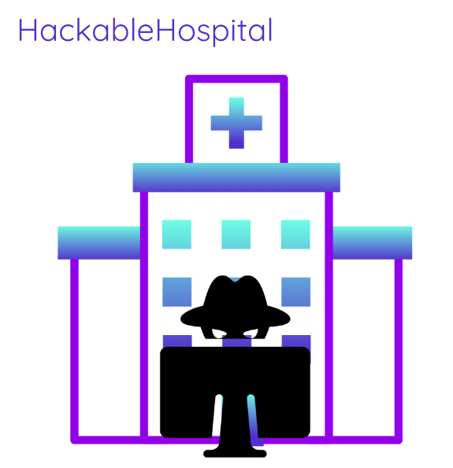
Interactives for Health Science Classes
Defend the Hospital (Incident Response) https://cyberskillslive.com/activity/defend-the-hospital/
HackableHospital (Offensive):
https://www.hackablehospital.com/
Digital Care Hub (Leadership & Consequence Management Focused):
https://www.digitalcarehub.co.uk/digital-skills-and-training/cyber-game/

Slide 38
We Want to Partner and Work With You!
Connect With Us & Share Your Thoughts!
Tell us what's working, what's missing, and what your students need most
Share how you're using these tools and frameworks in your own advising or counseling practice
Help us improve by letting us know what resonates and what needs refining
Bring Us to Your Campus – Free Training!
Invite us for an on-site workshop, training session, or faculty professional development day
Prefer virtual? We offer flexible remote training options that fit your schedule
Build With Us
Join a growing community of advisors, counselors, & educators committed
Collaborate on resources, share strategies, and learn alongside peers across institutions

Slide 39


Thank You!
Kristine Christensen, Ph.D.
Christensen@morainevalley.edu
PI, Explore Cyber
Director, Faculty Development &
Professor, Computer Information Systems &
Moraine Valley Community College
Dr. Deanne Cranford-Wesley
dcranfor@nccu.edu
Director of Cybersecurity Programs
North Carolina Central University
Explore Cyber,, is funded by the National Science Foundation Advanced Technological Education grant #2500740. Any opinions, findings, and conclusions or recommendations expressed in this material are those of the author(s) and do not necessarily reflect the views of the National Science Foundation

