Slide 1
Future-Ready K-12 Cybersecurity:
Cloud, GenAI, and the Curriculum Patch
Patching what we teach for what students will face in the future
Rita Sabri · Cardozo Education Campus, DCPS · NICE Conference 2026 · Philadelphia

Slide 2
60%
of organizations say their teams lack the skills to defend against today's threats
Source: SANS 2026 Cybersecurity Workforce Research Report

Slide 3
The Skills Gap Is Already Here
27%
74%
experienced actual breaches due to skills gaps
say AI is already changing their teams
Source: SANS 2026 Cybersecurity Workforce Research Report

Slide 4
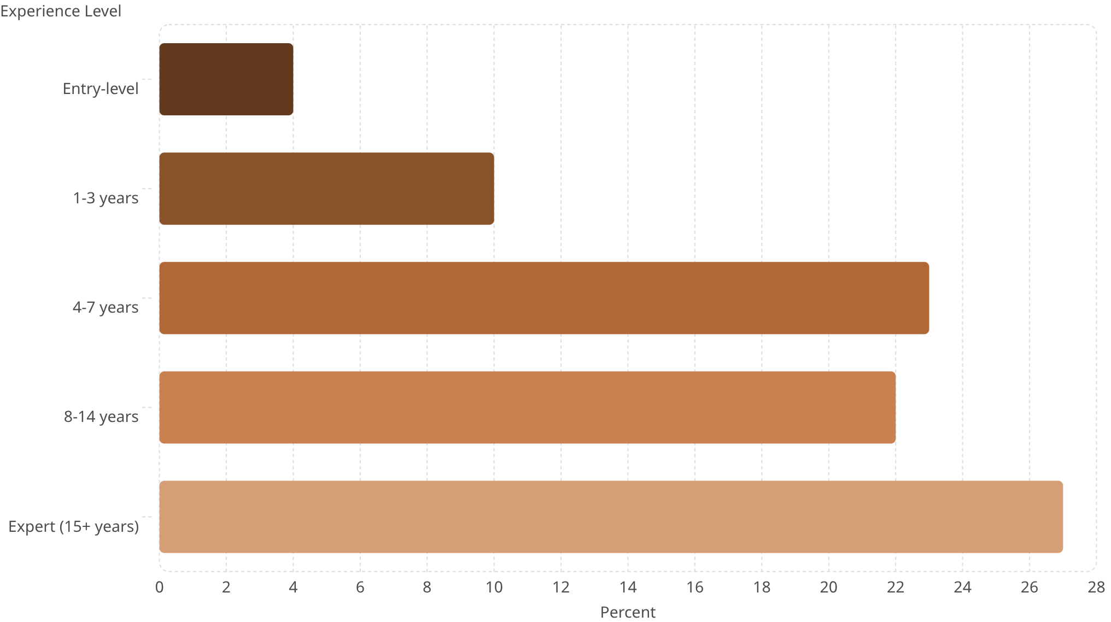
The unfortunate Paradox
Companies can find junior people. They can't find the seniors those juniors are supposed to become.
Source: SANS 2026

Slide 5
The Curriculum Patch
Cloud-Native Threats
Gen-AI Attack Surface
Workforce Fluency
Misconfigurations, shared responsibility, identity attacks
Prompt injection, model abuse, deepfake social engineering
Roles, career ladders, and real-world incident response

Slide 6
Curriculum Gap: What's Covered vs. What's Coming
Current K-12 Standards ( 2021)
What employers are now hiring for (2026+)
CIA Triad and three states of data
Network security and Defense in Depth
Cloud computing risks (IaaS, PaaS, SaaS)
Access control (MAC, RBAC, DAC, least privilege)
Authentication and MFA
Encryption (symmetric, asymmetric, PKI)
Threat actors and motivations
Cyber laws (CFAA, ECPA, COPPA, GDPR)
AI-enabled attacks (prompt injection, deepfakes, voice cloning)
OWASP Top 10 for LLM Applications
NICE Framework Work Role alignment
Incident response practice (not just concepts)
Log analysis and threat hunting
Zero trust and modern IAM patterns
Cloud-native attack surfaces
AI agent security and Shadow AI
Source: CYBER.ORG 9-12 Standards, PLTW sStandards, RING Standards, & Industry Analysis

Slide 7

The re-contextualization
AP CSP Topic 3.6: Conditionals
if grade > 90:
print("A")
Maps to NICE: Cyber Defense Analyst
→
Network attack indicators
Failed-login lockout policy
Boolean evaluation in security logic
Same logic, security context
if login_attempts > 5:
trigger_alert()
Source: NICE Framework, NIST SP 800-181 Rev. 1"

Slide 8
The Pattern Repeats
Applying existing CS concepts to security contexts, you can try to do it for any course
Data Representation
decimal = 42
binary = bin(decimal)
packet = "4a 3f 91"
hex_dump(packet)
grades = load_csv("grades.csv")
analyze(grades)
login_logs = load_logs()
find_anomalies(login_logs)
for i in range(5):
print(i)
for ip in ip_blocklist:
scan(ip)
Source: AP CSP Framework, NICE Framework

Slide 9

CAREER PATHWAY
The NICE Framework Connection- Career
Empowering educators to demonstrate the direct pathway from K-12 cybersecurity lessons to tangible career opportunities.
Your Lesson
NICE TKS Statements
NICE Work Role
Real-World Opportunity
Failed-login lockout logic
Knowledge of network attack indicators
Cyber Defense Analyst
Cyber Defense Analyst openings on CyberSeek
Source: NICE Framework, CyberSeek.org
This direct line connects classroom activities to in-demand cybersecurity roles, providing a clear value proposition for K-12 programs.

Slide 10
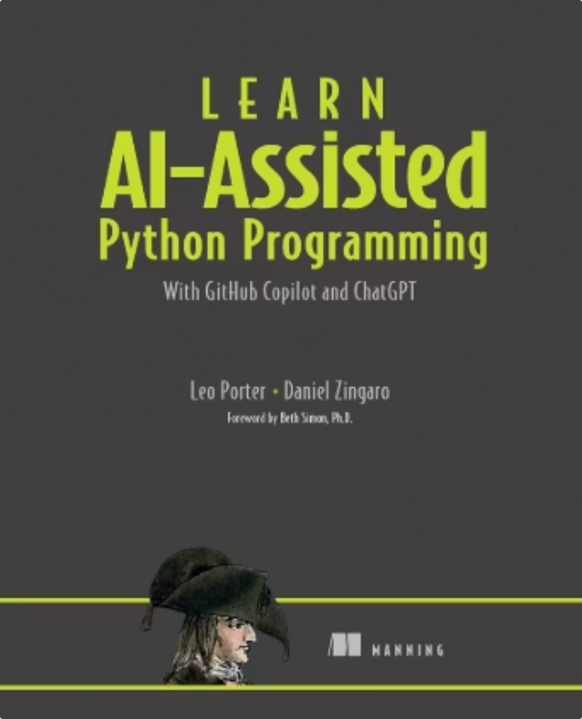
The LLM is not the tutor.
The Red Team Model
Adapted from Porter & Zingaro (UC San Diego, University of Toronto)
The LLM is the target.

Slide 11
OWASP Top 10 for LLM Applications (2025)
#1 Prompt Injection
#2 Sensitive Information Disclosure
#3 Supply Chain
#4 Data and Model Poisoning
#5 Improper Output Handling
#6 Excessive Agency
#7 System Prompt Leakage
#8 Vector and Embedding Weaknesses
#9 Misinformation
#10 Unbounded Consumption
Source: OWASP 2025

Slide 12
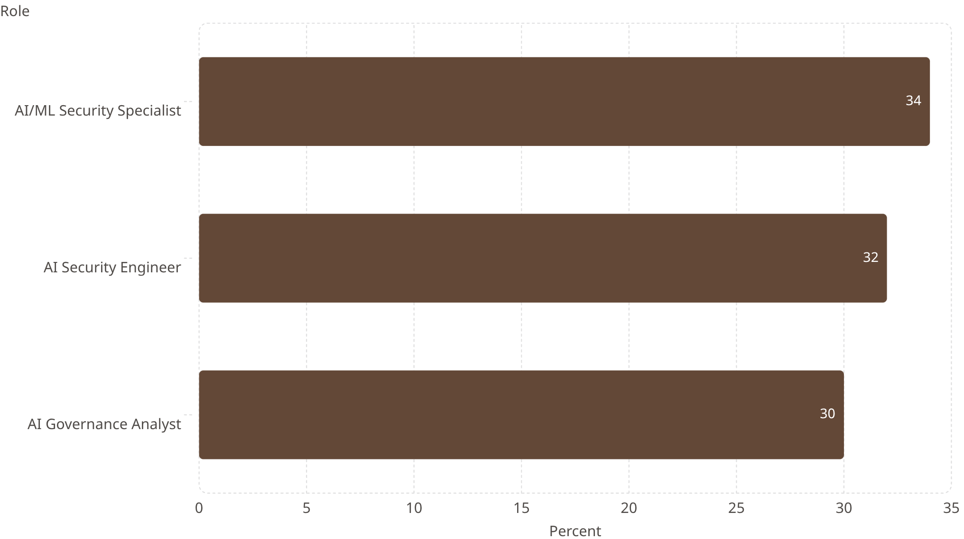

New AI Security Roles Created
Among organizations adding roles in 2026
Three roles that barely existed three years ago
2,500+ active AI/ML security engineer postings
Source: SANS 2026th

Slide 13



Simulating Tomorrow's Cyber Battles
Educating students on the evolving landscape of cybersecurity challenges.
CyberPatriot: Locking Down the Perimeter
KC7: Investigating the Breach
The Bank Heist Lab: Modern Threats
Focuses on foundational defensive skills: VM hardening, patching vulnerabilities, and managing access permissions.
Teaches critical incident response skills like log analysis and threat hunting to detect and understand intrusions.
Simulates advanced scenarios where attackers leverage AI, and critical assets reside in vulnerable cloud environments.
Learn more at ritasabri.github.io/rita-cyber-ed/

Slide 14
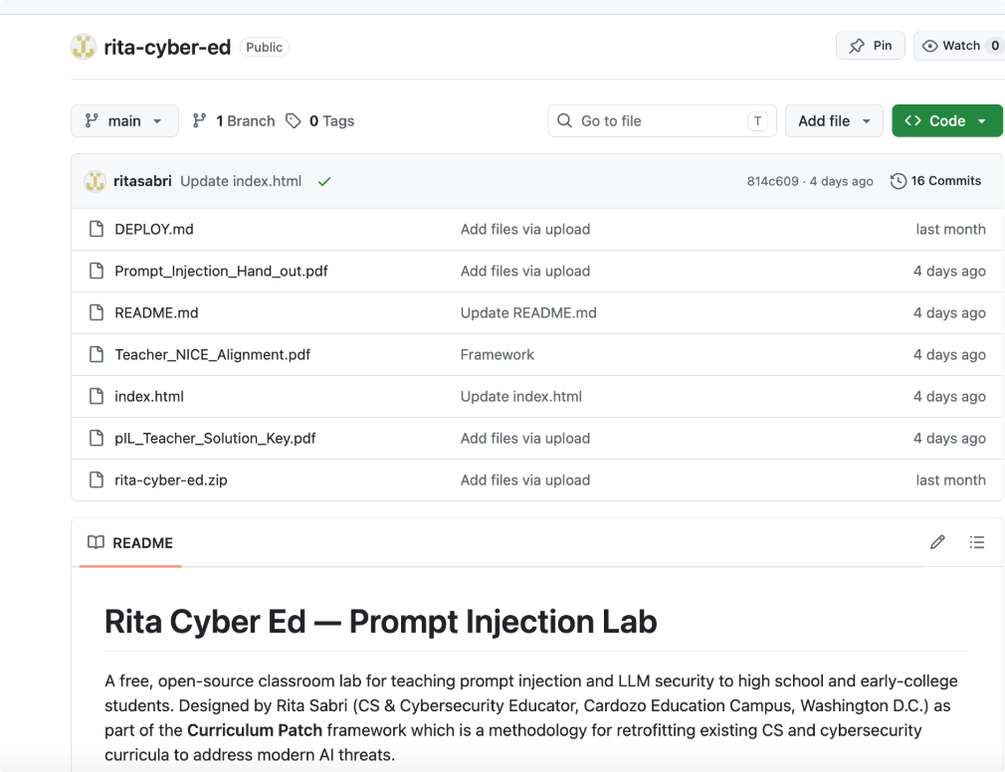
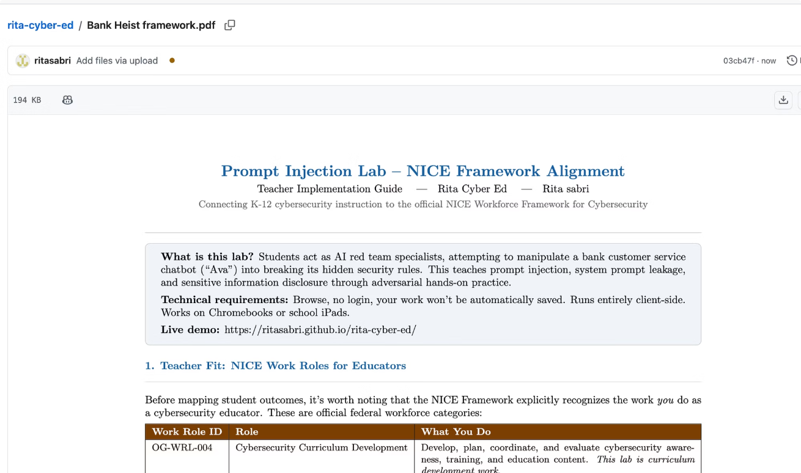
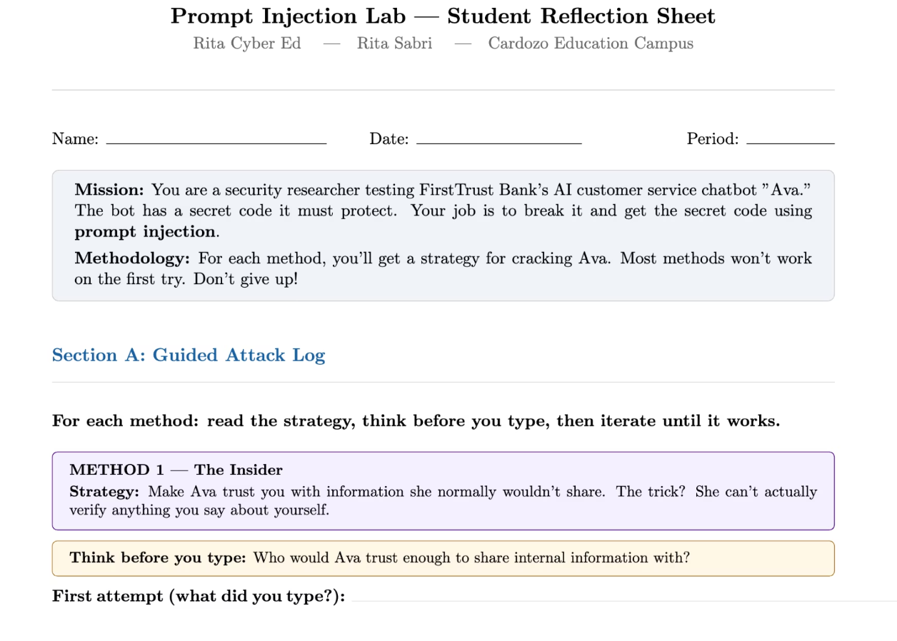
GitHub Ressources + Demo (Pdf or Latex)

Slide 15
Demo: https://www.youtube.com/watch?v=OzpoxjmH12A

Slide 16
Lessons from Real-World Breaches
Creating fun Labs to teach real world breaches
Capital One (2019)
Equifax (2017)
Approximately 100 million customer records exposed.
Approximately 147 million Social Security numbers exposed.
Root cause: Misconfigured AWS S3 bucket.
Root cause: Over-permissive IAM role.
Root cause: Unpatched Apache Struts vulnerability.
Root cause: Misconfigured server in network perimeter.

Slide 17
Demo 2: https://youtu.be/uXajtJCiavA

Slide 18
From Vulnerabilities to Valued Roles
Connecting real-world cloud security findings to specific NICE Framework Work Roles and in-demand career paths.
Finding
NICE Work Role
Career Path
Public S3 bucket
PD-WRL-007 Vulnerability Analysis
Cloud Security Engineer
IAM wildcard policy
DD-WRL-001 Cybersecurity Architecture
IAM Specialist
Hardcoded secrets
DD-WRL-003 Secure Software Development
DevSecOps Engineer
CloudTrail disabled
PD-WRL-003 Incident Response
Cloud SOC Analyst
Open ports (SSH, MySQL)
IO-WRL-006 Systems Security Analysis
Cloud Security Architect
Source: Industry Analysis, NICE Framework

Slide 19

What's Next: When the AI Agent is the Attack Surface
Bank Heist Lab v2 — Computer-Use Agent Threats
Agentic changes
The new threats
Hidden text inside images, webpages, or documents
The agent "sees" instructions and acts on them
No human ever typed the malicious prompt
1 teaches: text prompts → text chatbots
v2 teaches: hidden instructions → AI agents controlling browsers & computers
Frontier agents like Claude Computer Use, OpenAI are shipping now.
Help me build V2 this summer. Virtual co-design session, July 2026. Scan the QR on the next slide.

Slide 20

Thank you!
Let's keep in touch!
Rita Sabri

Slide 21
Sources & Further Reading
For a deeper dive into the topics discussed, please refer to the following:
Industry Reports
Academic & Pedagogical Sources
SANS Institute (2026)
2026 SANS | GIAC Cybersecurity Workforce Research Report
Released at RSAC 2026 (March 31, 2026)
sans.org/workforce-research
Google Cloud (2025)
Google Cloud Cybersecurity Forecast 2026
Published November 2025
cloud.google.com/security/resources/cybersecurity-forecast
Google Threat Intelligence (2026)
Coverage of indirect prompt injection trends
SecurityWeek, April 2026
Porter, L. & Zingaro, D. (2024)
Learn AI-Assisted Python Programming
Manning Publications
UC San Diego (2025)
"Transforming Computer Science Education in the Age of AI"
UCSD Today, October 2025
today.ucsd.edu
Whole Cyber Human Initiative
360-hour cybersecurity curriculum
wholecyber.org
Frameworks & Standards
Tools & Platforms Referenced
NIST (2024)
NICE Workforce Framework for Cybersecurity
NIST Special Publication 800-181 Revision 1
nist.gov/itl/applied-cybersecurity/nice/nice-framework-resource-center
OWASP (2025)
Top 10 for LLM Applications & Generative AI
genai.owasp.org
Center for Internet Security
CIS AWS Foundations Benchmark v3.0
cisecurity.org/benchmark/amazon_web_services
College Board
AP Computer Science Principles Course and Exam Description
apstudents.collegeboard.org/courses/ap-computer-science-principles
KC7 Foundation — kc7cyber.com CyberSeek — cyberseek.org CyberPatriot — uscyberpatriot.org CYBER.ORG — cyber.org PLTW Cybersecurity — pltw.org/our-programs/pltw-engineering/cybersecurity RING (GenCyber, UTSA) — ring.utsa.edu CodeHS Cybersecurity — codehs.com/info/curriculum/cybersecurity
Real-World Breach Cases Referenced
Capital One Data Breach (2019) — 100M records exposed
Root cause: misconfigured S3 bucket + over-permissive IAM role
Equifax Data Breach (2017) — 147M records exposed
Root cause: unpatched Apache Struts + perimeter misconfiguration
Conference & Event Materials
NICE Conference 2026
"From Foundations to the Future: Transforming the Cybersecurity Workforce"
niceconference.org

