Slide 1
When Labs Have Stakes:
Teaching Cybersecurity Through Real Consequences
Ian Sun | Boston University
Dr. Faisal Abdullah | Evolve Security Academy
NICE Conference and Expo 2026 | Philadelphia, PA | June 2, 2026
Notes:
30 m presentation scope:
me: ~20m, faisal: ~10-15m;
20m → 10m → 5m

Slide 2
Let's start with a show of hands.
Gotten a cert?
Built a lab?
Done a CTF or hackathon?
Worked in a real security role?
Had more access than you felt ready for?
Made a mistake that surprised you with how far it reached?
For educators & hiring managers:
Watched someone struggle in ways you didn't see coming?

Slide 3
Background
Before starting at BU, I:
Worked at a managed service provider, 40+ clients
  Some clients had trusted this firm for decades
  Many of them served low-income communities and SMBs
Was 18 and had admin access to all of it
  RMM, Google Admin, MDM, Windows Server, firewalls, etc.
  More access than most 18-year-olds should have
Yet mistakes happen.

Slide 4
Common mistakes…
…that have outsized consequences

Slide 5
Misconfigurations
What happened
What followed
Junior adjusts firewall / GPO / IPS
Appeared to be a routine change
Happened when seniors are busy and juniors had a bit too much access
"Settings saved successfully"
HR can't log into Workday
Printer access lost
Blame cascades from executive → VP → Director → junior
Junior never saw the blast radius
  … and is now on the hook
Notes:
before the lab section, examples of students make mistakes and consequence expand. talk about how I was terrified to change firewall settings and constantly asked my supervisors what to change

Slide 6
Redteaming: junior pentesters
Authorized engagement ✓
Signed RoE ✓
Ran a tool with deadly side effects (e.g. DoS)
Tool hangs, Ctrl-C
Client AD down minutes later
Angry calls, potential lawsuit
You can’t “least privilege” a pentester.
Notes:
most engagements are narrowly scoped

Slide 7
Two kinds of cyber professionals
Those who
experienced these mistakes
Those who
watched them happen
Notes:
two kinds of cyber professionals

Slide 8
Where labs have stakes
Teaching students through real but controlled consequences

Slide 9
The Three Tiers of Cybersecurity Labs
Tier 1
Tier 2
Tier 3
Classical Labs
Realistic Labs
Labs Have Stakes
What techniques ARE
How to USE them in real environments
How to decide when to or when NOT to use them
Notes:
‘ OR ‘1’=1

Slide 10
Why this matters more now
With AI saturating the training landscape…
AI made skill acquisition cheap
Judgment didn't get cheaper
Training apparatus targets the wrong scarcity
The tiers that build judgment are the ones that still pay
When skill is abundant, judgment is what remains

Slide 11
Why I built this lab with stakes
Internship ended, access went away
Wanted to keep learning in a realistic setting
Something tied to daily life, not just a sandboxed practice environment
So I built my own

Slide 12
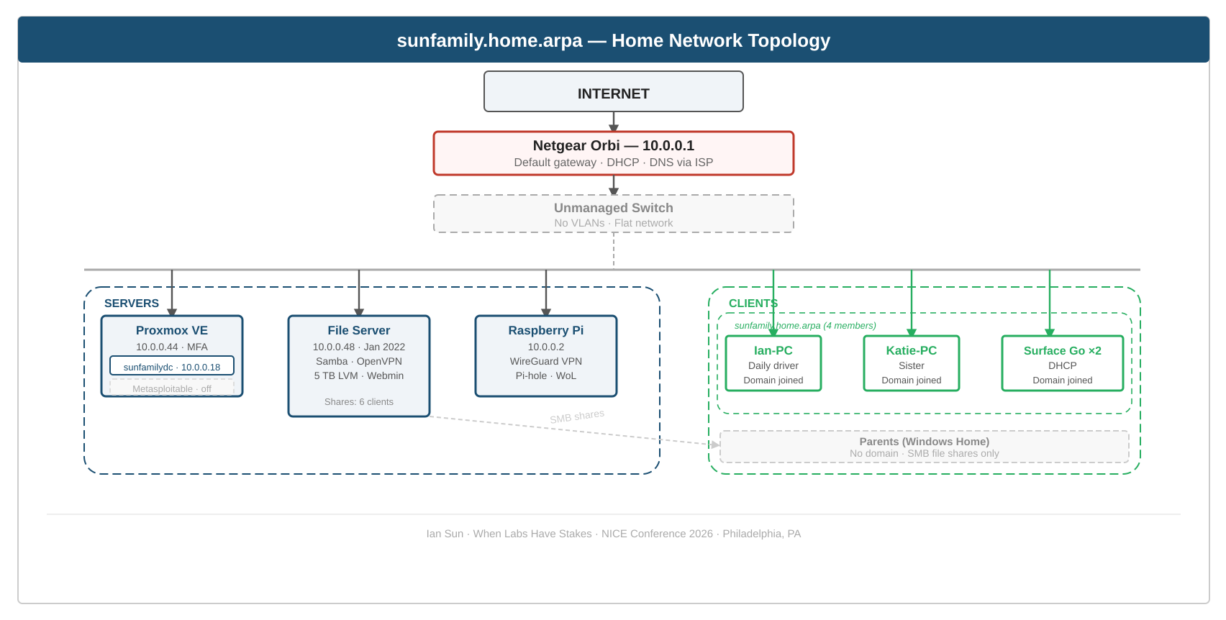
The lab diagram
Notes:
network diagram is helpful. network diagram can communicate what was actually being set up at home to give audience sense of what it looks like

Slide 13
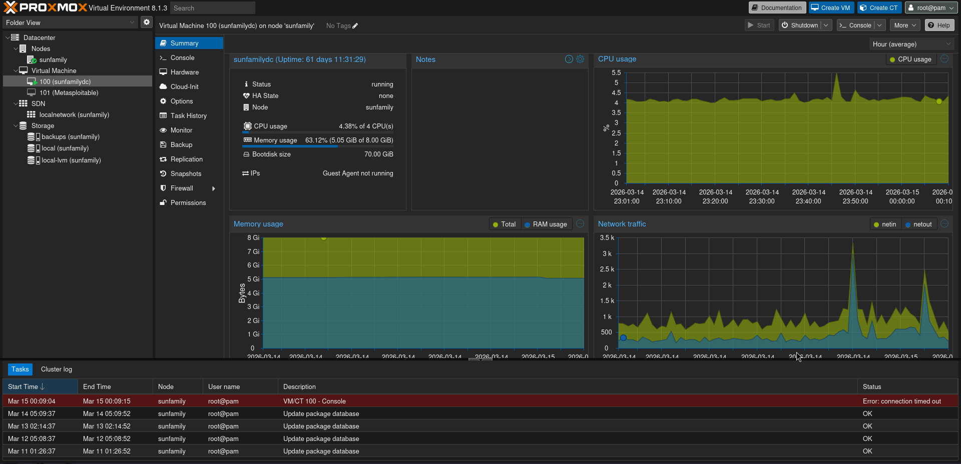
The lab

Slide 14
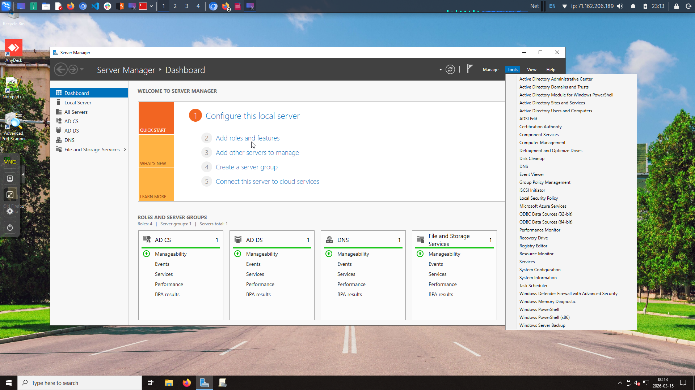
The lab

Slide 15
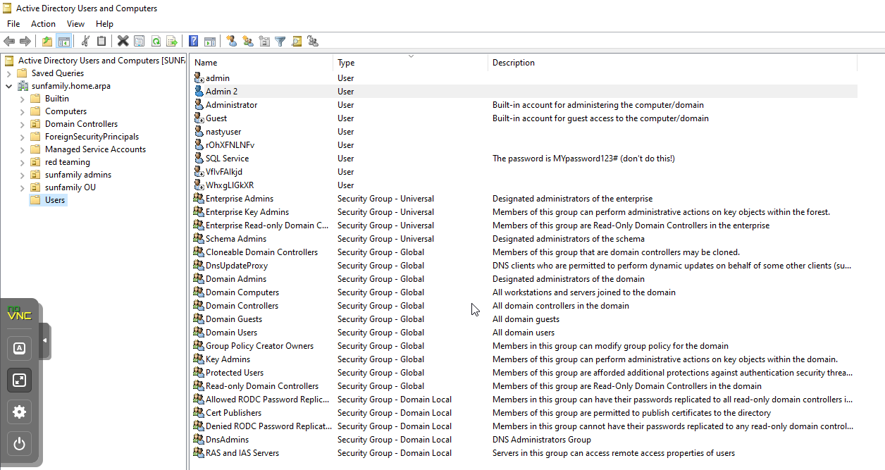
The lab

Slide 16
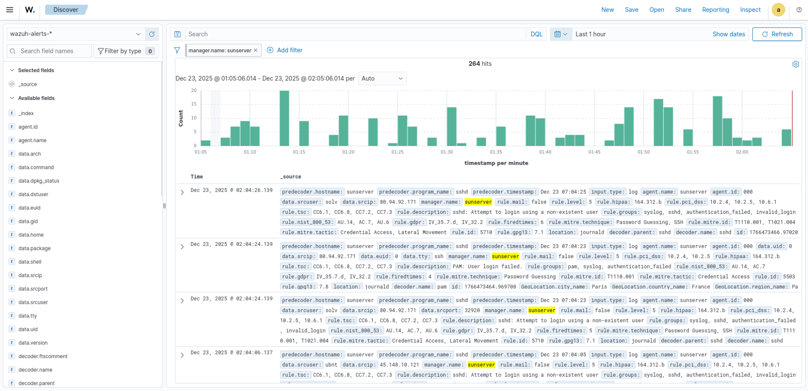
The lab

Slide 17
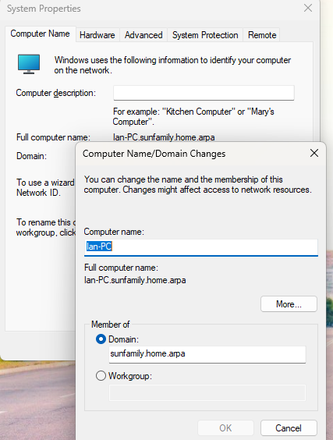
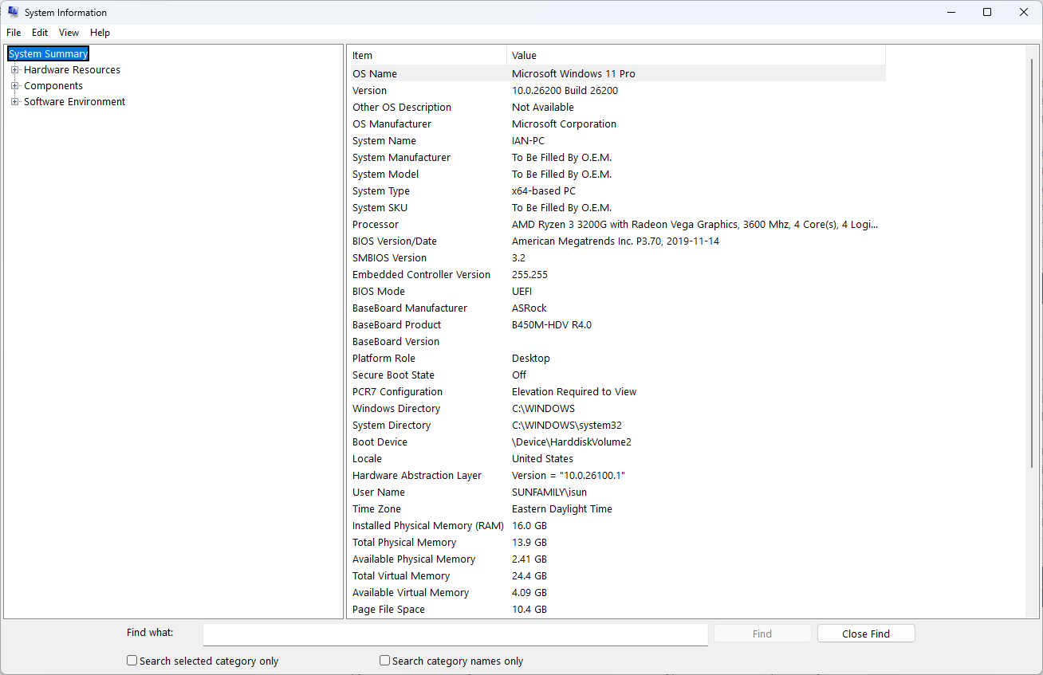
The daily driver

Slide 18
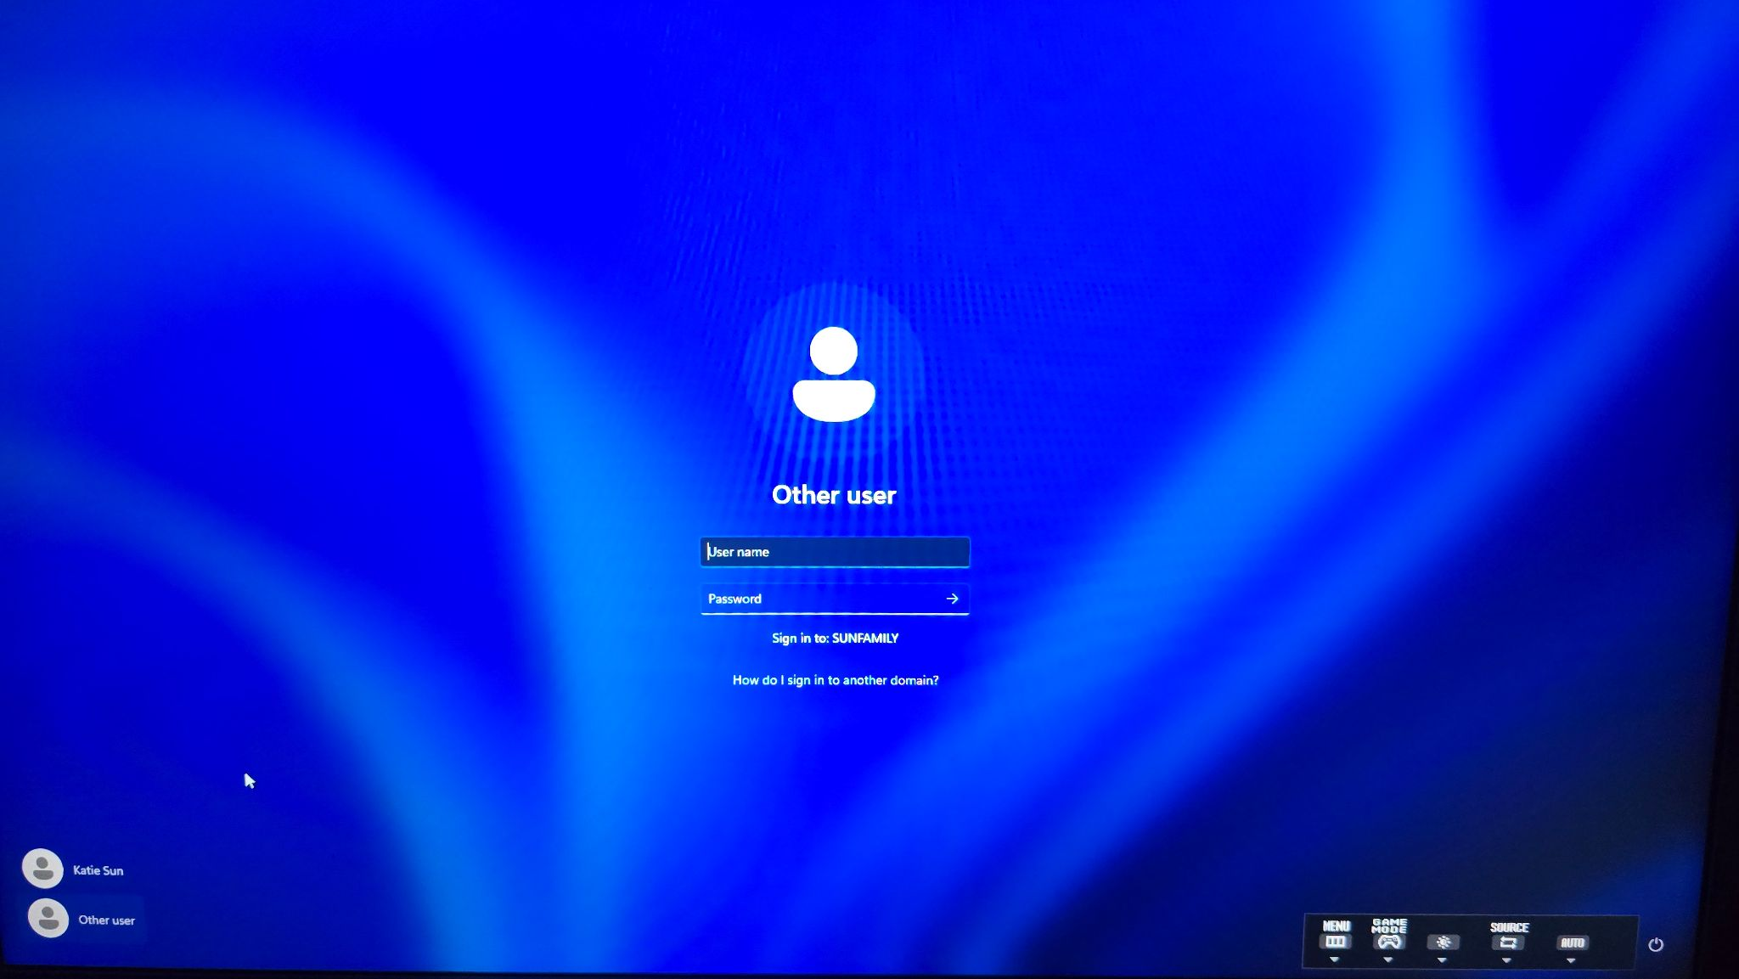
Sibling’s desktop

Slide 19
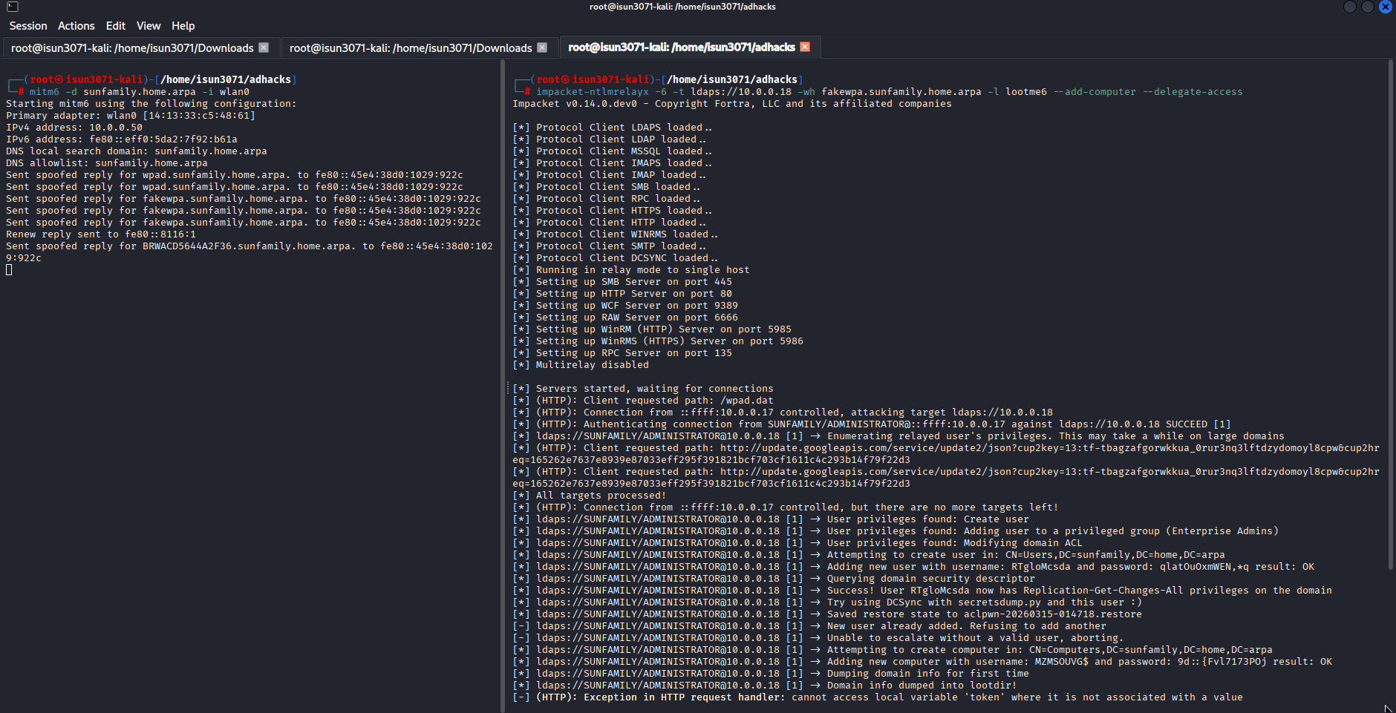
Pentesting on this lab

Slide 20
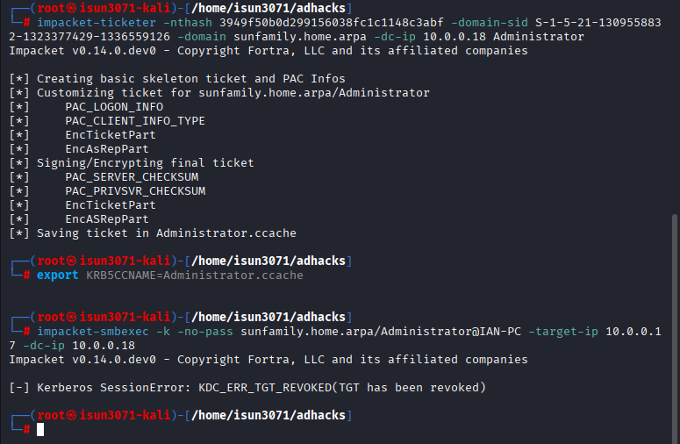
Pentesting on this lab

Slide 21
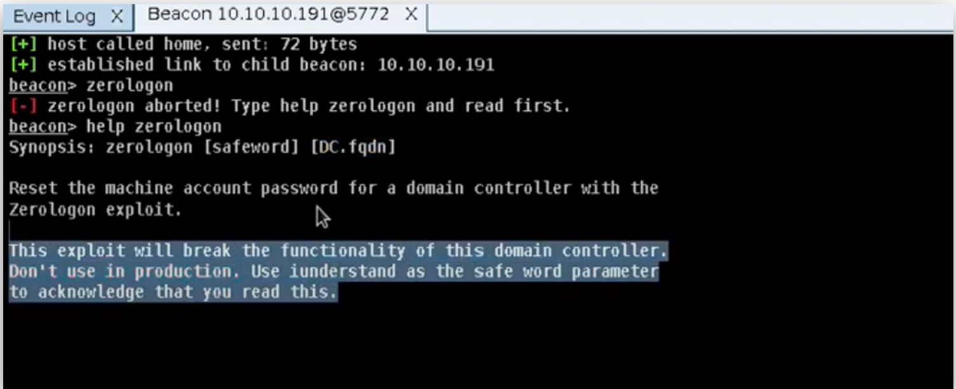
Zerologon (CVE-2020-1472) | CVSS 10.0

Slide 22
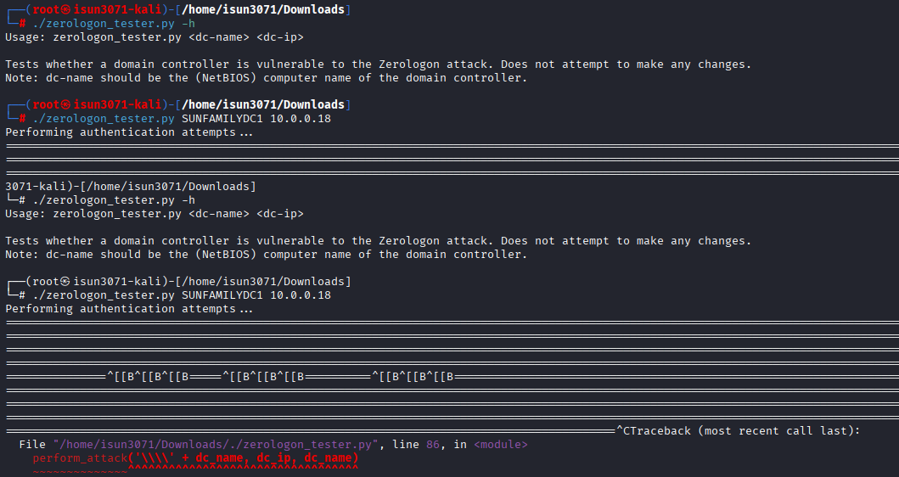
Zerologon (CVE-2020-1472) | CVSS 10.0

Slide 23
What happened?
Checker first
Exploit out of curiosity
Ctrl-C out
Password stopped working
Secondary admin regained access
Almost reinstalled the whole server
All that happened on a personal environment.
What would the damage be in an org environment?

Slide 24
Internal governor (why policy ain’t enough)
Company policy varies and is not always the most secure
Least privilege fails when:
Labs Have Stakes builds:
Org is understaffed
Access granted lazily
Credentials ≠ readiness
You're a pentester
Judgment that survives pressure
Instinct that travels with you
Works in dysfunctional orgs
No org control can provide this
Trained instinct > betting on company policy

Slide 25
Labs with stakes build judgment instinct:
Knowledge
→
Lives in conscious recall
Pressure (LHS)
→
Destroys conscious recall, fallback to instinct
Instinct
→
Unconscious execution and survives pressure
Judgment forms here

Slide 26
Two ways to build stakes
Type 1: Personal environment integration
Type 2: Classroom environment integration
(what you saw before)
(what you will see next)
Notes:
stakes in lost

Slide 27
Evolve Security Academy Methodology
Evolve Security - Leading penetration testing company
  20-week Cybersecurity Bootcamp
  Only hands-on labs in Live-Classes.
CyberLab™ Platform - Browser based virtual machines
Primary audience - career changers, IT professionals, recent grads
  Our audience knows consequences of mistakes at work.
  Build a controlled environment to learn cyber with personal stakes.

Slide 28
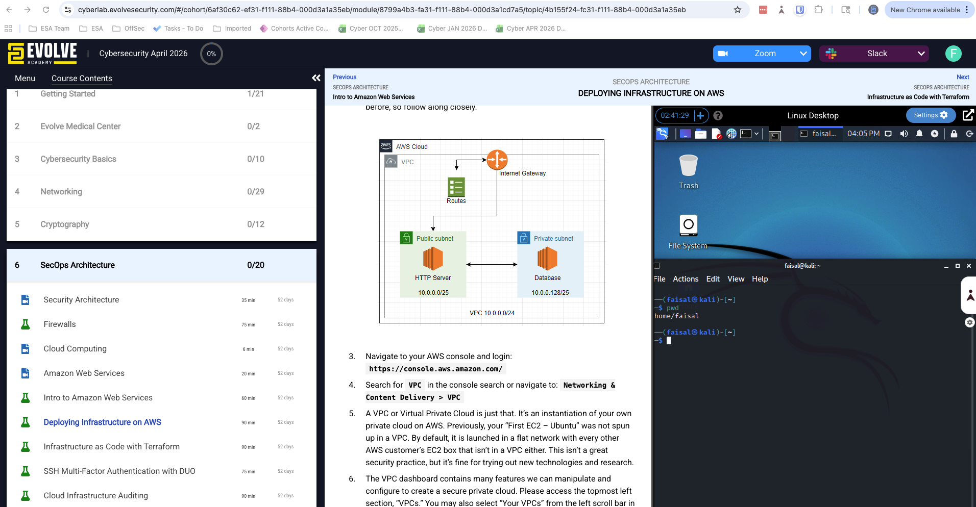
Evolve Security Academy Labs
H
[ Faisal's section and CyberLAB screenshot + key points ]

Slide 29
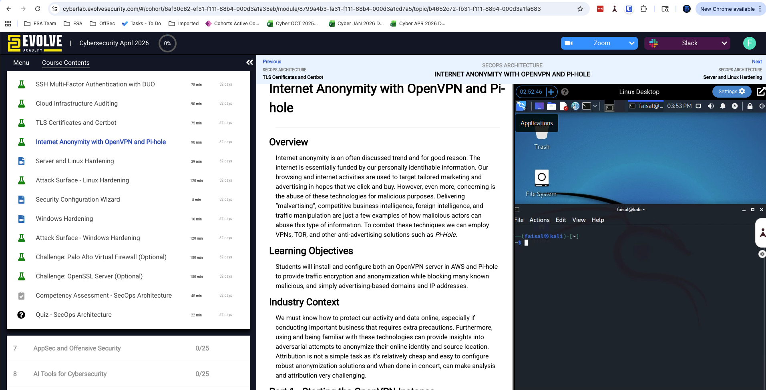
Extending the Stakes
[ Faisal's section and AWS instances, project extension, real client engagement ]

Slide 30
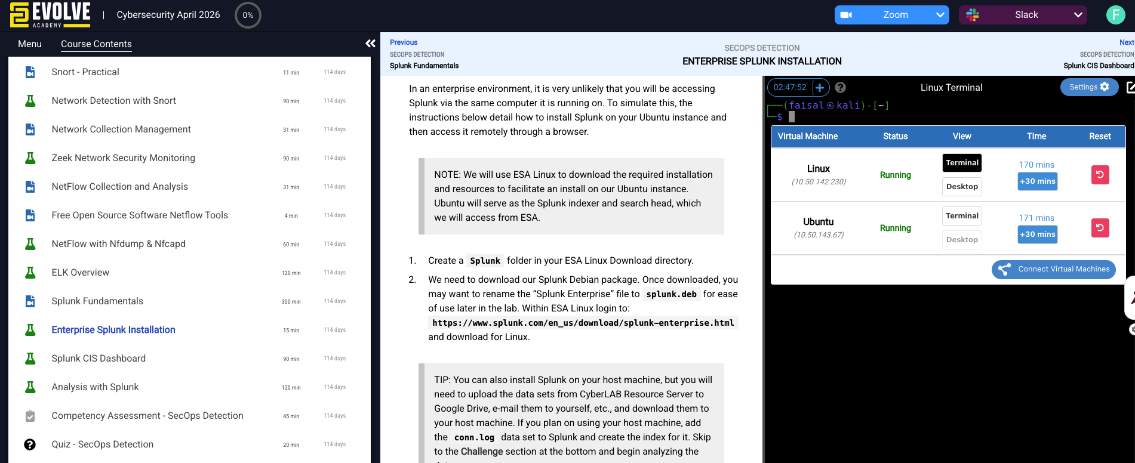
Extending the Stakes
[ Faisal's section and AWS instances, project extension, real client engagement ]
Notes:
emphasize the kali box persistence and how reset button takes you back to square 1

Slide 31
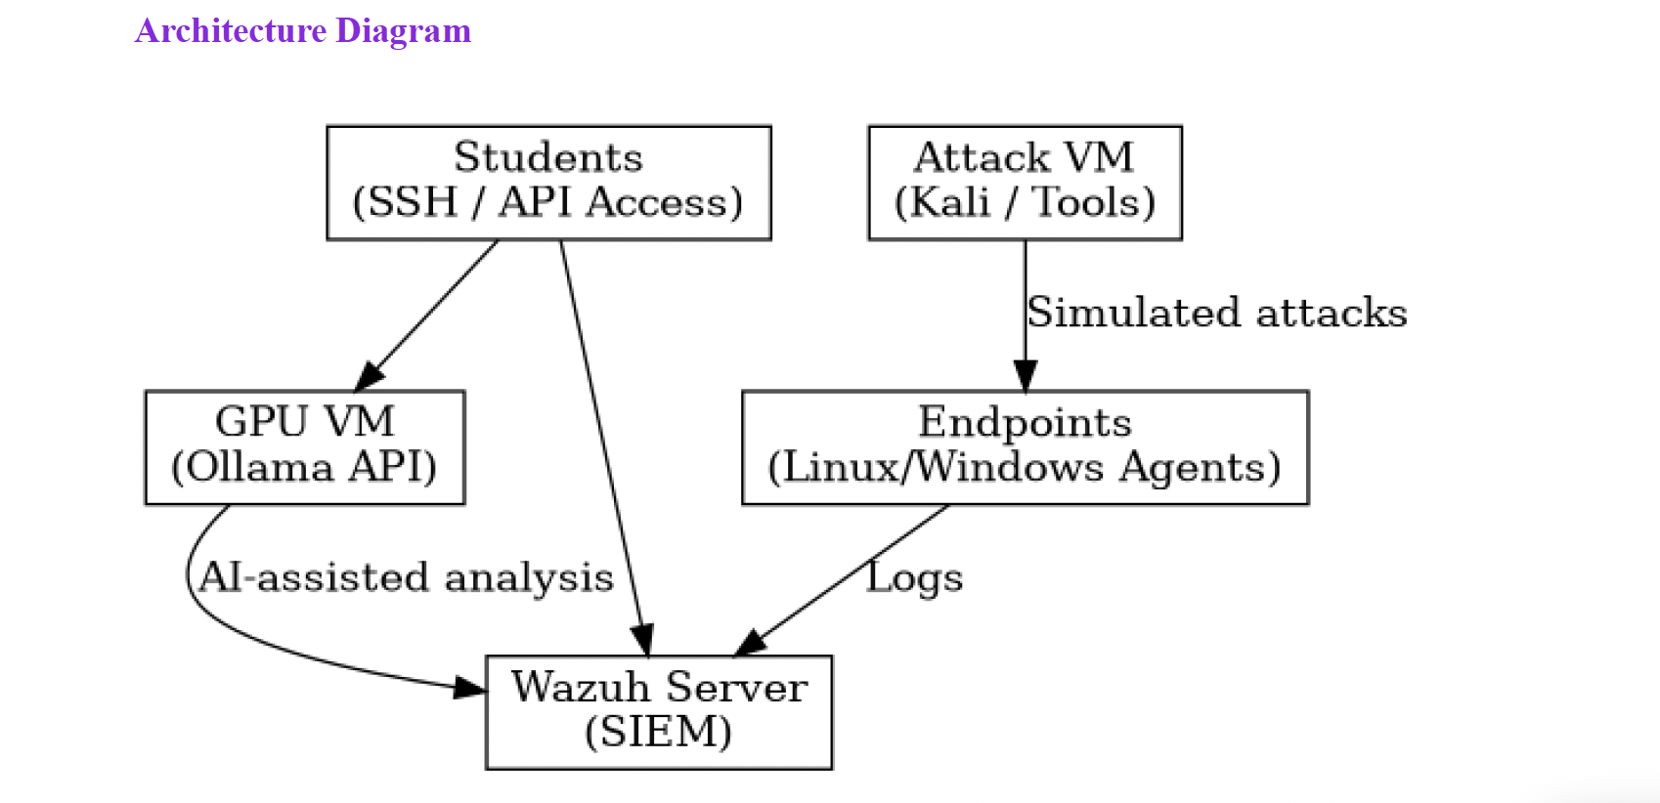
Extending the Stakes - AI SOC Lab
[ Faisal's section and AWS instances, project extension, real client engagement ]

Slide 32
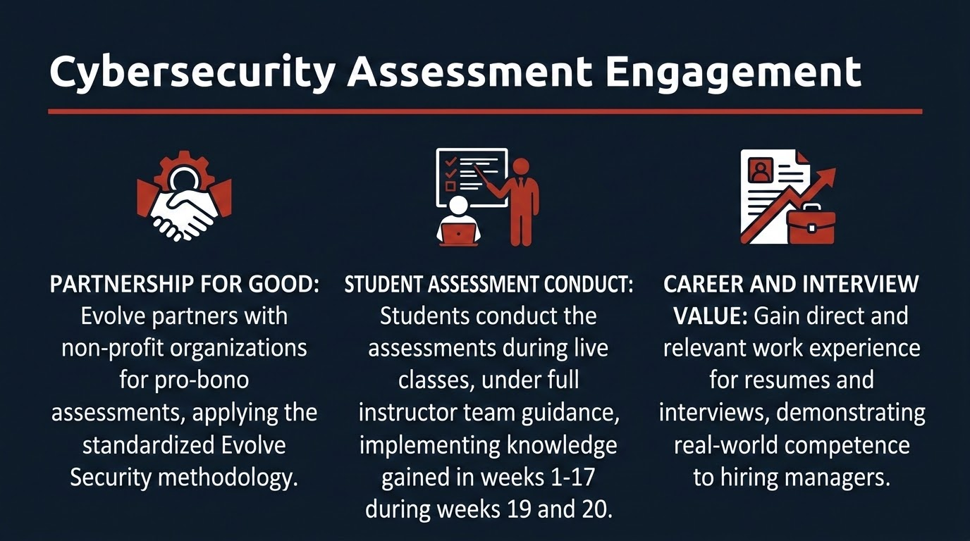

Slide 33
Cybersecurity Assessment Methodology
Stage 1
Stage 2
Stage 3
Stage 4
Internal Vulnerability Assessment
External
Vulnerability Assessment
Phishing Engagement
Risk Engagement
Stage 5 - Report Readout
Presented to the CTO or Director of IT
Includes Vulnerabilities found, discovery process, risks and remediation

Slide 34
The case for labs with stakes
AI makes upskilling cheap
Mistakes are inevitable and propagate
Judgment is what’s left
AI can do most junior work
AI can teach people at scale
Entry level hiring slowdowns
Firewall misconfigs
Pentesting mistakes
AI hallucinations
Downstream effects you might not anticipate
Labs with stakes build judgment via consequence exposure and felt risk
Notes:
depends on if evolve has the type 2 here

Slide 35
What To Do Monday
Practitioners:
Integrate your lab setup into your daily life (vs on/off switch)
Extend class projects beyond the grade and pentest it
Educators:
Encourage students to maintain labs beyond assignments
Don't discourage personal environment integration
Curriculum designers:
Replace one clean VM exercise with a consequential equivalent
Add limited resets to lab VMs, postmortems
Hiring managers:
"Tell me about a time your lab broke because of something you did"
Notes:
educators: look at your labs in class; think about making changes where students use their own resources to set up labs at home. .e.g. they use own personal aws architecture. free tier machines with no cost to institution. instead of just using preconfig. labs, have students set up a free tier aws/gc/azure env. more practical assignments. for professors who use the preconfigured network to teach, but for assignments they can use their own environments.

Slide 36
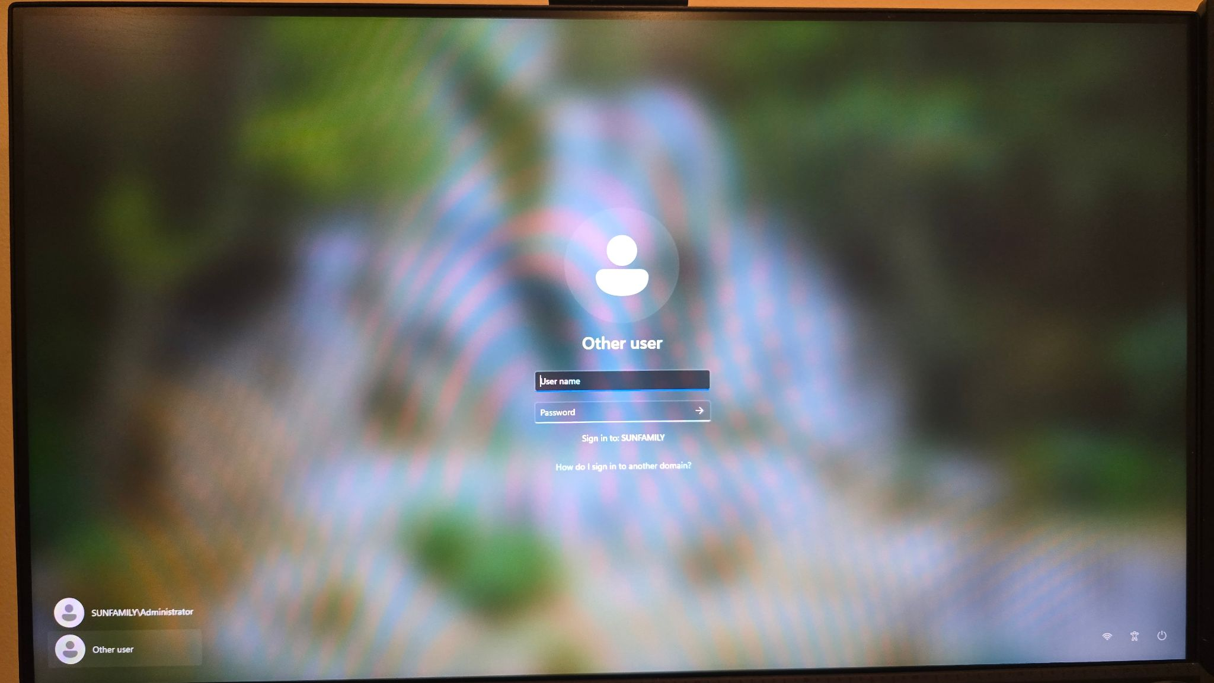
Still running
What's your version?

