Slide 1


Slide 2
Building Global Cybersecurity Capacity: Opportunities Through the Fulbright Specialist Program

Slide 3
Today’s Agenda
Fulbright Specialist Program 101
  Program Overview
  Eligible Project Areas
  Example Specialist Activities
Program Structure
What’s Next? Understanding the Matching Process
Q&A
Notes:
Fulbright Specialists – Amirah

Slide 4
Fulbright Specialist Program
Established in 2001, the Fulbright Specialist Program is a part of the larger Fulbright Program that provides U.S. citizens who are well-established academics and professionals with opportunities to engage in short, high-impact, project-based exchanges across the globe.
Projects between two and six weeks focused on education, training, or capacity building
150+ eligible countries and other areas
~400 projects annually at institutions of higher education and eligible non-academic institutions (e.g. government agencies, cultural institutions)
Grant benefits: round-trip economy class international airfare, modest transit allowance, $200 daily honorarium, visa fees, and limited benefits health plan. Foreign receiving institutions traditionally provide lodging, meals, and in-country transportation.
Administered by World Learning

Slide 5
Eligible Project Fields
Agriculture
American (U.S.) Studies
  Includes topics in the arts and humanities
Anthropology
Archaeology
Biology Education
Business Administration
Chemistry Education
Communications & Journalism
Computer Science & Information Technology
Economics
Education
  Includes Community College Education, Vocational/Technical Education, and Higher Education Administration
Engineering Education
Environmental Science
Law
Library Science
Math Education
Peace & Conflict Resolution Studies
Physics Education
Political Science
Public Administration
Public/Global Health
Social Work
Sociology
Urban Planning

Slide 6
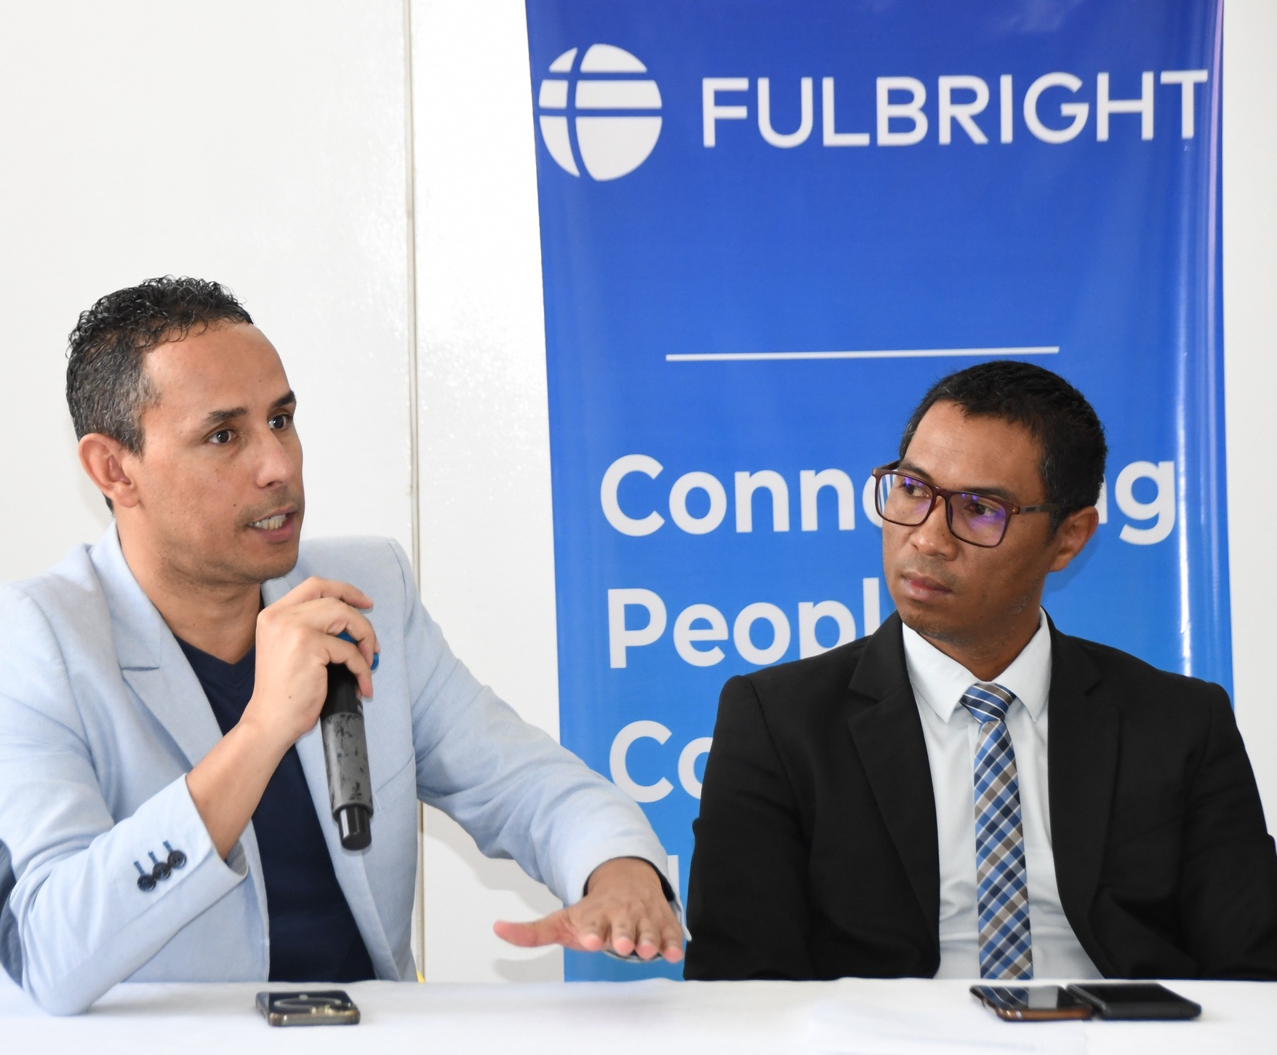
What Do Specialists Do?
Education, training, or capacity-building activities designated by the foreign receiving institution, such as:
Delivering seminars, training or workshops
Consulting on faculty or workforce development
Developing academic or training curricula and materials
Giving lectures at the graduate or undergraduate level
Conducting needs assessments or evaluations for a program or institution
Supporting accreditation process for a university program
Engaging in strategic planning activities
Mehdi Mekni, University of New Haven
Fulbright Specialist to Madagascar

Slide 7


A Historic Year for Fulbright
2026 marks both America’s 250th anniversary (i.e. Freedom 250) and the 80th anniversary of the Fulbright Act – a bold investment in global peace and American prosperity through educational and cultural exchange.
Throughout 2026, Fulbright Specialists are engaged in projects and/or public engagement activities like school visits, lectures, and other events that celebrate the 250th anniversary.

Slide 8
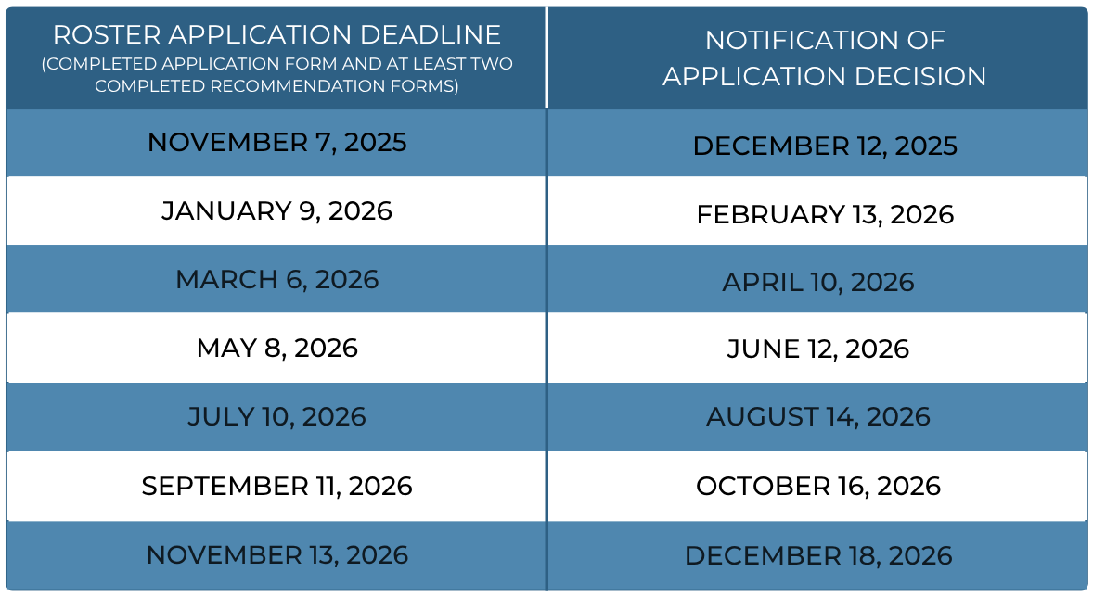
Program Structure
Field-driven structure: overseas institutions develop ideas and submit project proposals to their local U.S. Embassy/Fulbright Commission.
U.S. individuals must apply for admission to the Fulbright Specialist Roster and be approved by a peer review panel.
  Peer review panel: three individuals from your same general field, based on discipline/specializations you selected.
If admitted, you are placed on the Roster for three years, during this time you are eligible to match with projects.
Notes:
Fulbright Specialists – Amirah

Slide 9
Key Eligibility Criteria
U.S. citizenship at the time of application
Demonstrated experience/expertise in one’s field; a terminal degree is not required
Open to tenure-track and non-tenure track faculty, emerita/us faculty, adjunct faculty, administrators, professionals, etc.
Participation in another type of Fulbright Program (e.g. Fulbright U.S. Scholar Program) does not impact eligibility
Once on the Roster, there is a 24-month waiting period between individual projects
Individuals may join the Roster more than once; there is a 24-month waiting period between tenures
Notes:
Fulbright Specialists – Amirah

Slide 10
Application Components
Essay One: Please describe why you are interested in serving as a Fulbright Specialist and how your participation would benefit institutions abroad as well as your institution/employer in the U.S.
Please include specific examples of activities that you may be interested in leading or completing at an institution abroad as part of your program.
Required:
Personal Information
Education
Employment
Resume/CV
Essays (2)
References (3)
Optional:
Geographic Preferences
Language Skills
Essay Two: Please describe any previous experience working in an international environment and why you believe that you would be effective serving as a Fulbright Specialist at institutions abroad.
If you do not have prior experience in an international setting, please describe what strategies you would employ in order to be successful while serving as a Fulbright Specialist in a cross-cultural context.

Slide 11
What’s Next? Identifying an Institution Abroad
OPEN
PROJECT
Institution is open to a range of candidates from the Roster
NAMED
PROJECT
Institution has nominated a specific individual as the preferred Specialist
During your Roster tenure, you can view available ‘open’ projects across all disciplines. These are shared on a rolling basis.
You need to submit a short (300 word) Statement of Interest and Resume/CV to be considered for an open project.
Receiving institution reviews a list of qualified candidates and selects a finalist, with whom they conduct a follow-up interview.
Roster candidates can do outreach to identify an institution to nominate them for a project; the institution must lead proposal development and submission.
If a project with a nomination is selected, World Learning will offer that individual the first opportunity to accept the nomination.
Nomination does not guarantee someone is matched to a project. One must still meet all eligibility criteria, including placement on the Roster and meeting all waiting periods.

Slide 12
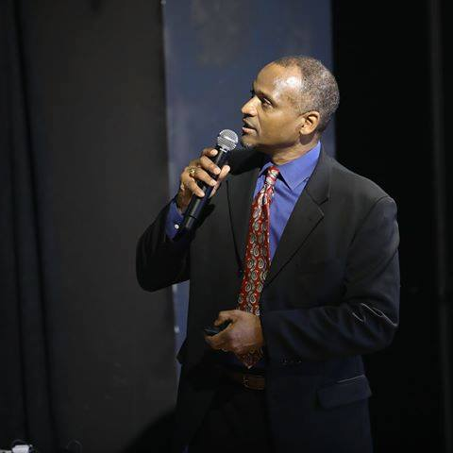
Next Steps
Refer to fulbrightspecialist.worldlearning.org to:
Review eligibility criteria and U.S. application deadlines
View recorded information sessions featuring alumni or join an Ask a Program Officer event
Identify alumni through the Alumni Directory
Start your application
Questions? Email us at fulbrightspecialist@worldlearning.org
William Butler, Capitol Technology University
Fulbright Specialist to Kosovo

