Slide 1

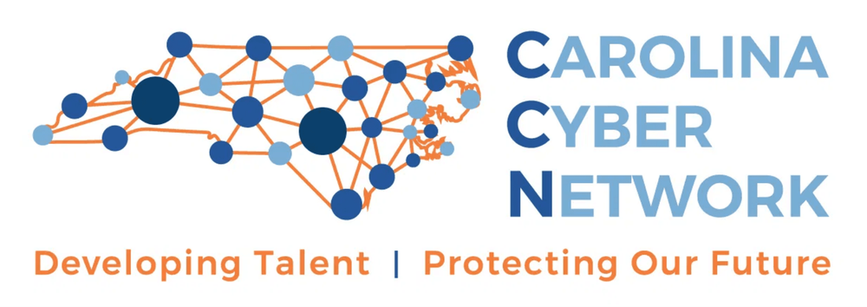
CyberSafe: A Student-Led Model for Community Cyber Resilience
Bridging the Gap Between Cybersecurity Education and SMB Needs
Gabe Lindsey
Rodney Cobb
Chad Pinyan
Jovan Slijepcevic
NICE CONFERENCE | PHILADELPHIA, PA

Slide 2

FRAMING THE CHALLENGE: THREE LANES
STUDENTS NEED
SMALL BUSINESSES NEED
SCHOOLS NEED
Affordable cybersecurity guidance
Scalable experiential learning
Real-world experience & confidence
Community relevance & employer connections
Trustworthy help & actionable steps
Soft skills & mentorship
Exposure to employers & community partners
Awareness without fear or shame
A model faculty can actually support
The CyberSafe model aligns these three lanes into a single mission.
Notes:
a story on a student who overcame so much to give that presentation…now they are working in cyber
a small business that learned how to implement MFA or did an assessment and realized they were really exposed
story about wake tech and how the news showed up on campus

Slide 3
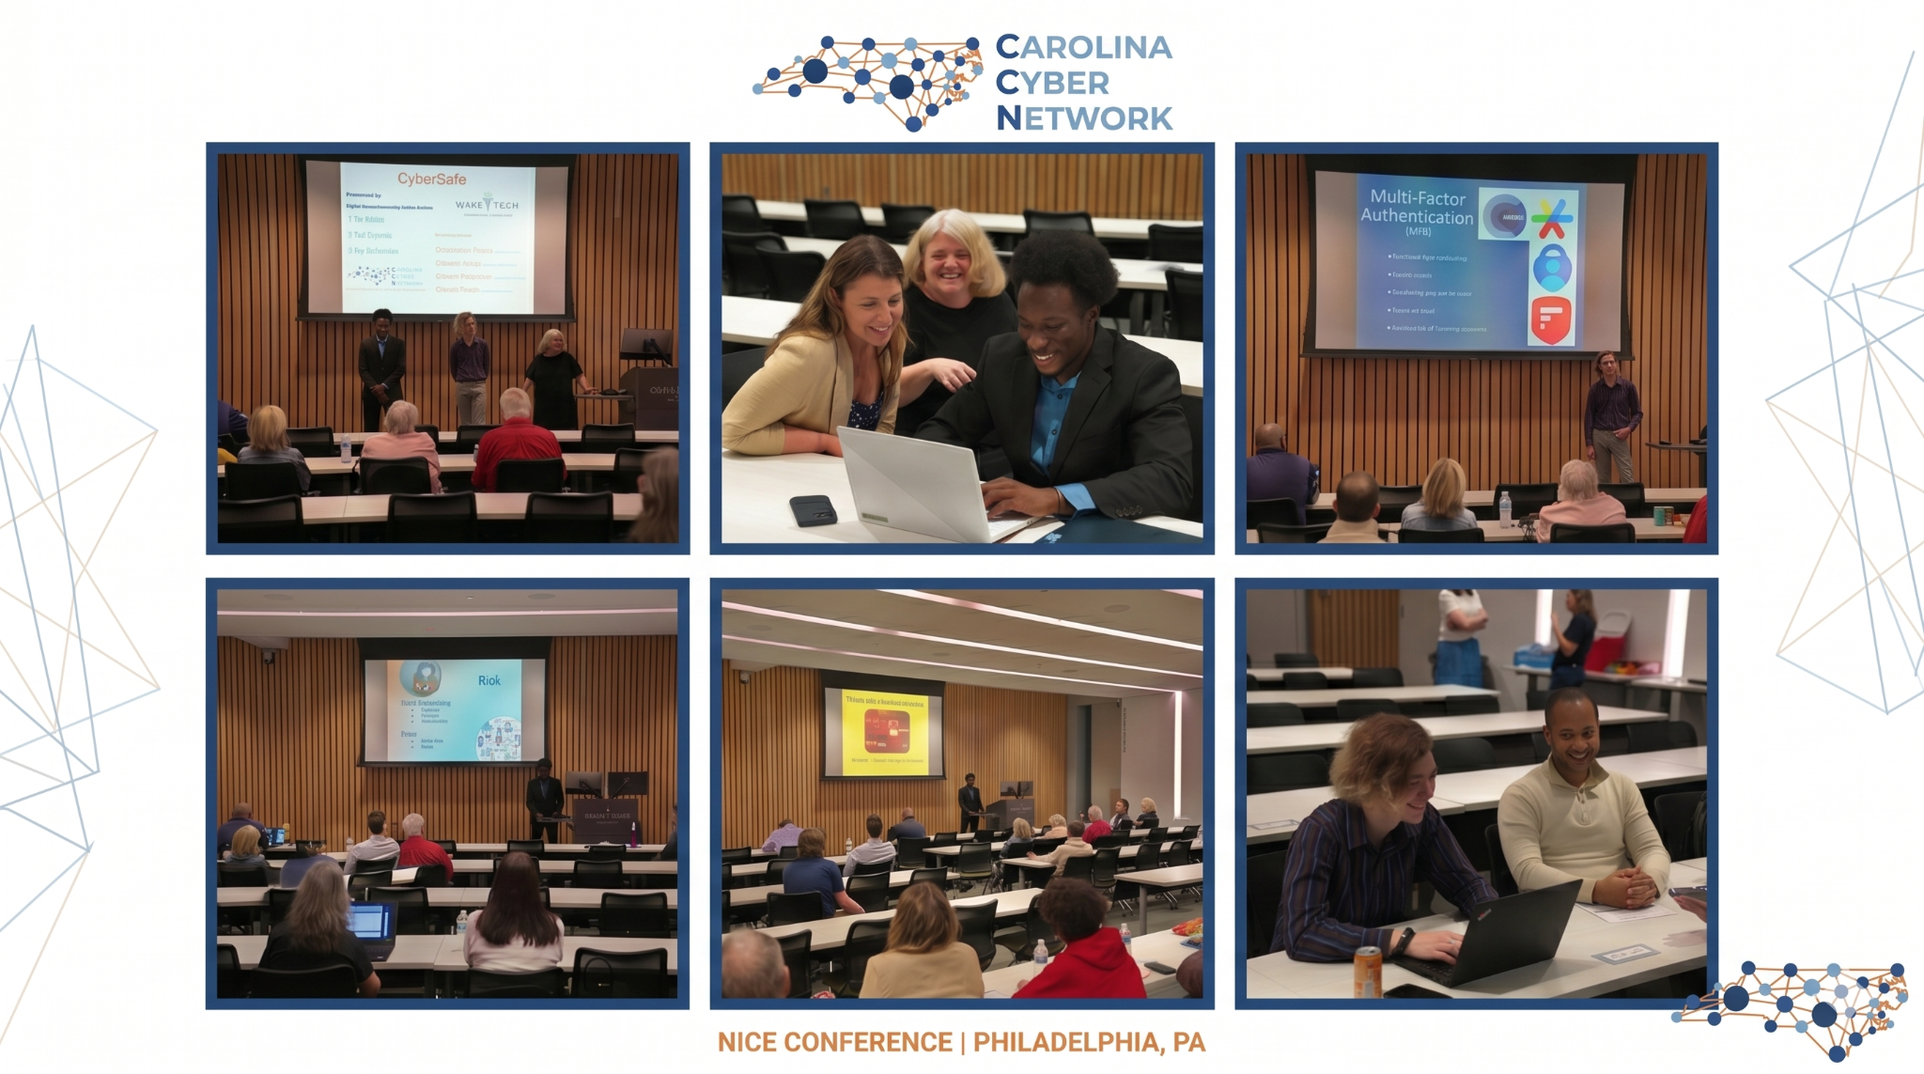
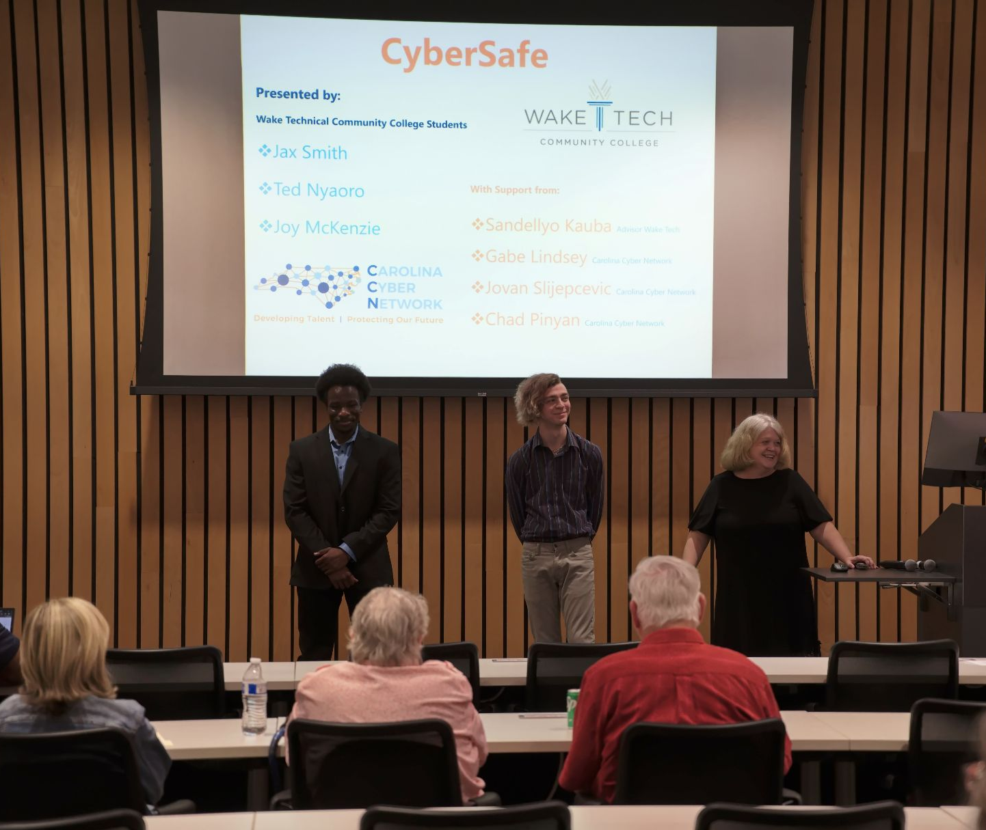
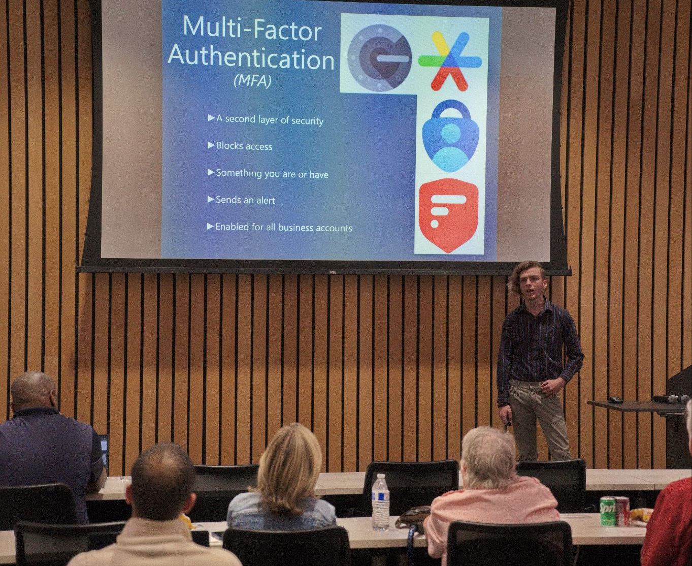
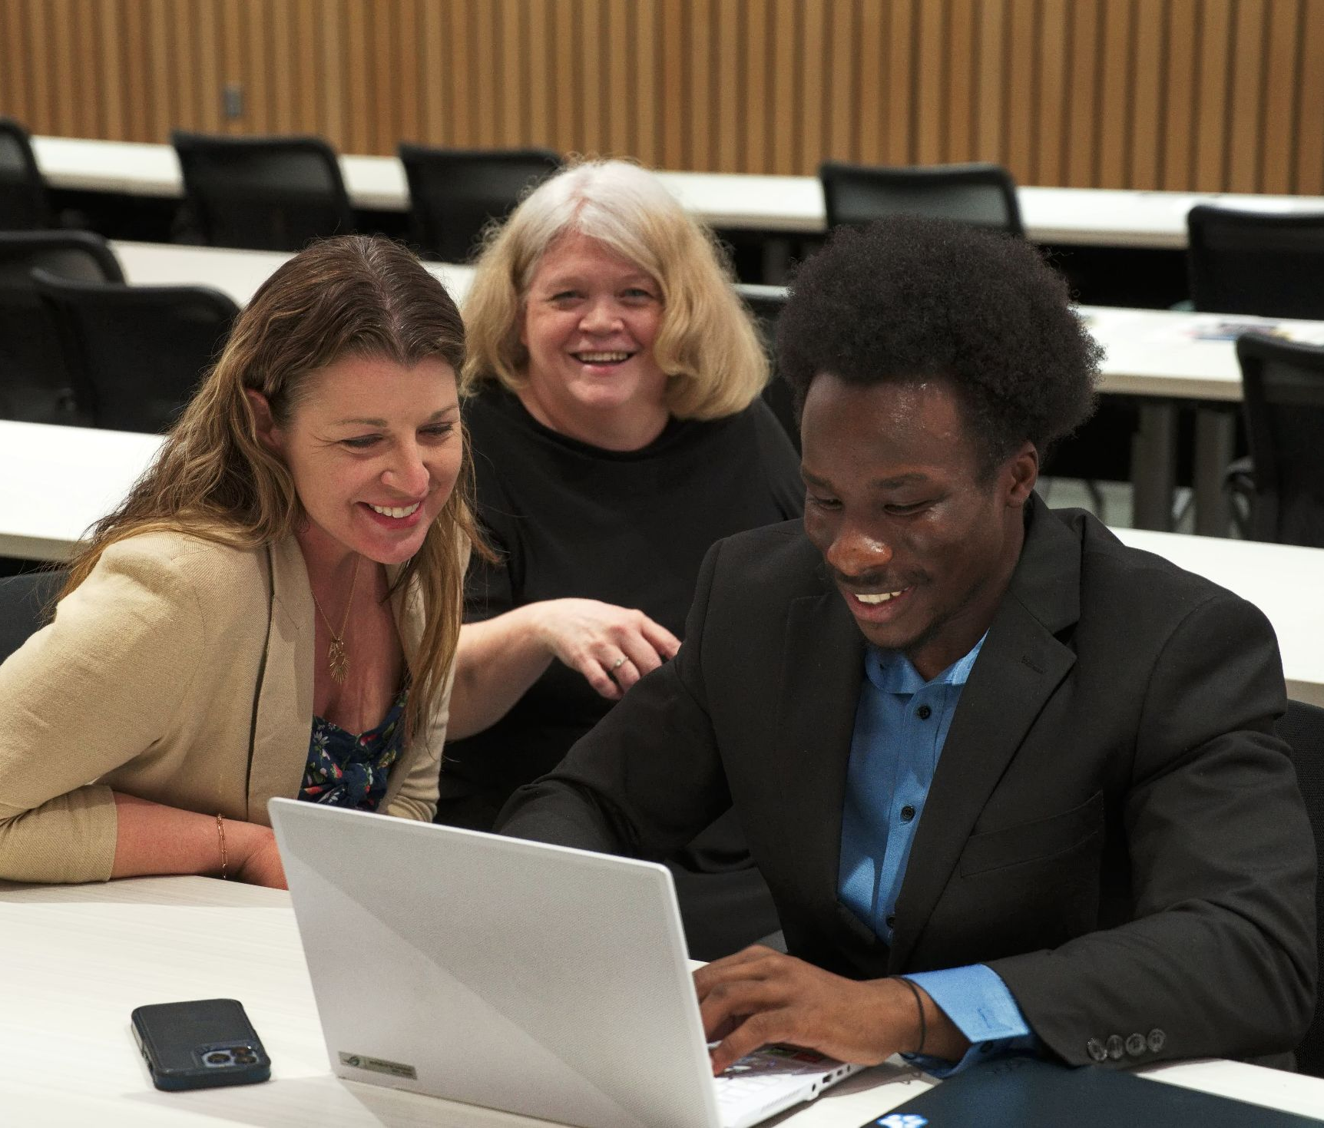
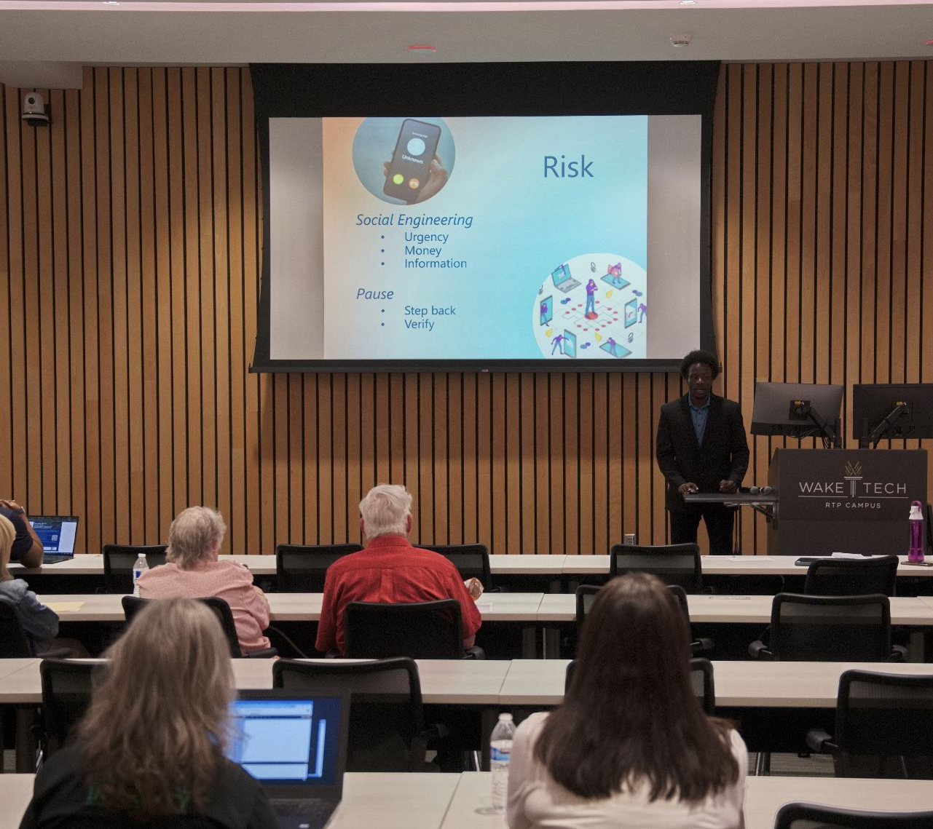
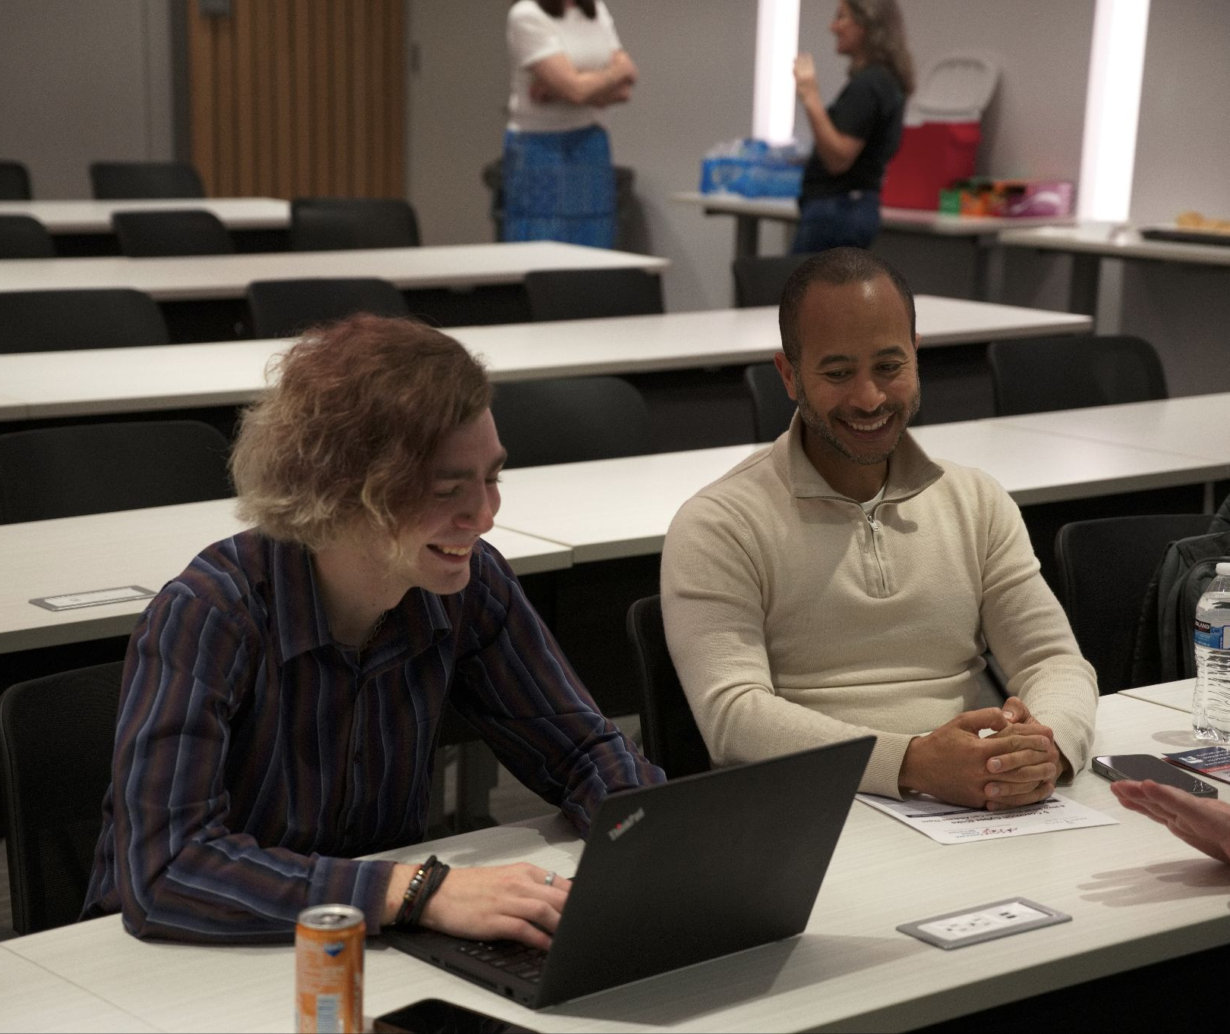
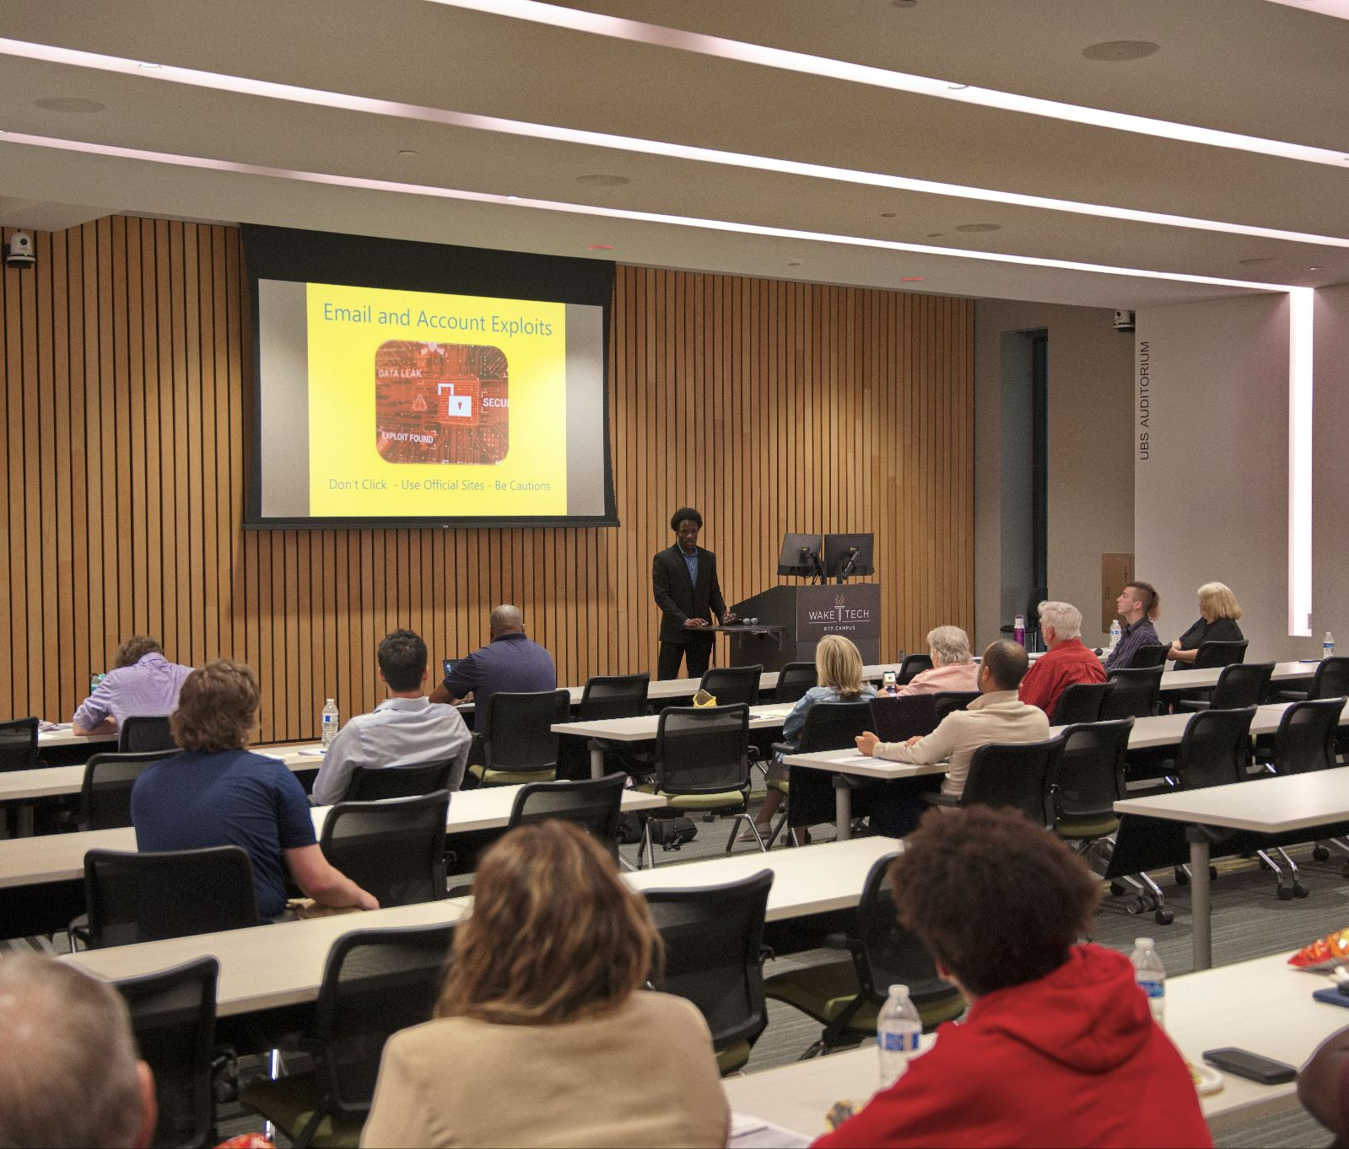

Slide 4

THE CYBERSAFE MODEL
01
02
03
04
05
Lead
Sourcing
Community Outreach
Knowledge
Transfer
In-Person Presentation
Rapid Fire Assessment
Students use Python & OSINT techniques to identify and research local SMBs in need of support.
Proactive engagement to establish trust and explain the value proposition of student-led cyber readiness.
Translating complex cybersecurity jargon into actionable fundamentals for non-technical business owners.
Students lead a professional session, demonstrating their public speaking and community engagement skills.
A high-impact evaluation using the NIST CSF 2.0 framework to provide immediate security insights.

Slide 5

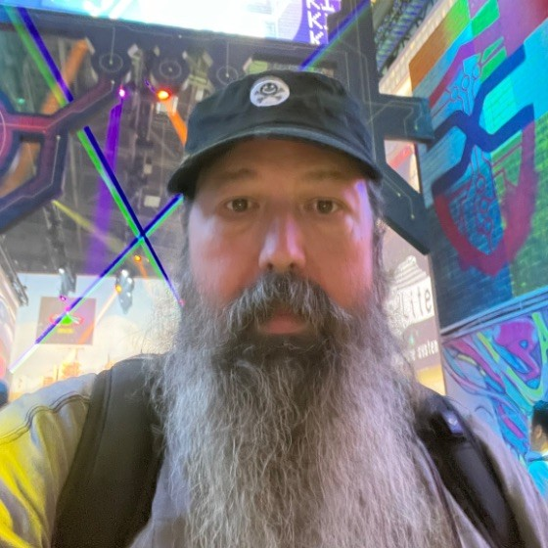
THE FACULTY PERSPECTIVE
Curriculum Integration: Mapping experiential learning to the NICE Framework without increasing faculty overhead.
Rodney Cobb
Professor of Cybersecurity
Cleveland Community College
Student Transformation: Moving from "too scared to answer on Zoom" to leading professional in-person presentations.
Institutional Impact: Strengthening the college's role as a community anchor and a premier pipeline for work-ready talent.

Slide 6
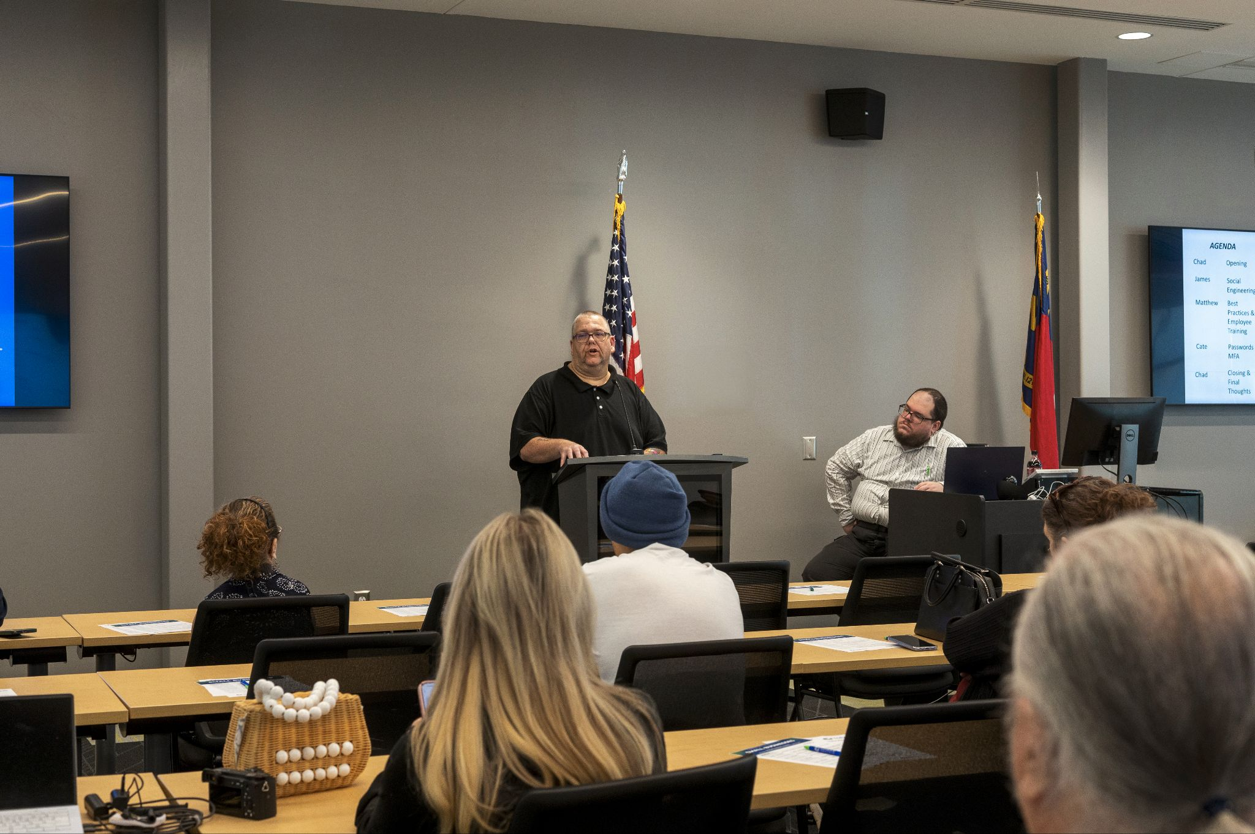
THE STUDENT JOURNEY: CHAD PINYAN
COMMUNITY IMPACT
Real Difference: Gaining the satisfaction of making a tangible impact on the security of local businesses in my community.
Service Learning: Understanding that cybersecurity is about protecting people and their livelihoods.
PEER MENTORSHIP
Complementary Strengths: Learning to identify and leverage the strengths and weaknesses of teammates.
"From technical labs to landing a full-time role with Carolina Cyber Center through real-world relationships."

Slide 7
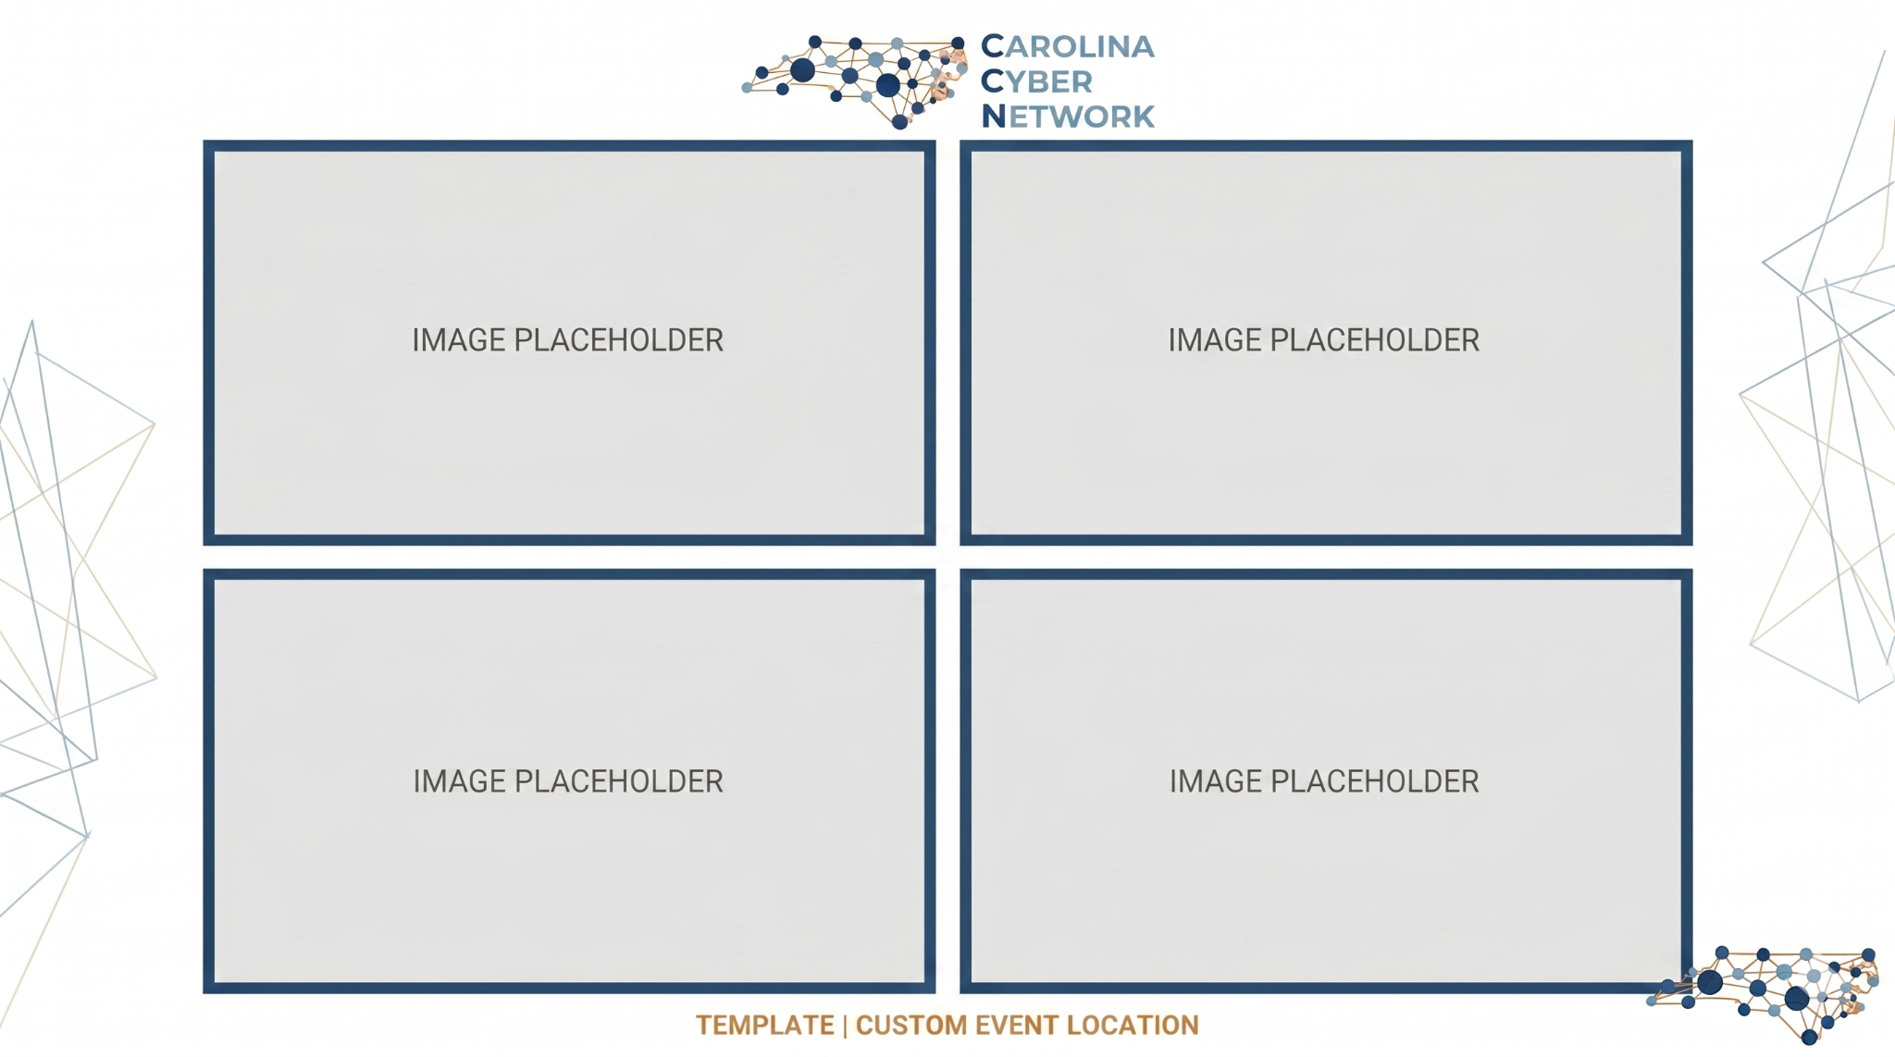
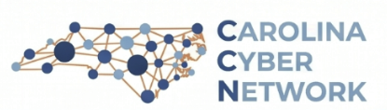
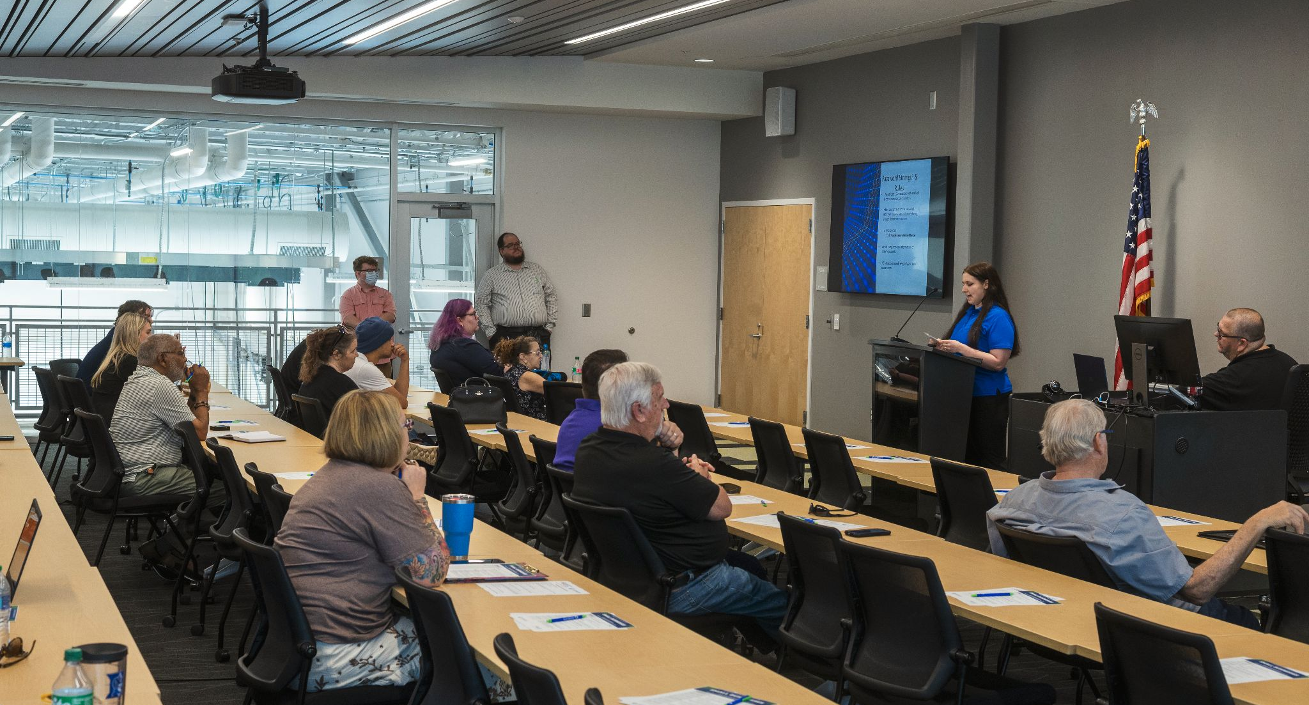
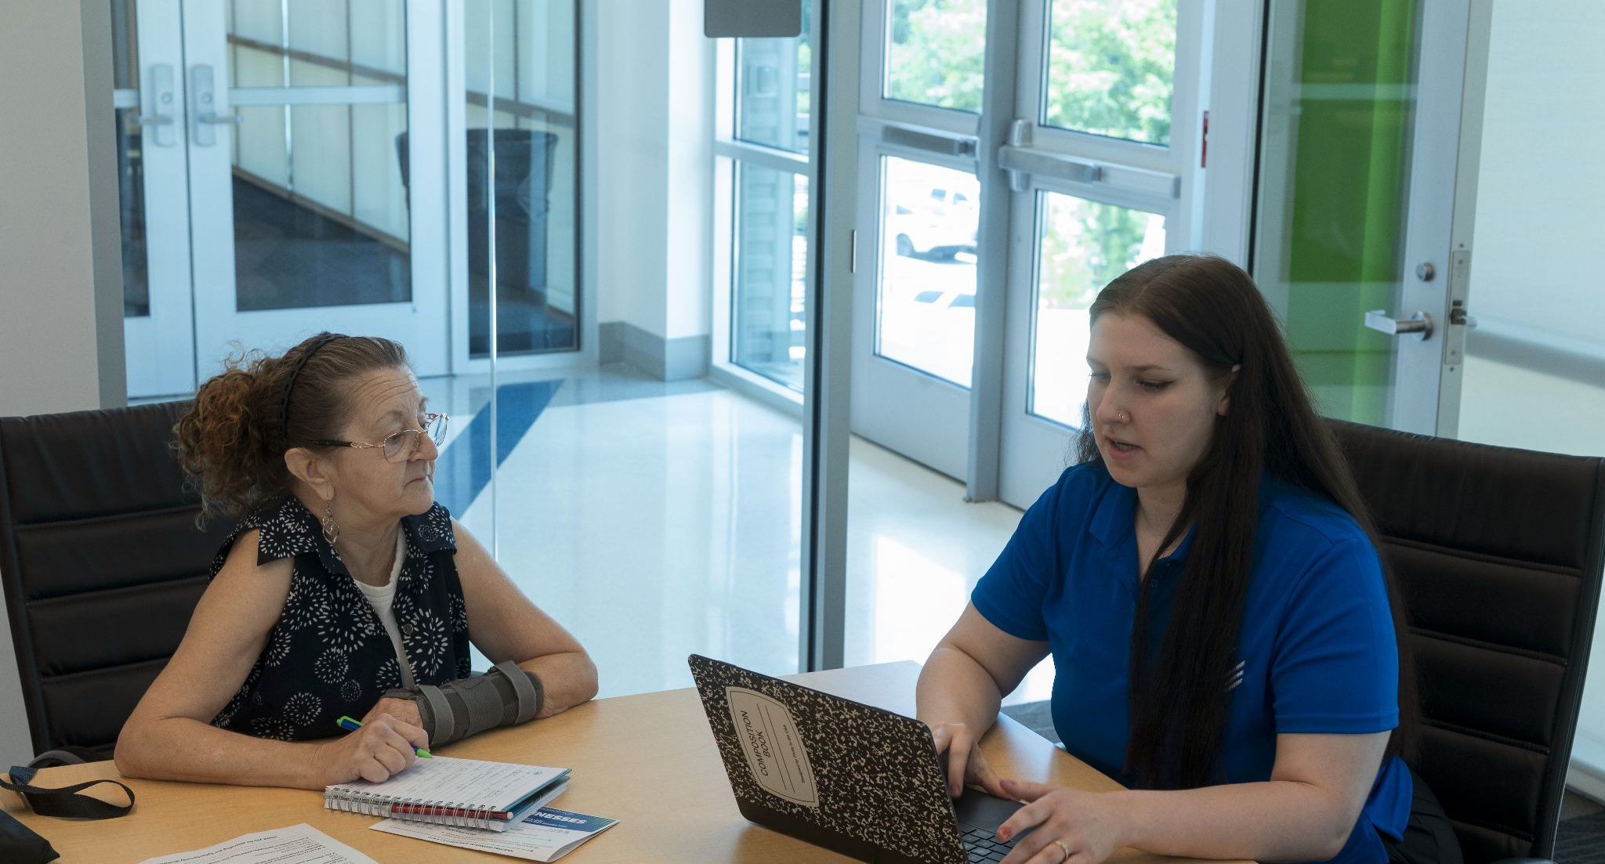
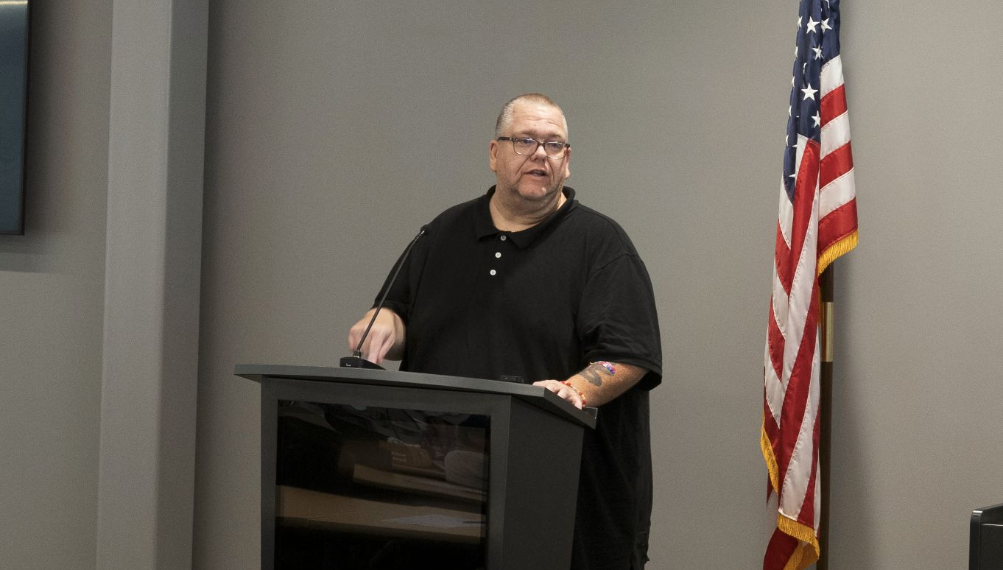
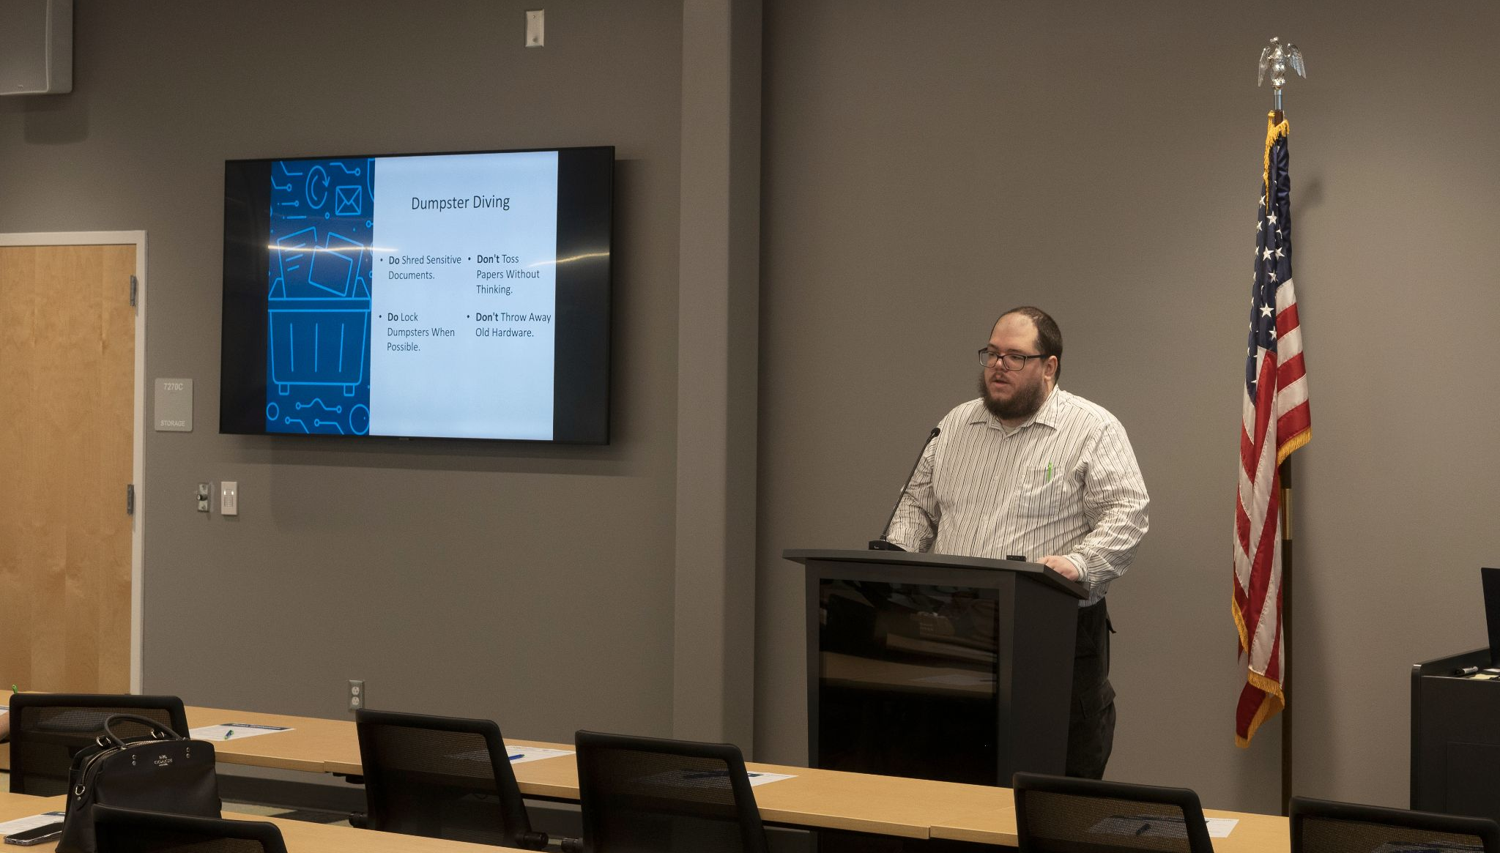

Slide 8
LESSONS LEARNED: INSIGHTS FROM THE FIELD
Outreach is Local
The "In-Person" Factor
Digital marketing isn't enough. In-person outreach and partnerships with local community hubs are critical for building trust.
Student teams perform significantly better when they have opportunities to meet in person outside of formal project meetings.
Simplicity Wins
Peer Learning
SMBs need actionable, resource-light steps they can implement immediately without being overwhelmed by jargon.
Effective growth happens when complementary strengths are paired together—technical depth meets outgoing communication.
The most important lesson: It takes time to grow.

Slide 9
IMPLEMENTATION FRAMEWORK
1
Identify: Select students, community partners, and a faculty leader.
2
Logistics: Set a clear time and location for the final presentation.
3
Execution: Actively assist students throughout the project lifecycle.
4
Iteration: Learn and adjust the model for what works best for your school.
Highly Recommended: Use the first group of students to train the next group.

Slide 10
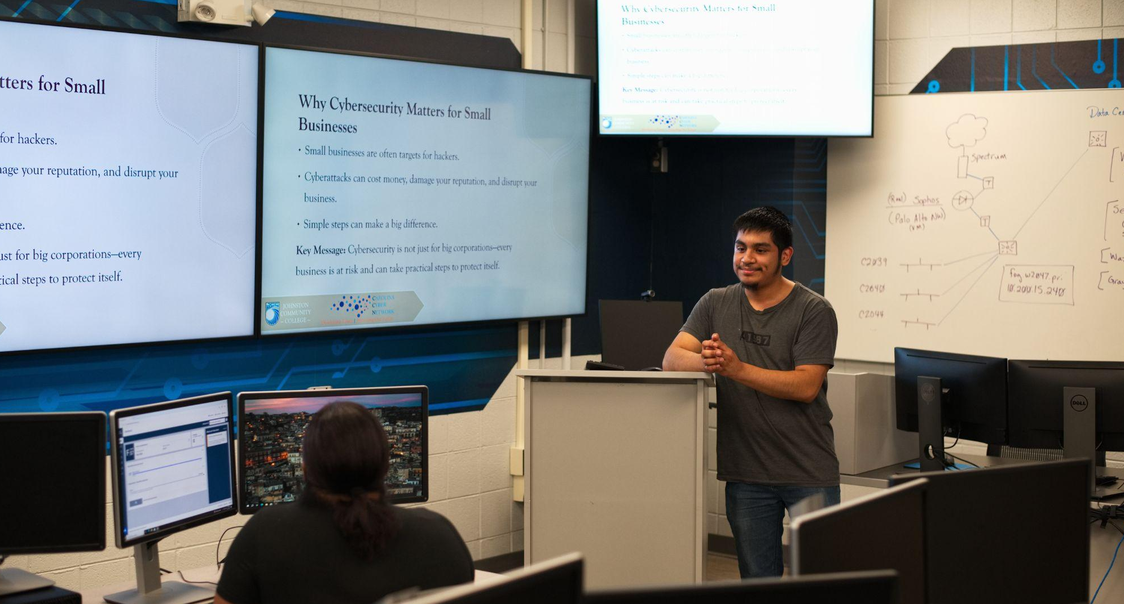
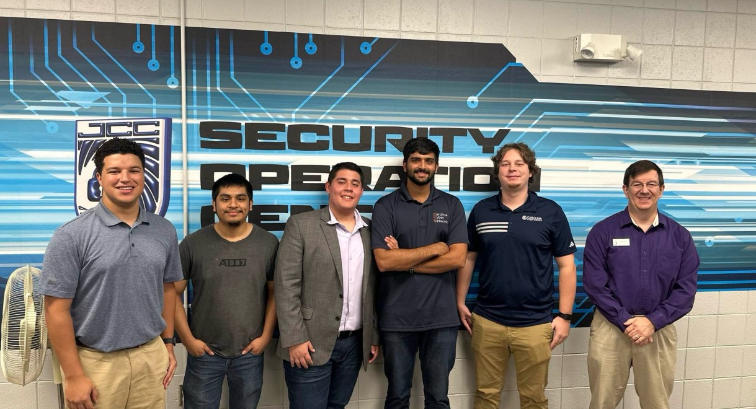
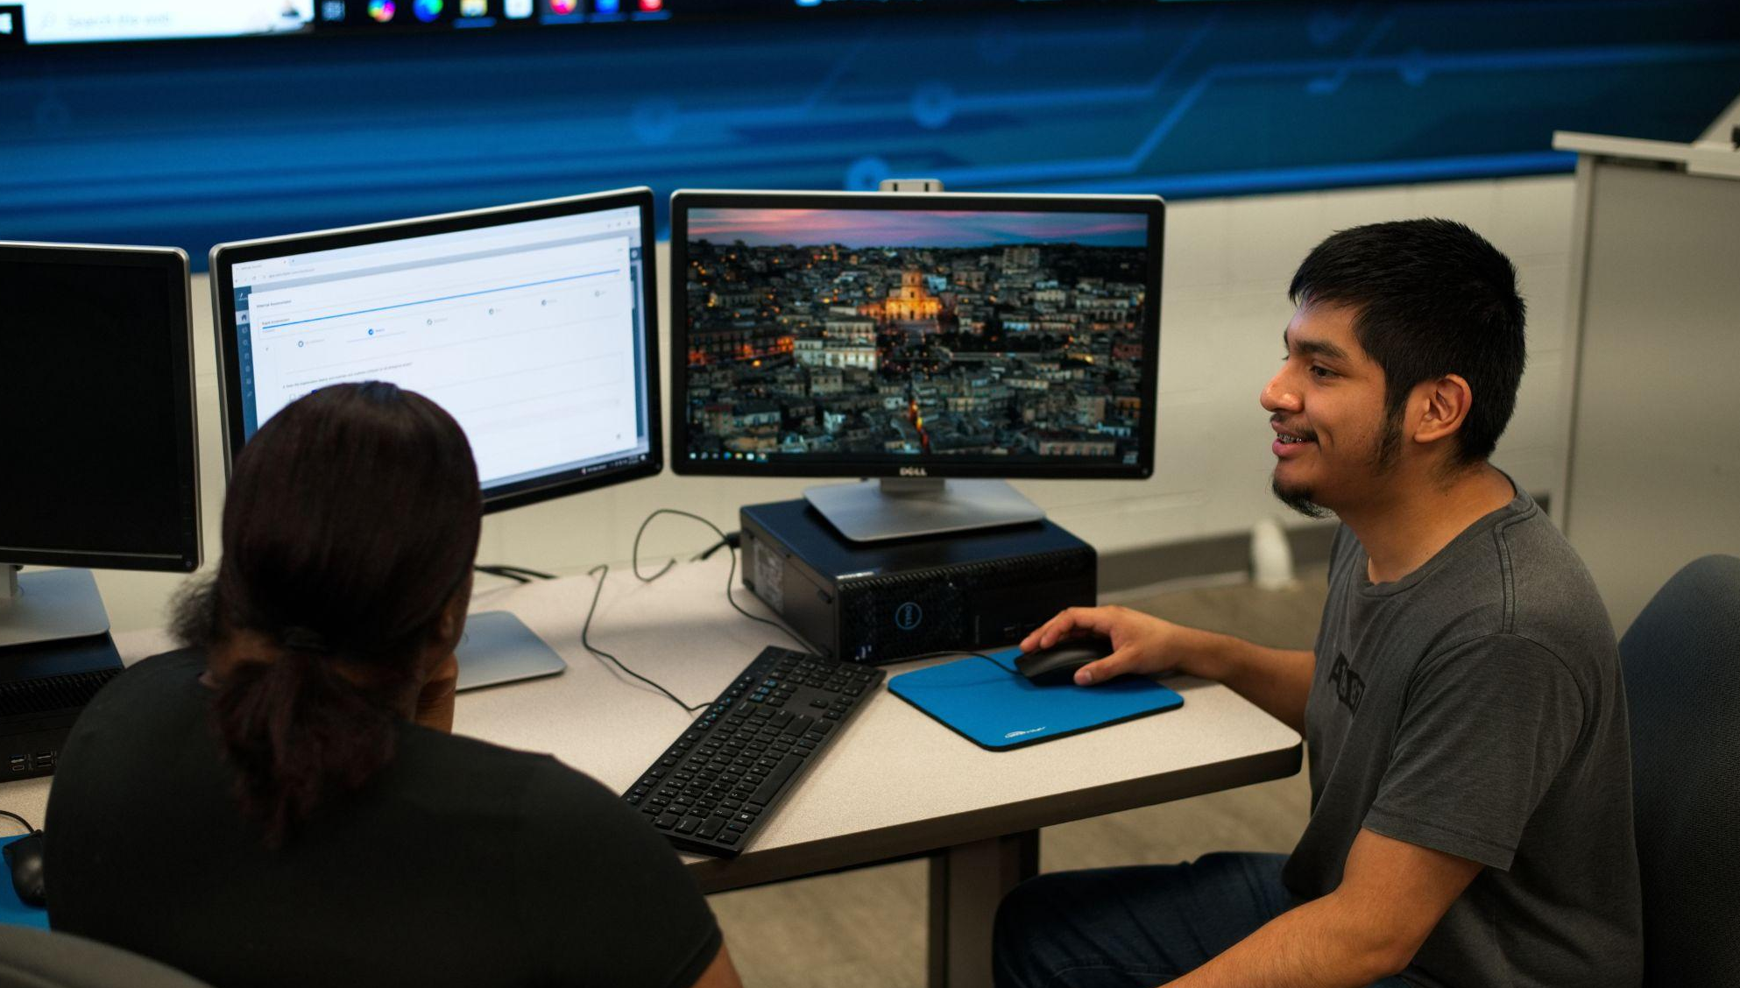
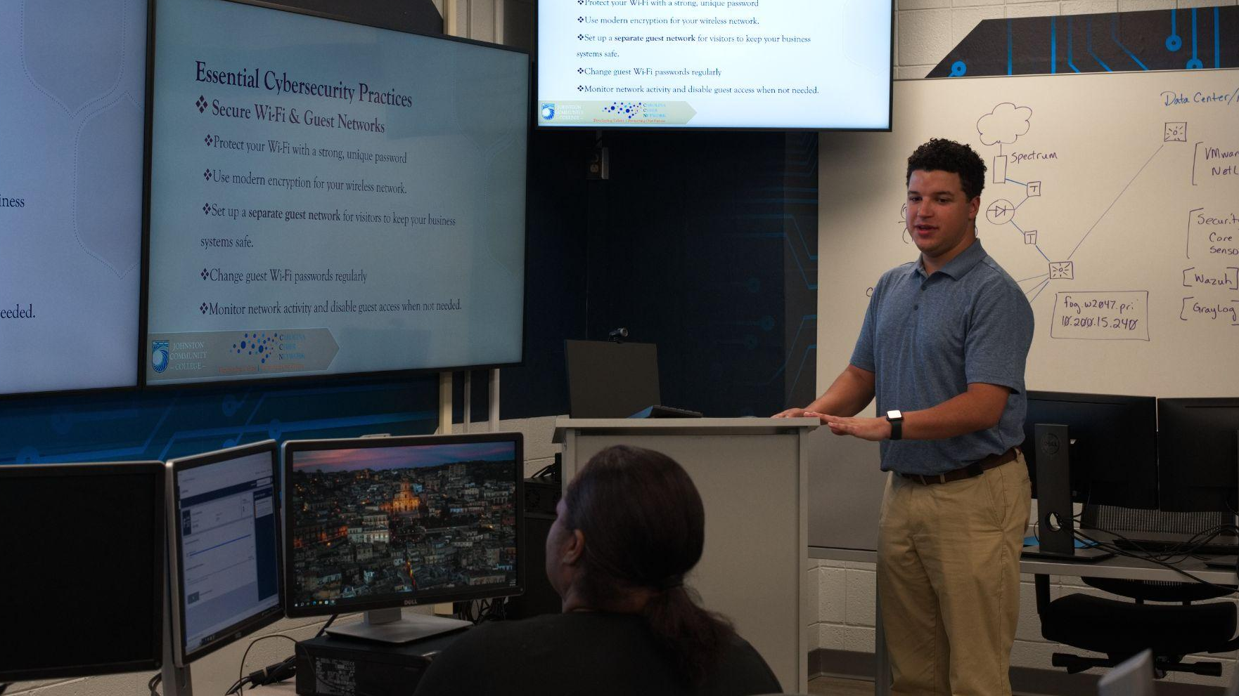

Slide 11

BREAKOUT DISCUSSION
Shaping the Future of the CyberSafe Model
Scaling the Model
Implementation Hurdles
How can we adapt this student-led framework to different regional economies or school sizes?
What specific problems or barriers could you see keeping your school from implementing this model?
Measuring Impact
Collaboration
Beyond student placement, how do we track long-term cybersecurity improvement in SMBs?
How can government and private industry better support these experiential learning pipelines?
NICE CONFERENCE | ROUNDTABLE SESSION

Slide 12
