Slide 1
Angelo State University RSOC
Creating Cyber Warriors to Defend the Future
Russell Ezzell & Leigh Rasberry

Slide 2
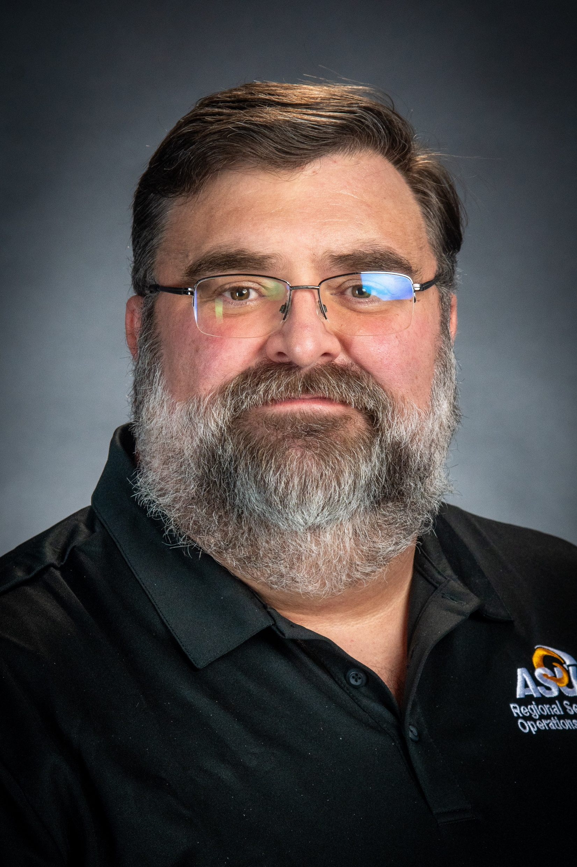
Russell Ezzell, MBA, CISSP
Manager,
Regional Security Operations Center
russell.ezzell@angelo.edu
325-486-6143

Slide 3
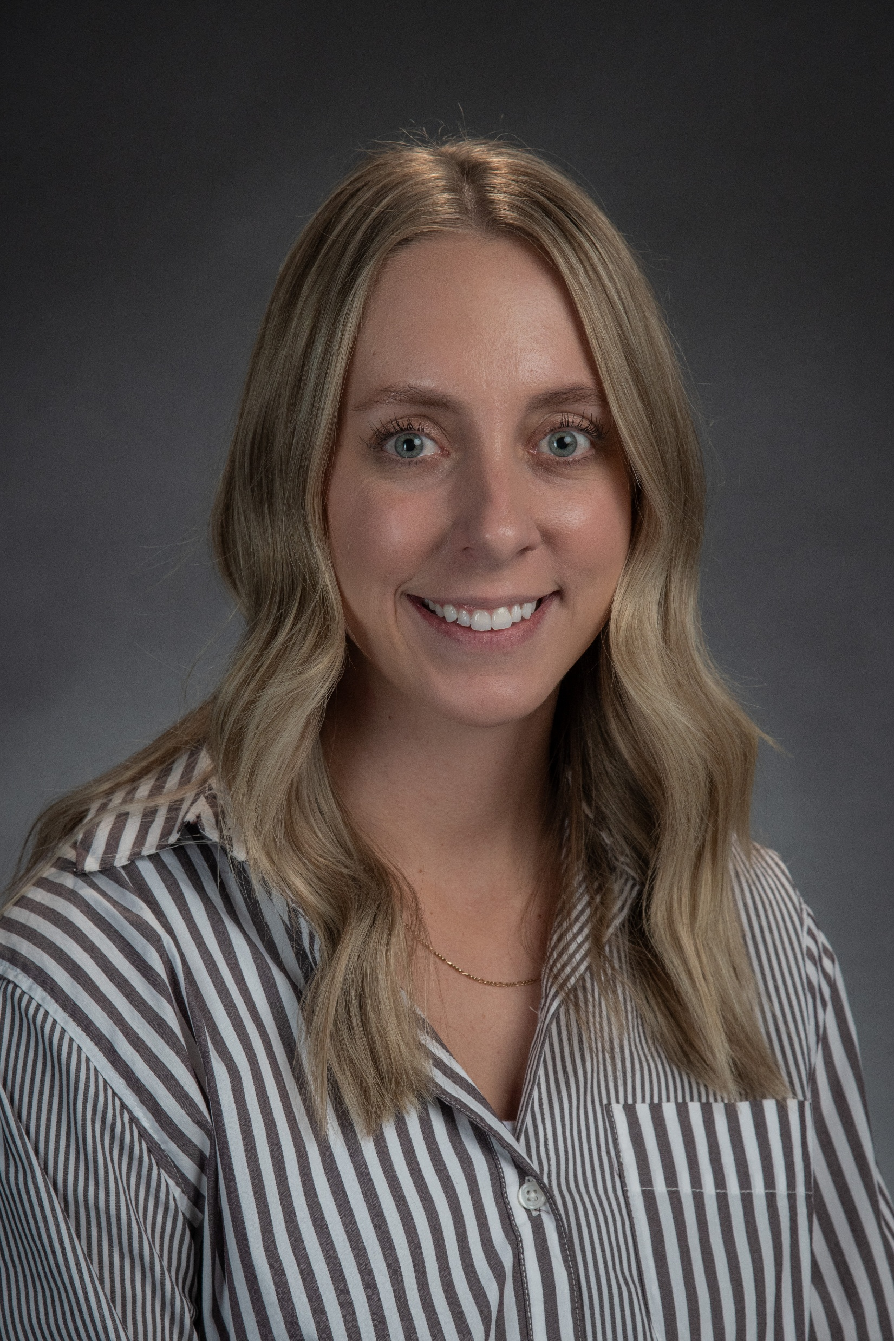
Leigh Rasberry, M.Ed.
Training Coordinator,
Regional Security Operations Center
leigh.rasberry@angelo.edu
325-486-6691

Slide 4
Agenda
Origin of the RSOC
Who we are
What we do
What we’ve learned

Slide 5
Origin of the RSOC

Slide 6
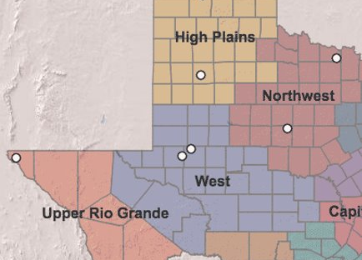
RSOC Origins
Empowering Legislation Texas HB 150
Budget approved for two years in 89th Legislative Session. This funding allows us to provide our services at no cost to municipalities.
12 full-time professional Cybersecurity Analysts, 30 part-time student workers that augment 24/7 security operations.
CJIS background checks on all employees ensure a high level of trust.

Slide 7
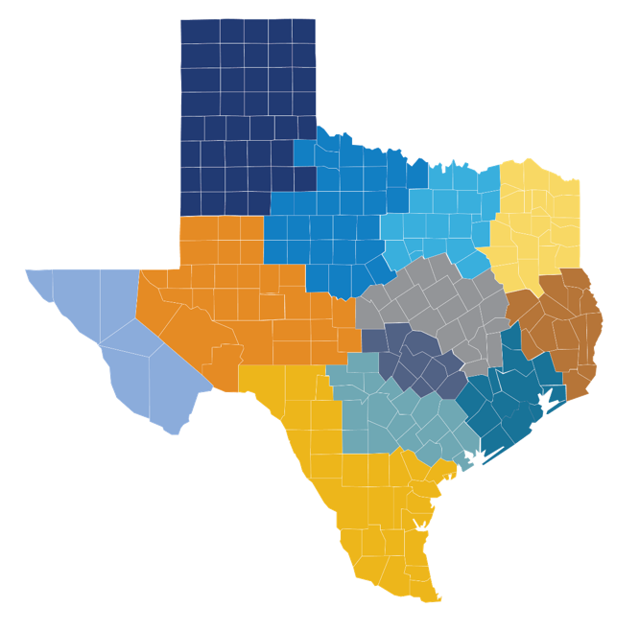




Angelo State University
San Angelo, TX
Economic Region: West Texas
(325)942-2150
rsoc@angelo.edu
University of Texas at Austin
Austin, TX
Economic Region: Capitol
(512)475-9242
security@ut-rsoc.org
University of Texas Rio Grande Valley
Edinburg and Brownsville
Economic Region: South Texas
(956)665-7762
RSOC@utrgv.edu

Slide 8
Who We Are

Slide 9
ASU IT TEAM
RONNIE HAWKINS
President of ASU
RUSSELL EZZELL
RSOC Manager
SCARLET CLOUSE
Dean of Education
Director of KBHI
BECKY
Procurement Specialist and Project Assistant
KOLTEN*
Cybersecurity Engineer Team Lead
LEIGH
Training Coordinator
JAQUIEN
Cybersecurity Analyst Lead
BRENT
Project Manager
KIMI
Project Assistant / Digital Content Creator
GARRETT*
CHRISSY
BRAULIO
EDWARD
CJ
JADEN*
Staff Analyst - Day
JAMES*
BRITTANY*
ASONG
SETH*
CARLOS*
JUSTIN*
Staff Analyst -
Night
NICOLAS
Cybersecurity Engineer II
GIDEON*
Cybersecurity Engineer I
HAILEY*
Cybersecurity Engineer I
*Former RSOC Student Analyst
24/7 Security Operations
STUDENTS IN TRAINING
Blue Lanyard (11)
STUDENT ANALYSTS
Gold Lanyard (14)

Slide 10
What We Do

Slide 11

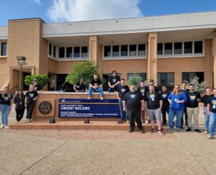
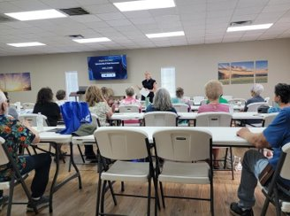
RSOC Mission
Provide cybersecurity protection to local Municipal Governments
Train ASU students in a live SOC environment to elevate the Texas workforce
Community outreach and cybersecurity training

Slide 12
Outcome 1: Protecting West Texas
Steady | 120
ISD | 80
Higher Ed | 5
County | 16
City | 12
Region | 4
Critical Infra | 3
Total Endpoints
50,000+

Slide 13
Technical Measures
2025 Recap (Jan to Dec)
4,571 Analyst Investigations
  Majority of triage performed by RSOC students
  Almost any of these analyst investigations could have led to more serious cyber attacks
9 True Positive Incidents Declared
  3 of 9 occurred 8 to 5, Mon to Fri
  6 of 9 occurred after hours
9 Incidents by Type
  3 compromised credentials running malware
  2 ransomware attacks
  2 targeted phishing campaigns
  1 remote credential dumping
  1 USB delivered worm
2 Experienced Incident Responders on Texas VIRT Team
  1 CISSP (Russell)
  1 SecurityX (Kolten)

Slide 14
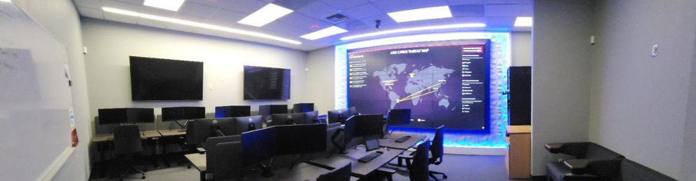
RSOC Ops Room

Slide 15
Outcome 2: Train Students
Stage 0 = onboarding and additional background checks
Stage 1 = self-paced cybersecurity training and shadowing
Stage 2 = tier 1 triage and continued learning
Stage 3 = student leadership
Additional Student Supports
  Certification Program
  Mentorship Program
  Temp Employment Program

Slide 16
Certification Program
Employees have access to study materials and resources (online lectures, courses, and practice exams).
The RSOC funds one attempt at an industry-recognized certification exam per participant per exam.
After obtaining Security+, employees can choose certifications aligned with their role or career goals (with manager approval, if applicable).

Slide 17
Industry Recognized Certifications
Certification | Students | Staff | Combined | DoD 8140 Alignment
Microsoft Asure Fundamentals | 2 |  | 2 | Cloud Security Specialist / Administrator
Microsoft Azure SC-900 |  | 1 | 1 | Cloud Security Specialist / Administrator
Splunk Core Certified User |  | 2 | 2 | Cyber Defense Analyst
A+ | 2 | 3 | 5 | IAT Level I
ISC2 CIC | 2 | 8 | 10 | IAT Level II / IAM Level I
AWS CCP | 1 | 2 | 3 | Cloud Security Specialist / Administrator
Palo Alto Network Academy Network Security Fundamentals |  | 1 | 1 | Network Security Specialist / Administrator
Network+ | 1 | 3 | 4 | IAT Level I
CCNA | 1 |  | 1 | Technical Support Specialist
Security+ | 11 | 19 | 30 | IAT Level II / IAM Level I

Slide 18
Certification | Students | Staff | Combined | DoD 8140 Alignment
CySA+ | 6 | 18 | 24 | IAT Level II / CSSP Analyst / CSSP Incident Responder
PenTest+ | 2 | 5 | 7 | CSSP Analyst / Auditor
CCFR | 2 | 11 | 13 | CSSP Incident Responder
CCFH |  | 4 | 4 | IAT Level II / CSSP Analyst / CSSP Incident Responder
CCFA |  | 1 | 1 | IAT Level II / CSSP Analyst / CSSP Incident Responder
Darktrace Threat Visualizer Essentials |  | 3 | 3 | IAT Level II / CSSP Analyst / CSSP Incident Responder
Darktrace Threat Visualizer Security Practitioner |  | 1 | 1 | IAT Level II / CSSP Analyst / CSSP Incident Responder
Darktrace Cyber Analyst |  | 1 | 1 | IAT Level II / CSSP Analyst / CSSP Incident Responder
CASP+ / SecurityX | 2 | 4 | 6 | IAT Level III / IAM Level II / IASSAE I-II
GCFA |  | 1 | 1 | CSSP Incident Responder
CISSP |  | 3 | 3 | IAT Level III / IAM Level II-III
Total | 32 | 93 | 125

Slide 19
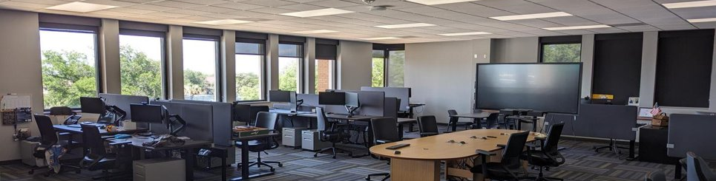
RSOC Training Room

Slide 20
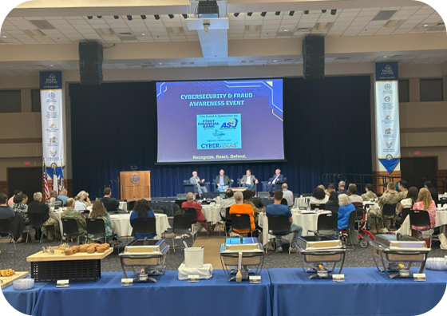
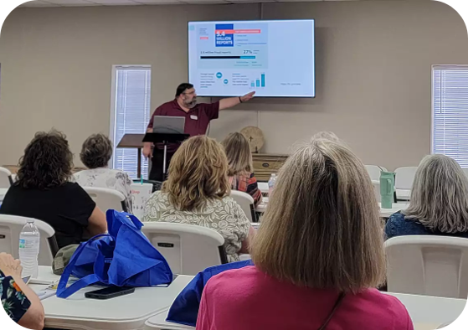
Outcome 3: Community Awareness

Slide 21
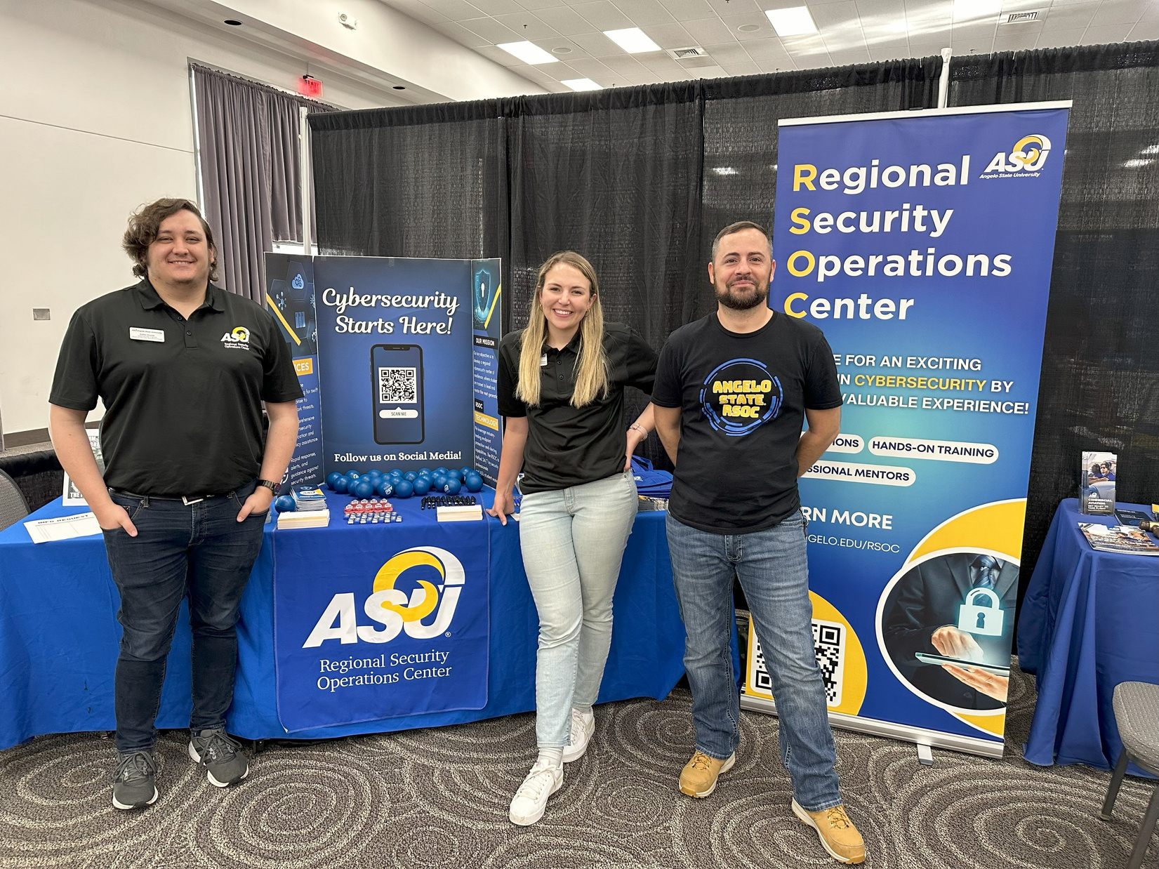
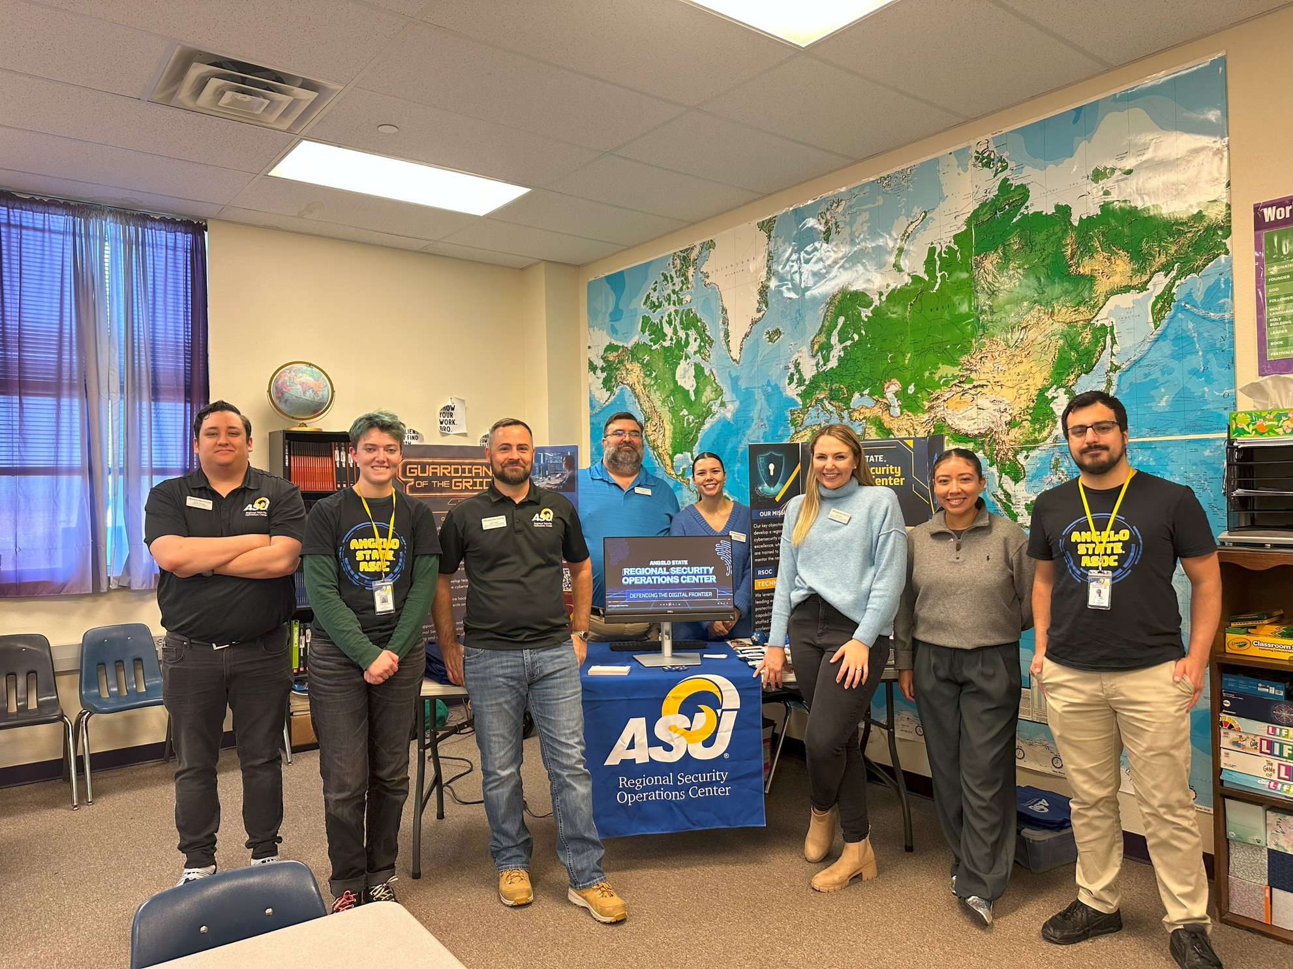

K-12 Outreach

Slide 22







Cyber Patriot
Cyber Patriot is a national youth cyber defense competition for middle and high school students.
Created by Air and Space Force Association.
In partnership with KBHI, RSOC staff and students support area schools by providing Cyber Patriot Mentors.

Slide 23
What We've Learned

Slide 24
LESSONS LEARNED
Structure must evolve with growth.
Students are far more capable than we realize.
Employers want students with power skills.
Communication is as important as technical skill.
Hands-on experience and specialization increase engagement.
Expect some growing pains.
Notes:
Flexibility is valuable early on, but defined roles, workflows, and procedures become increasingly critical as workload increases.
With the right training and trust, students can (and want to) take on advanced tasks and leadership/
Developing playbooks, templates, and SOPs improve efficiency on all fronts (technical operations, onboarding/offboarding, etc.)
Clear internal and external communication is essential for success.
Real-world scenarios and focused tracks not only lead to faster skill development but also higher engagement.
Like any pilot program, iteration is inevitable. Feedback loops allow for continuous improvement.

Slide 25


Questions?
VISIT OUR WEBSITE
RUSSELL.EZZELL@ANGELO.EDU
LEIGH.RASBERRY@ANGELO.EDU

