Slide 1




Cyberseek: The Data Behind
Workforce Evolution
June 2, 2026

Slide 2
The State of the Tech Workforce
National overview
Tech Occupation Employment
Job Family | Job Postings 2025 | Job Roles and Specializations
Support | 324,620 | Tech Support Specialist, Help Desk Technician, A/V Technician
Infrastructure | 608,160 | Systems Administrator, Network Administrator, Cloud Administrator
Software | 828,790 | Software Developer, Web Developer, DevOps Engineer
Data | 453, 740 | Database Administrator, Data Analyst, Data Scientist
Cybersecurity | 153,430 | Cybersecurity Specialist, Cybersecurity Engineer, Cybersecurity Analyst
Technology Enablement | 266,050 | IT Project Manager, IT Manager, CIO
Millions of workers
38%
increase in new monthly job postings in 2026
Source: CompTIA analysis of Lightcast job posting data
CompTIA State of the Tech Workforce 2026

Slide 3
The Shift toward Skill-Based Approaches
Current skills-based investment
Hiring Activity for AI skills and positions
Heavy
90%
Heavy or moderate investment to date
Light/none
Moderate
Understanding of skills needed
Very strong
Moderately strong
Somewhat strong
Source: CompTIA IT Industry Outlook 2026
CompTIA analysis of Lightcast job posting data

Slide 4
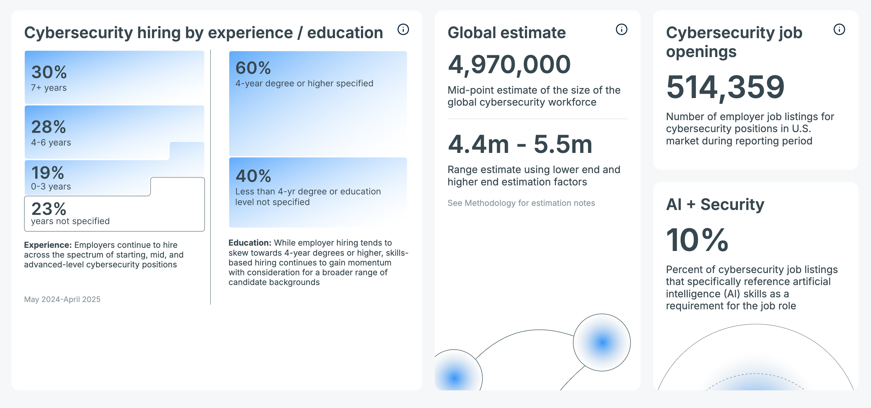
Cyberseek data addresses key workforce questions
How are companies building talent pipelines?
How severe is the cybersecurity skills shortage?
How is AI impacting the cybersecurity market?
Source: Cyberseek | May 2024-April 2025 reporting period

Slide 5
Plans for the Future
1
Greater alignment with CompTIA taxonomy and NICE Framework
2
Emphasis on skill clusters and levels of responsibility
3
Deeper integration with education and training providers

